Slide 1

CYOS Container Yard Operations
An end-to-end workflow for container movement, document control and exception handling
Flow Ops Global
Gate → Documents → Validation → Yard → Inspection
Notes:
Frame this as one continuous operating flow, followed end to end by a single container.

Slide 2
OVERVIEW
Workflow Overview
A single flow across gate, documents, yard movement and inspection
1
2
3
4
5
Plan
Authorize
Gate in
Move
Resolve
Dashboard and maps identify containers, spaces and next actions.
Documents are collected, validated and the visit is released.
The driver is called forward and given an initial yard position.
Shuttle and crane jobs transfer the container to its target zone.
Holds are placed, inspections routed and containers cleared.
VISUAL PRINCIPLE
OPERATIONAL PRINCIPLE
EXCEPTION PRINCIPLE
Each view appears only when it advances the story: queue, map, action, confirmation.
Statuses change visibly as work moves from waiting to approved, called in and complete.
Inspection holds are managed without losing map context or container traceability.
CYOS Container Yard Operations
Notes:
Five stages. Everything that follows is one of these five, in order.

Slide 3
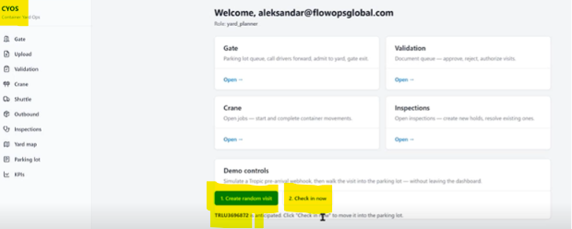
PLAN
Operating Command Center
A role-based dashboard that starts the workflow
Landing screen centralizes access to every yard tool
Gate, Upload, Validation, Crane, Inspections and Parking lot in one place
Operators enter the workflow from the job they need to perform
Guided demo opens with a crane-random visit and check-in
Left navigation anchors the full process through Yard map and KPIs
Navigation friction is reduced for every operating role
CYOS Container Yard Operations
Notes:
The landing screen is where every role enters the workflow.

Slide 4
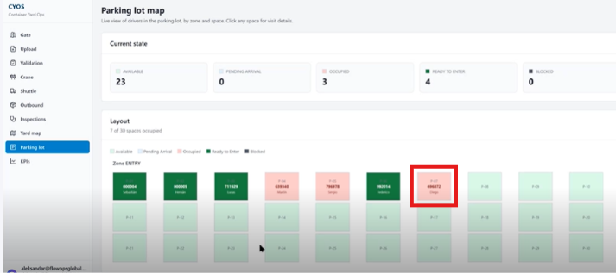
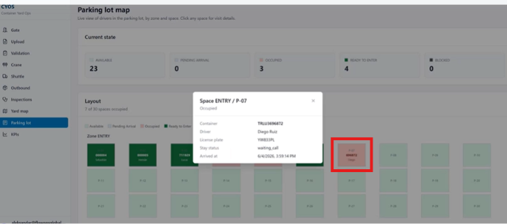
PLAN
Pre-Gate Visibility
Parking lot map shows live visit status by zone and space
Available, occupied and ready-to-enter spaces visible before gate processing
Status cards quantify capacity and queue state at a glance
Clicking a space exposes container, driver and arrival data
Space detail panel supplies context for the next operational decision
Zone-level view keeps the yard readable as volume changes
CYOS Container Yard Operations
Notes:
Before anything moves, the operator can already see capacity and queue state.

Slide 5
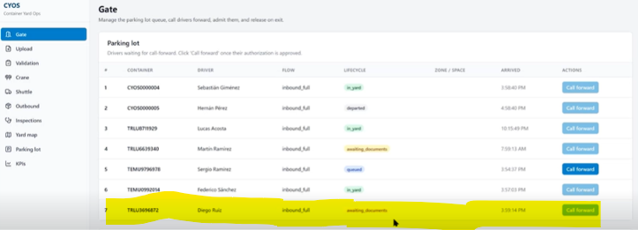
AUTHORIZE
Gate Intake
The gate queue identifies the visit waiting for documents
Container TRLU3696872 appears with status awaiting documents
Rows combine container, driver, flow, lifecycle, zone and space
Arrival time and available actions sit on the same row
Awaiting-documents status routes the visit to Upload before authorization
The same container identifier remains traceable through every later screen
CYOS Container Yard Operations
Notes:
Container TRLU3696872 enters the story here and stays highlighted throughout.

Slide 6
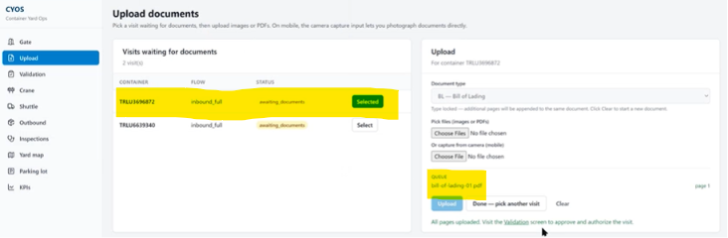
AUTHORIZE
Document Intake
Document upload captures the bill of lading for the selected visit
The waiting visit is selected from the left-side queue
Document type is chosen before the file is attached
Bill of Lading PDF is uploaded as page 1 of the visit record
Upload sends the document straight into validation
Validation can then approve or reject without re-keying the visit
CYOS Container Yard Operations
Notes:
Upload is a two-field step: pick the visit, attach the bill of lading.

Slide 7
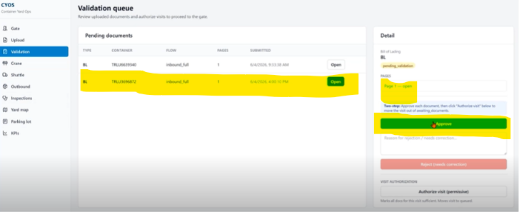
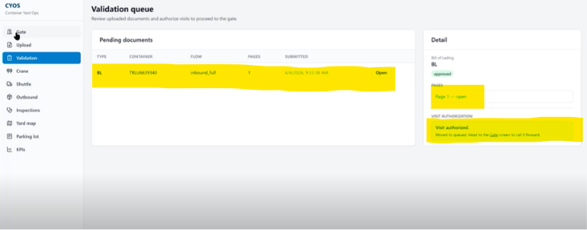
AUTHORIZE
Document Validation
Validation converts uploaded paperwork into gate authorization
Validator reviews the uploaded document for the selected visit
Pending documents are queued and selected for approval
Approval creates a visible authorization for the gate team
Lifecycle advances from pending validation to approved
The approved state is what enables the gate to call the driver forward
CYOS Container Yard Operations
Notes:
This is where paperwork becomes gate authorization.

Slide 8
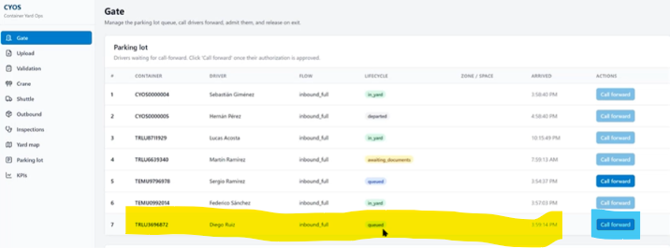
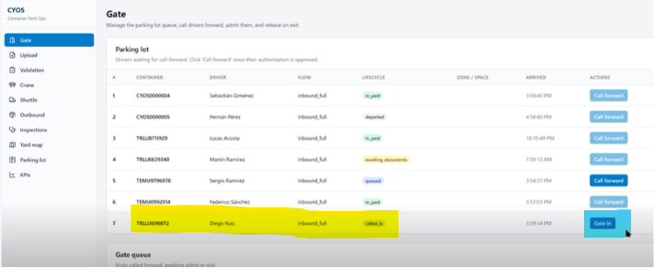
GATE IN
Gate Release
The gate calls the approved driver forward
The validated visit returns to the gate queue automatically
Gate action changes from waiting to call-forward execution
Lifecycle updates to called_in with a Gate in action available
Drivers are only called forward once documentation is approved
Gate staff work from status, not from paperwork chasing
CYOS Container Yard Operations
Notes:
The gate action only changes once validation has cleared.

Slide 9
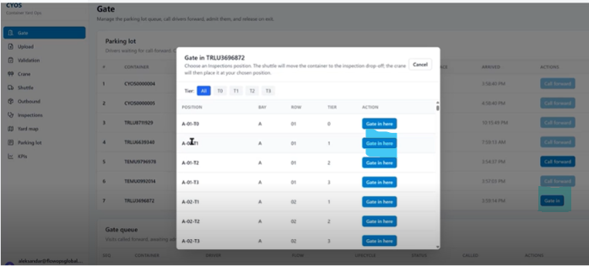
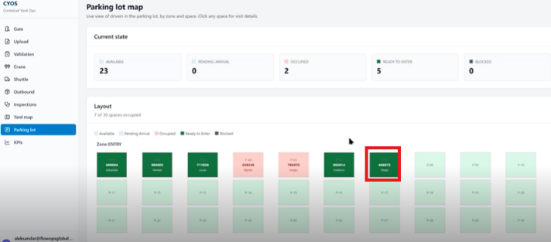
GATE IN
Gate-In Placement
Gate-in assigns the container to an operational drop-off slot
The gate-in modal lists eligible inspection and drop-off positions
Operators choose the initial position at the moment of entry
The parking lot map confirms the assigned space after selection
The action is grounded in map capacity, not a disconnected form
Position context carries into the shuttle job that follows
CYOS Container Yard Operations
Notes:
Placement decisions are made against live map capacity.

Slide 10
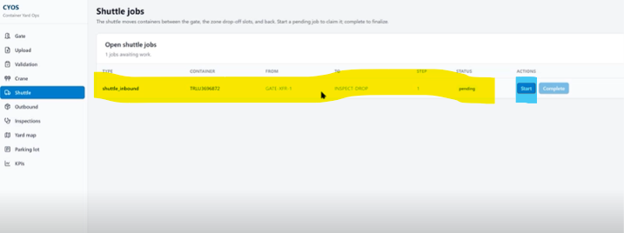
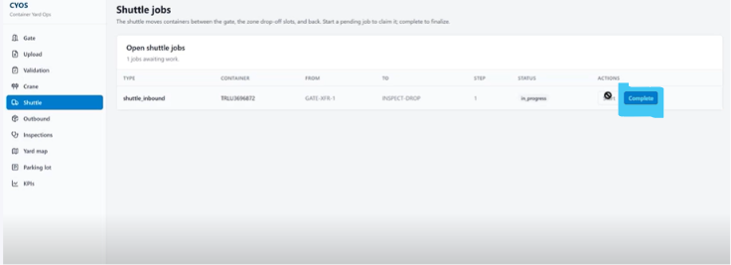
MOVE
Internal Transfer
Shuttle jobs move the container from gate to inspection drop
CYOS creates a shuttle job automatically after gate-in
The job moves the container from gate transfer to inspection drop
Operators start and complete the job to finalize the transfer
Job list carries type, container, origin, destination, step and status
Every yard move stays auditable from claim through completion
CYOS Container Yard Operations
Notes:
Shuttle jobs are the auditable unit of yard movement.

Slide 11
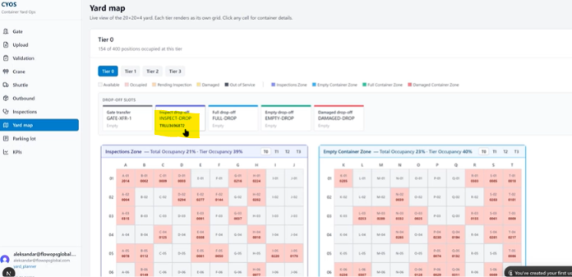
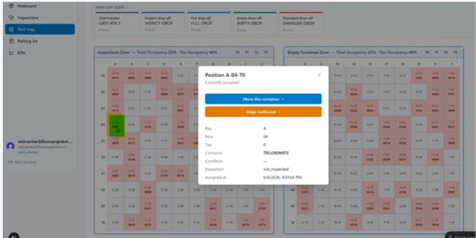
MOVE
Yard Map
Zone-level context for drop-off and inspection areas
Operating zones rendered across the tiered yard grid
Drop-off slots and occupancy patterns visible at a glance
Each tier renders as its own grid with per-cell detail
Position panel exposes container condition and move options
Inspection, empty, full and damaged zones are distinguished throughout
CYOS Container Yard Operations
Notes:
The yard map is the shared reference every other screen points back to.

Slide 12
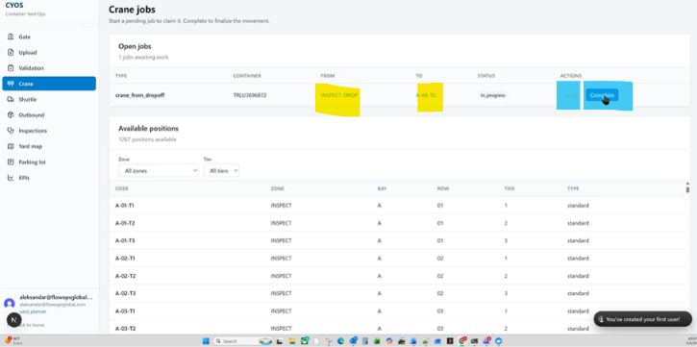
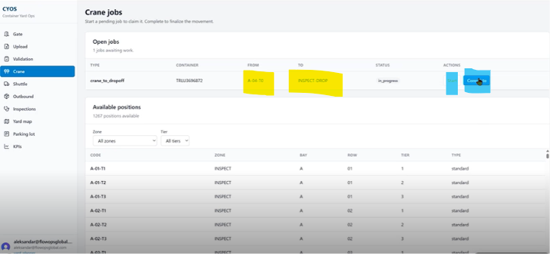
MOVE
Crane Execution
Crane jobs complete the move into the inspection area
The system creates a crane movement from the inspection drop-off
The job runs from INSPECT-DROP to inspection position A-04-T0
Confirmation and completion are recorded against the job
The crane view pairs current work with available positions
Placement options stay visible during execution
CYOS Container Yard Operations
Notes:
Crane jobs place the container in a specific inspection position.

Slide 13
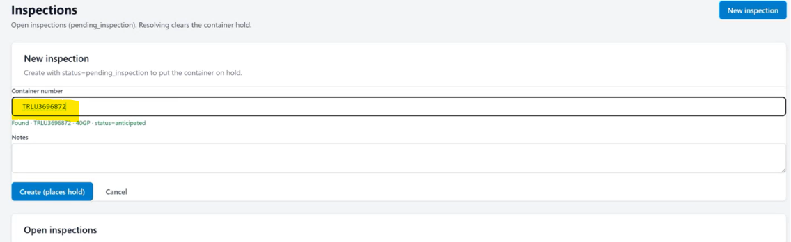
RESOLVE
Exception Handling
Inspection holds place a container under controlled review
A new inspection is opened directly from the container number
Entering the container finds the unit and creates a pending inspection
The container is held until the issue is resolved
Open inspections can pass or fail with a recorded outcome
Resolving the inspection clears the container hold
The container stays linked through gate, yard, crane and inspection
CYOS Container Yard Operations
Notes:
Holds are the exception path; the container never leaves the record.

Slide 14
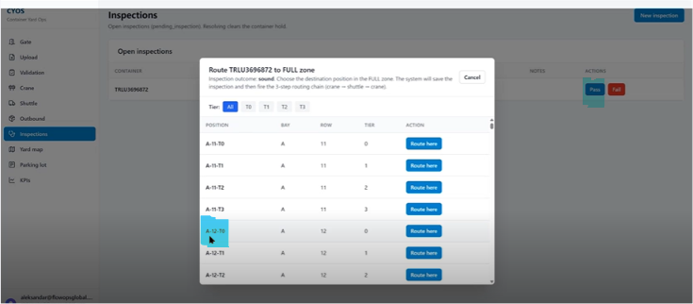
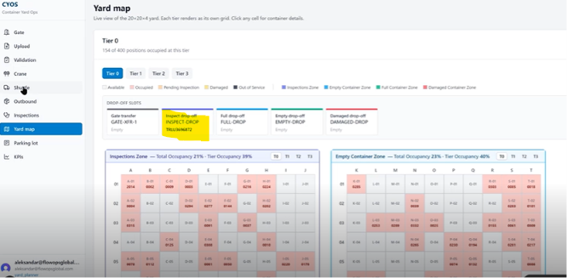
RESOLVE
Inspection Resolution
Cleared containers are routed to the full container zone
The route modal chooses a destination from the inspection outcome
The container is routed from inspection to the full container zone
The yard map confirms inspection-drop and final zone context
Map context is preserved throughout the exception path
Routing decisions remain tied to the original container record
CYOS Container Yard Operations
Notes:
Routing after inspection keeps map context intact.

Slide 15
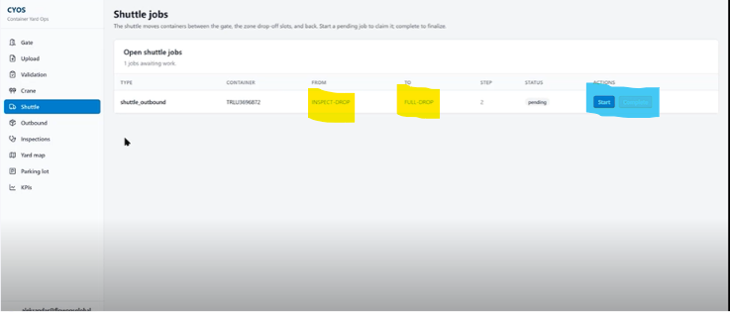
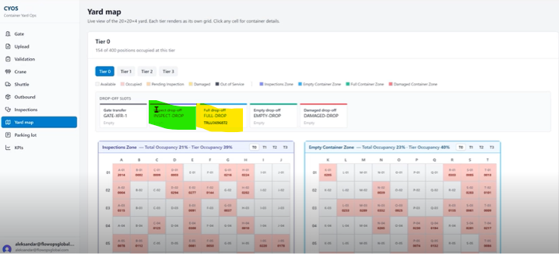
RESOLVE
Final Transfer
Shuttle job moves the cleared container to the full drop-off slot
An outbound shuttle job runs from INSPECT-DROP to FULL-DROP
The pending job is started and completed by the operator
The yard map shows the container arriving at the full drop-off slot
Drop-off slots stay separated by gate, full, empty and damaged
Tier occupancy updates as the move completes
CYOS Container Yard Operations
Notes:
A second shuttle job carries the cleared container to the full drop.

Slide 16
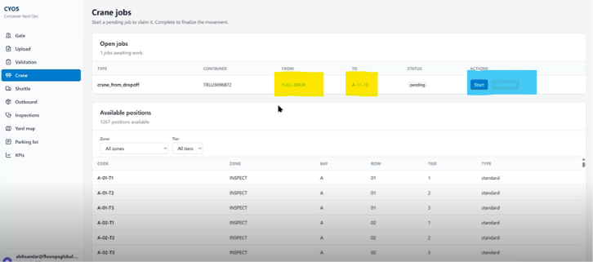
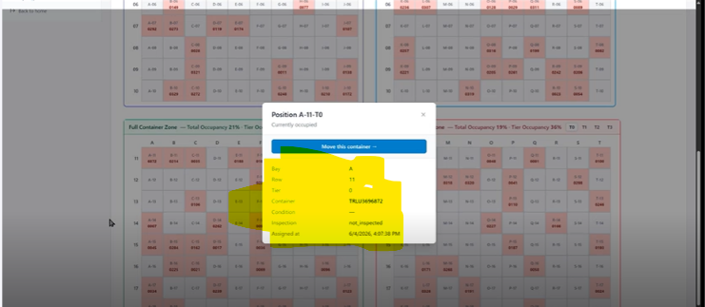
RESOLVE
Final Placement
A crane job sets the container in its final tier position
A crane job is created from FULL-DROP to final position A-11-T0
Available positions are listed by zone, bay, row and tier
Completion places the container in the Full Container Zone
The position panel confirms container, condition and assignment time
The container remains movable from the same panel
CYOS Container Yard Operations
Notes:
The journey closes at a specific tier position, fully traceable.

Slide 17
Clear status, controlled handoffs, visible movement
Every container stays traceable from initial planning through gate authorization, yard transfer, inspection handling and final routing.
INTEGRATED WORKFLOW
MAP-DRIVEN DECISIONS
AUDITABLE EXECUTION
Gate, upload, validation, shuttle, crane and inspection work as one operating sequence.
Live parking and yard maps show space, status and the next best action.
Every status change and movement job is visible, actionable and tied to a container ID.
Flow Ops Global
CYOS Container Yard Operations
Notes:
Three things to leave them with, then the ask.

Slide 18
Contact
LOCATION
PHONE
EMAIL
Toronto, Ontario, Canada
+1 (416) 402-4551
miguel@flowopsglobal.com
flowopsglobal.com
CYOS Container Yard Operations
Notes:
Close with a working session on their yard.

