Slide 1

Enterprise Transportation Management System
From purchase order to payment on one platform: master data, planning, rating, execution and financial settlement
Flow Ops Global
Product Overview
Notes:
Frame the TMS as one system spanning procurement through settlement.

Slide 2
OVERVIEW
Platform Map
Six operating domains built on one traceable data model
1
2
3
4
5
6
Master Data
Order to Cash
Carrier & Rating
Execution
Financials
Platform
Parties, locations, regions, modes, commodities, items, equipment, drivers and the rules that govern them.
Purchase orders, releases, ship units, shipments, trips, hazmat, OS&D, emissions and returns.
Dispatch, tracking, cold chain, documents, notifications and yard, dock and gate operations.
Profitability, carrier invoices, freight audit, settlement groups and payables.
Integration, reporting, security and roles, audit trail, approvals and collaboration.
Carrier qualification, tendering, LTL tariffs, spot quotes, fuel, accessorials and cost allocation.
ONE INSTANCE
CONFIGURABLE
TRACEABLE
Multiple legal entities, business units, currencies, languages and tax jurisdictions.
Statuses, numbering, validation and workflows configured by unit, customer, carrier, mode and lane.
Every record links from PO line through release, shipment, stop, charge, invoice, bill and payment.
Enterprise Transportation Management System
Notes:
Five domains. Everything that follows sits in one of them, in this order.

Slide 3
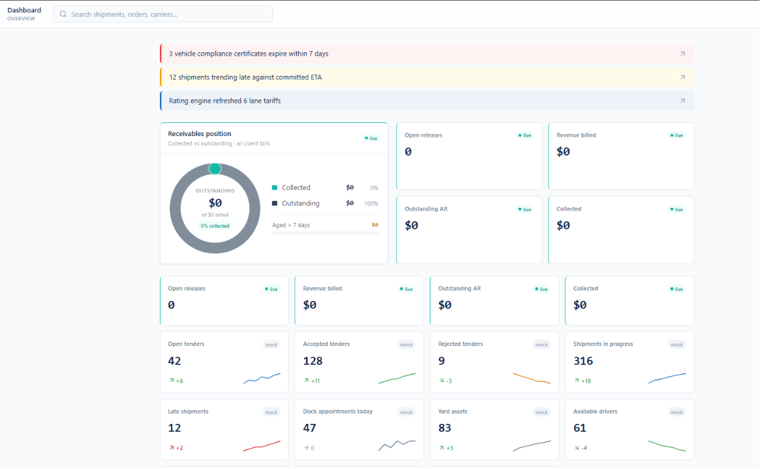
OVERVIEW
Operating Dashboard
Role-based alerts, receivables position and live operational KPIs
Action-first alert band surfaces expiring compliance certificates and at-risk shipments
Each alert links straight into the record that needs attention
Receivables position shows collected versus outstanding across all client bills
Open releases, revenue billed, outstanding AR and collected tracked live
Tender, shipment, dock, yard and driver metrics grouped with trend indicators
Global search reaches shipments, orders and carriers from any screen
Enterprise Transportation Management System
Notes:
The daily home screen: exceptions first, then financial and operational KPIs.

Slide 4
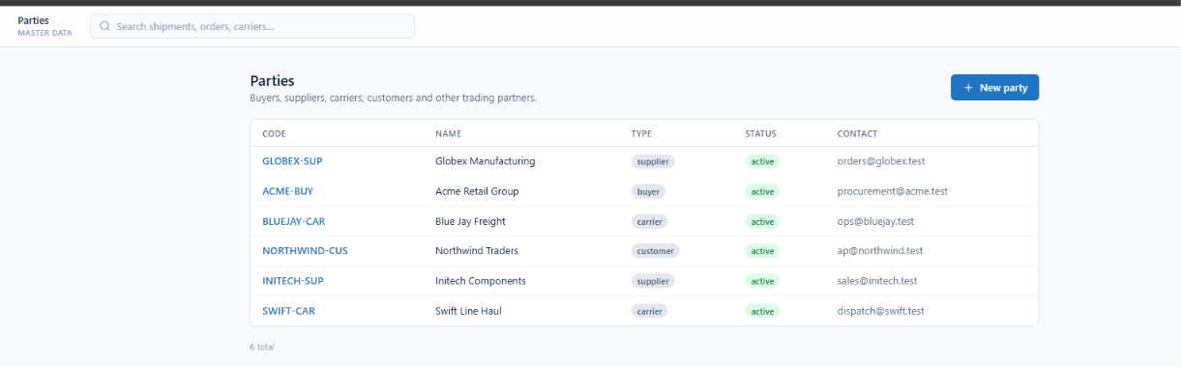
MASTER DATA
Parties
One registry for buyers, suppliers, carriers and customers
Buyers, suppliers, carriers, customers and other trading partners in one master
Party code, name, type, status and primary contact on every row
Type badges distinguish supplier, buyer, carrier and customer roles
Active status controls whether a party can be used downstream
Tax ID, legal name and billing contact maintained per party
Enterprise Transportation Management System
Notes:
Parties are the trading-partner master every transaction points back to.

Slide 5
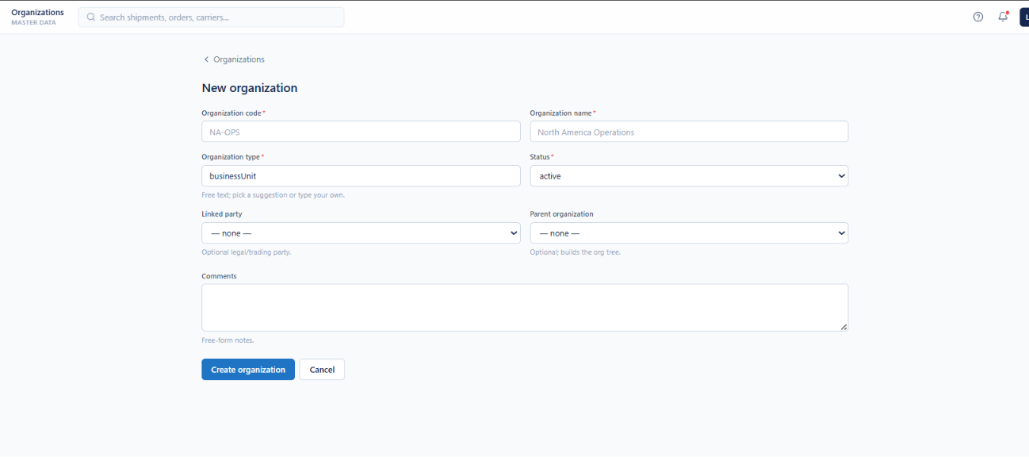
MASTER DATA
Organizations
Internal business units, divisions and legal entities
Organization code, name and type define each internal unit
Free-text organization type accepts a suggestion or your own value
Linked party ties the organization to a legal or trading entity
Parent organization builds the org tree
Supports multiple operating companies, regions and countries in one instance
Enterprise Transportation Management System
Notes:
Organizations model internal structure, optionally linked to a legal party.

Slide 6
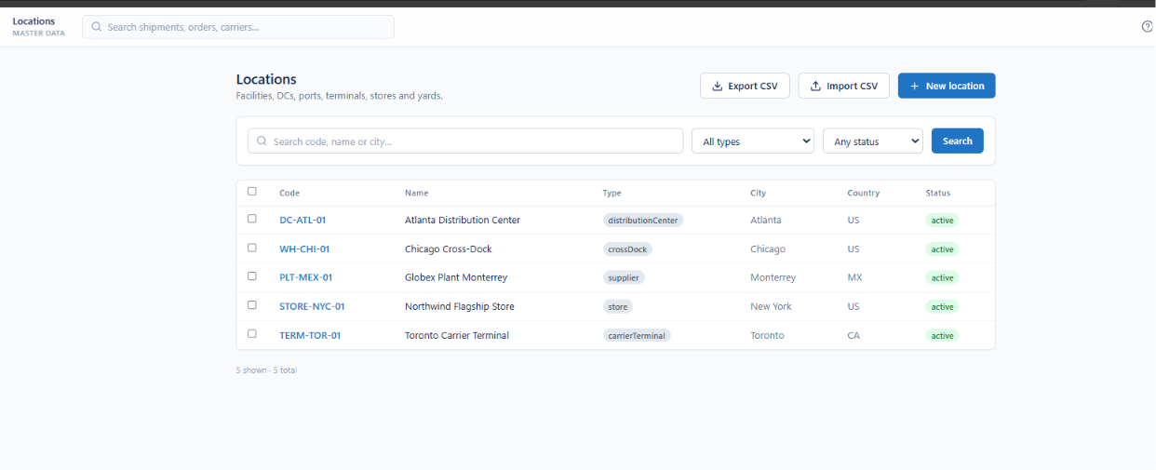
MASTER DATA
Locations
Facilities, DCs, ports, terminals, stores and yards
Every facility type held in one location master
Code, name, type, city, country and status per record
Search by code, name or city and filter by type and status
CSV import and export support bulk maintenance
Locations are referenced by appointments, lanes and rating
Enterprise Transportation Management System
Notes:
One location master behind appointments, lanes and rating.

Slide 7
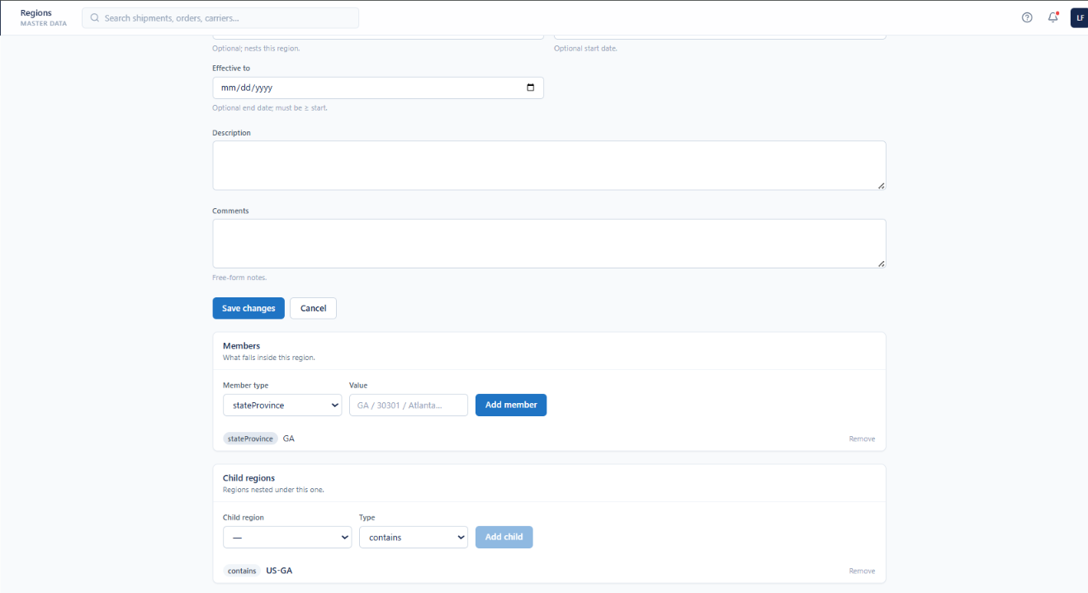
MASTER DATA
Regions
Service areas and rating zones with members and nesting
Regions define service areas, rating zones and delivery zones
Effective from and to dates version every definition
Members declare what falls inside by state, postal code or city
Child regions nest underneath with a containment type
Region definitions drive region-scoped charge rules
Enterprise Transportation Management System
Notes:
Regions are the geographic groupings charge rules resolve against.

Slide 8
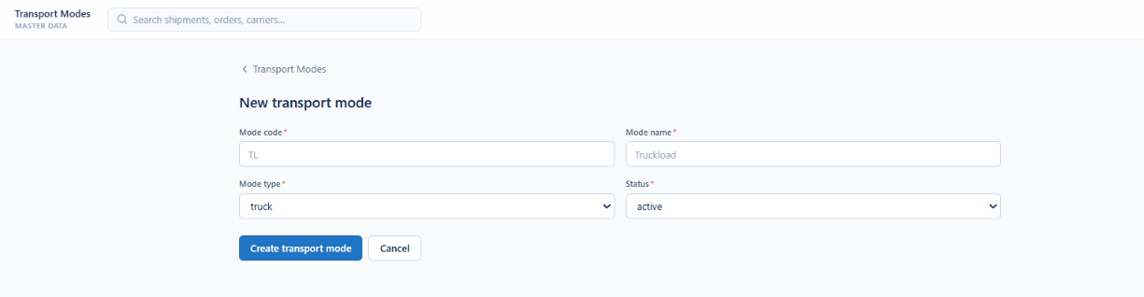
MASTER DATA
Transport Modes
Truck, rail, ocean, air, parcel and intermodal
Mode code and name define each mode of transport
Mode type classifies it as truck, rail, ocean, air or parcel
Active status controls availability to planning and rating
Modes are shared by rating, tendering and reporting alike
Enterprise Transportation Management System
Notes:
Modes are the shared vocabulary for how freight moves.

Slide 9
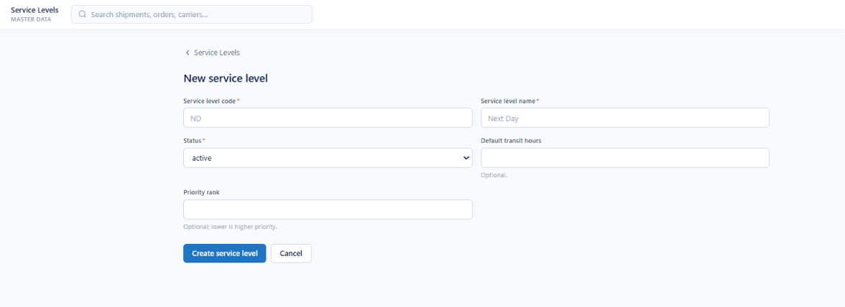
MASTER DATA
Service Levels
Transit commitments such as Next Day, 2-Day and Economy
Service level code and name define each transit commitment
Default transit hours drive ETA calculation
Priority rank orders service levels, lower being higher priority
Active status governs which levels planning may select
Enterprise Transportation Management System
Notes:
Service levels set the promise ETA and on-time measurement are judged against.

Slide 10
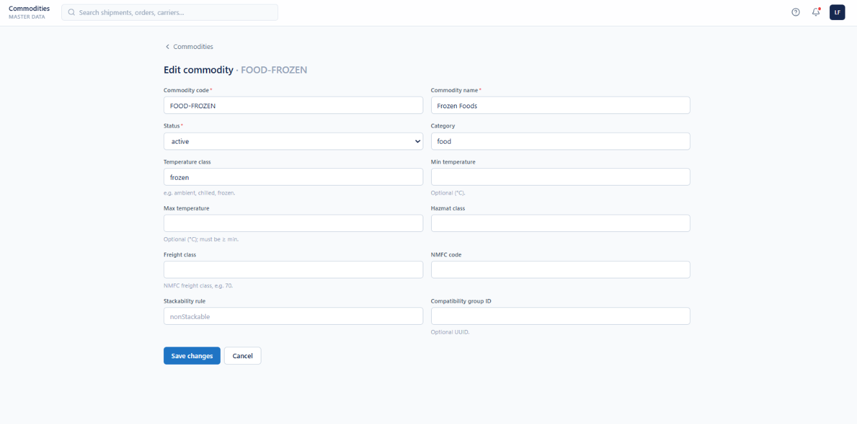
MASTER DATA
Commodities
Handling, temperature and freight-class attributes
Category and temperature class classify each commodity
Min and max temperature bound the acceptable range
Hazmat class, freight class and NMFC code captured
Stackability rule and compatibility group drive load building
Items inherit classification through a commodity link
Enterprise Transportation Management System
Notes:
Commodity data is what makes rating and compatibility checks possible.

Slide 11
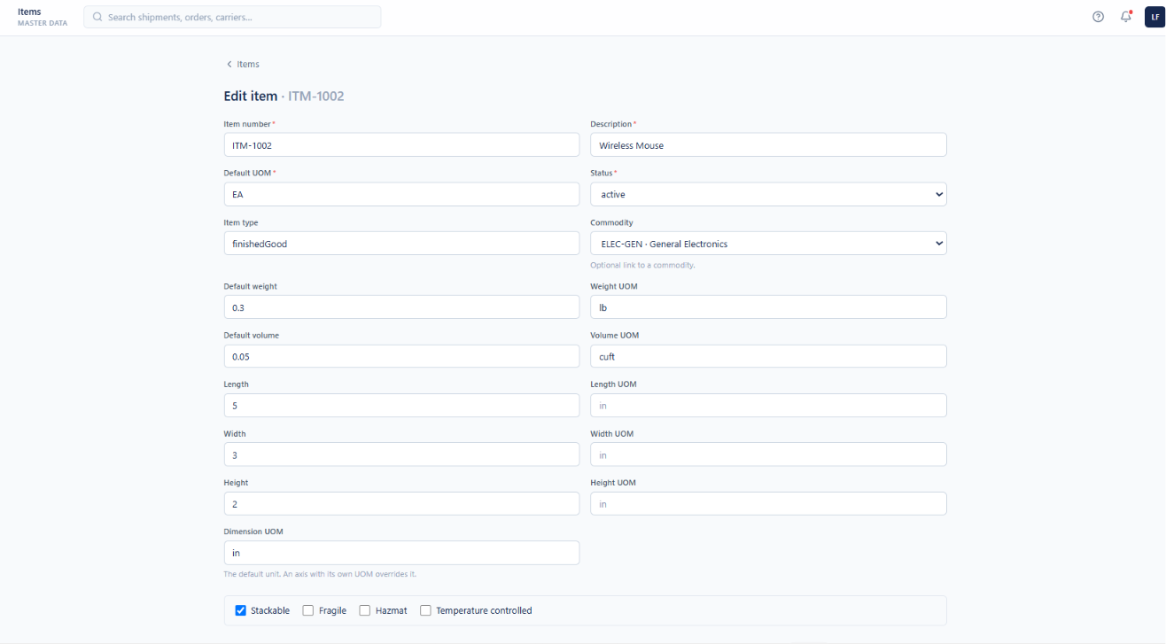
MASTER DATA
Items
SKUs with dimensions, weight and handling flags
Item number, description, default UOM and type per SKU
Optional commodity link inherits classification
Default weight and volume held with their own units
Length, width and height captured, each able to override the default unit
Stackable, fragile, hazmat and temperature-controlled flags set per item
Enterprise Transportation Management System
Notes:
Item dimensions and flags feed chargeable weight and load building.

Slide 12
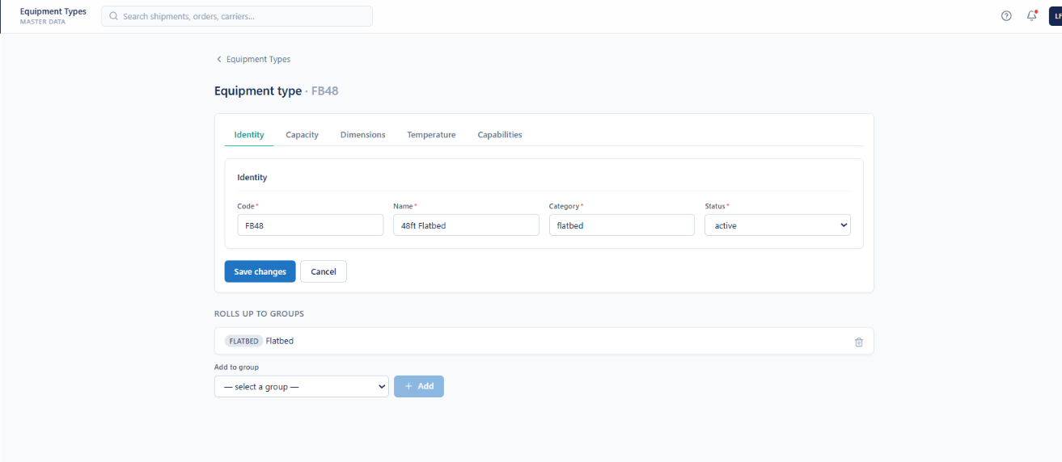
MASTER DATA
Equipment Types
Reusable profiles with capacity, dimensions and capabilities
Identity, Capacity, Dimensions, Temperature and Capabilities on tabs
Code, name, category and status identify each profile
Profiles roll up to one or more equipment type groups
Groups are added and removed without editing the profile
Profiles are deactivated rather than deleted, preserving history
Enterprise Transportation Management System
Notes:
Profiles are reusable; groups are what tendering enforces against.

Slide 13
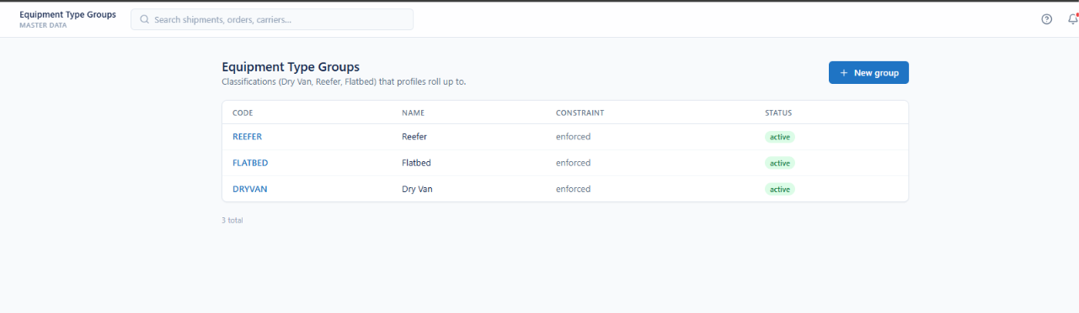
MASTER DATA
Equipment Type Groups
Classifications that equipment profiles roll up to
Dry Van, Reefer and Flatbed classify what planning may substitute
Each group carries a code, name and constraint mode
Enforced constraints block incompatible equipment assignment
Groups keep equipment matching consistent across planning and dispatch
Enterprise Transportation Management System
Notes:
Groups decide what planning may legitimately substitute.

Slide 14
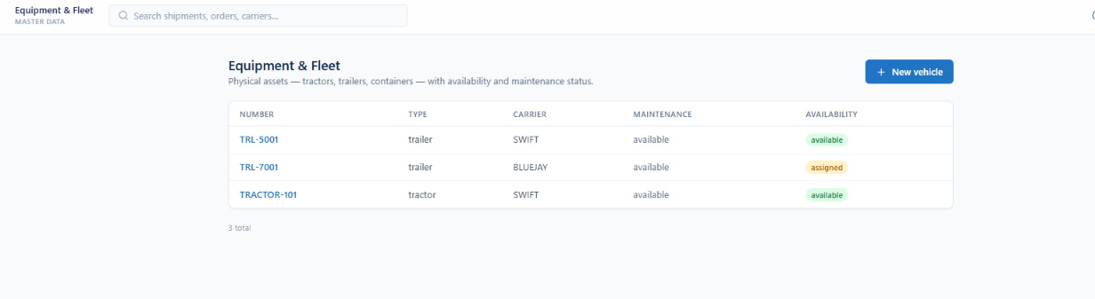
MASTER DATA
Equipment & Fleet
Physical assets with availability and maintenance status
Tractors, trailers and containers registered as physical assets
Unit number, type and owning carrier per vehicle
Maintenance state tracked separately from availability
Available and assigned states reflect live dispatch
Enterprise Transportation Management System
Notes:
Physical assets, distinct from the type profiles that describe them.

Slide 15
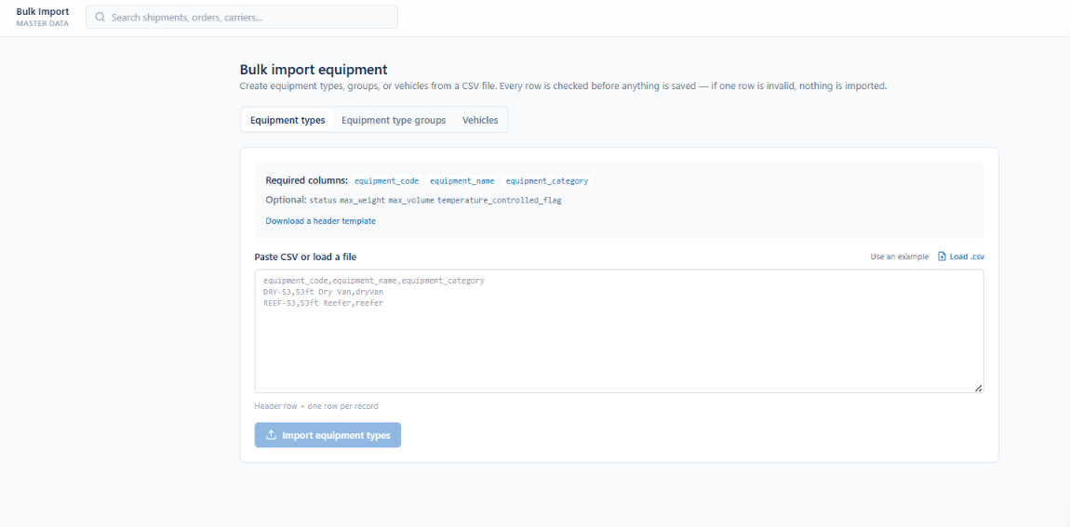
MASTER DATA
Bulk Import
CSV loading for equipment types, groups and vehicles
Equipment types, groups or vehicles created from a CSV file
Required and optional columns documented per import type
A downloadable header template starts the file
CSV pasted directly or loaded from disk
Every row is checked first: if one row is invalid, nothing is imported
Enterprise Transportation Management System
Notes:
The implementation loader: all-or-nothing validation.

Slide 16
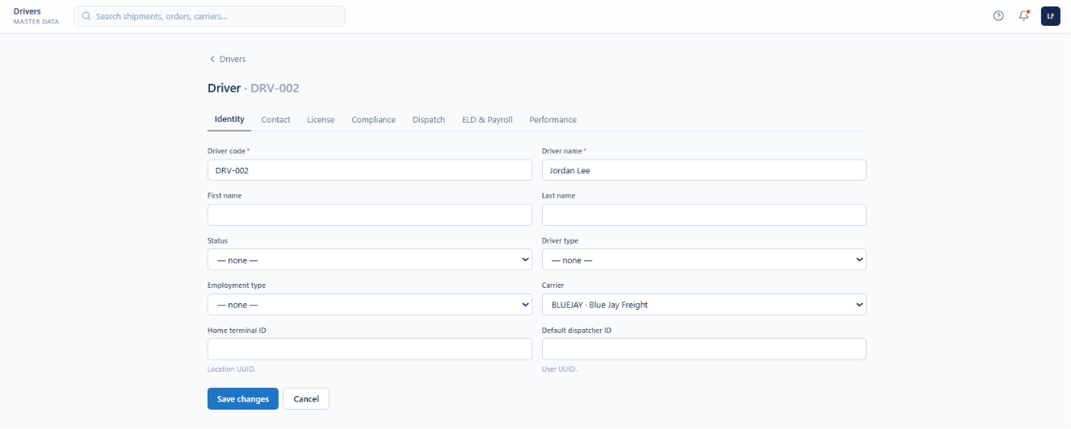
MASTER DATA
Driver Identity
Driver master with employment and terminal assignment
Driver code and name identify each record
Seven tabs organize identity, contact, license, compliance, dispatch, pay and performance
Status, driver type and employment type recorded per driver
Carrier links the driver to the operating provider
Home terminal and default dispatcher tie them to a location
Enterprise Transportation Management System
Notes:
One driver record, seven tabs.

Slide 17
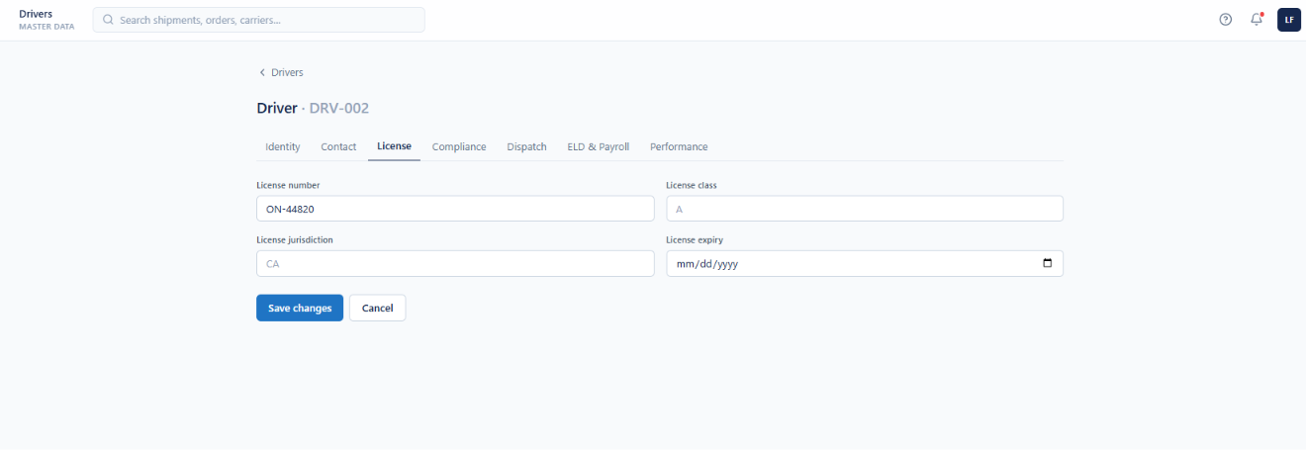
MASTER DATA
Driver Licensing
Commercial licence detail and expiry tracking
Commercial licence number and class held per driver
Issuing jurisdiction recorded alongside
Expiry date drives regulatory compliance monitoring
Approaching expiries surface as dashboard alerts
Enterprise Transportation Management System
Notes:
Licence expiry is one of the dashboard compliance alerts.

Slide 18
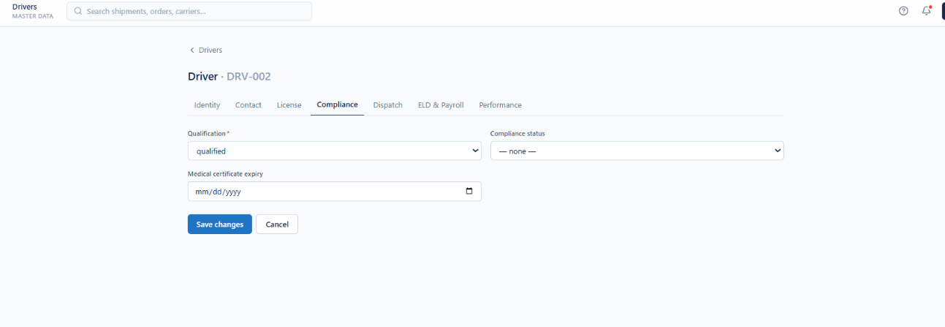
MASTER DATA
Driver Compliance
Qualification status and medical certification
Qualification status is required on every driver record
Compliance status tracked independently of qualification
Medical certificate expiry recorded and monitored
Drivers who are not qualified are excluded from dispatch
Enterprise Transportation Management System
Notes:
Qualification is required; it gates dispatch.

Slide 19
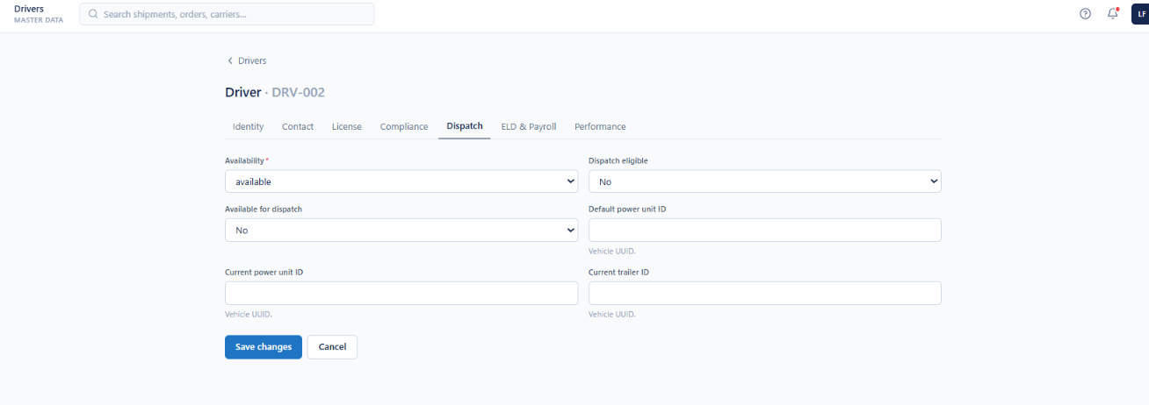
MASTER DATA
Driver Dispatch Readiness
Availability, eligibility and current equipment
Availability and dispatch-eligible flags maintained separately
Available-for-dispatch controls inclusion in assignment
Default power unit recorded per driver
Current power unit and trailer show live assignment
Enterprise Transportation Management System
Notes:
Availability and eligibility are deliberately separate flags.

Slide 20
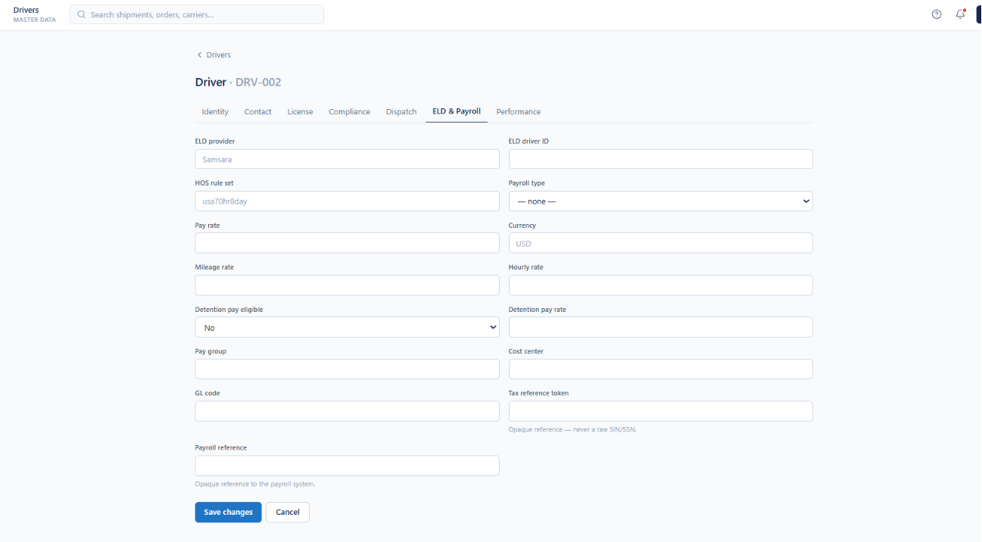
MASTER DATA
Driver ELD & Payroll
Telematics identity and pay configuration on the driver record
ELD provider, driver ID and HOS rule set configured per driver
Pay rate, mileage rate and hourly rate held with currency
Detention pay eligibility and rate captured for settlement
Pay group, cost center and GL code connect drivers to accounting
Payroll and tax references stored as opaque tokens, never raw identifiers
Enterprise Transportation Management System
Notes:
ELD and payroll live on the driver, not a separate system.

Slide 21
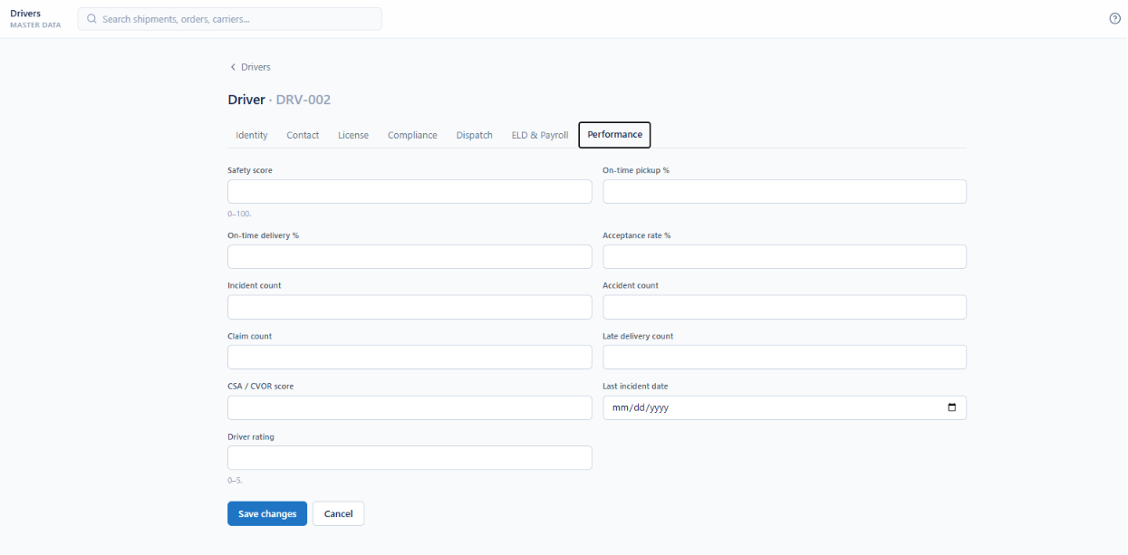
MASTER DATA
Driver Performance
Safety, service and incident scoring
Safety score and driver rating held on fixed scales
On-time pickup, on-time delivery and acceptance rate tracked
Incident, accident, claim and late delivery counts recorded
CSA and CVOR score kept with the last incident date
Feeds carrier scorecards and dispatch prioritization
Enterprise Transportation Management System
Notes:
Performance data feeds carrier scorecards and dispatch prioritization.

Slide 22
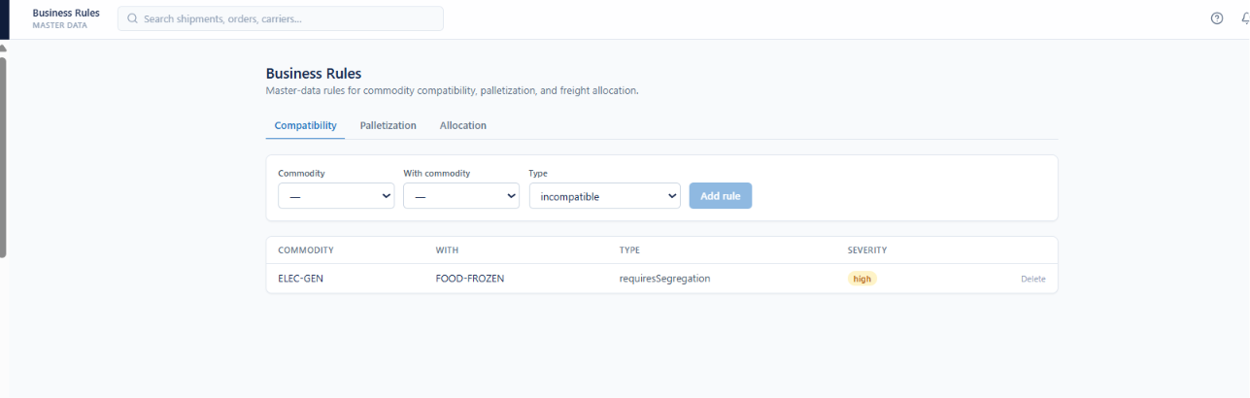
MASTER DATA
Business Rules
Compatibility, palletization and allocation declared as data
Commodity compatibility, palletization and freight allocation rules in one place
Incompatible and requires-segregation pairs declared explicitly
Each rule carries a severity
Rules are added and removed without a software release
Enterprise Transportation Management System
Notes:
Rules are master data, not code.

Slide 23
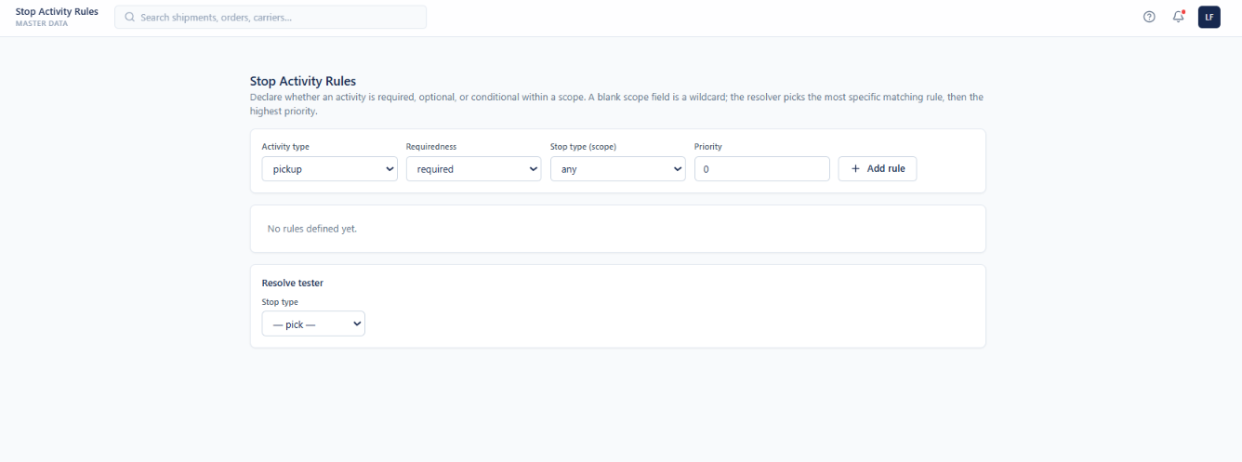
MASTER DATA
Stop Activity Rules
Activities declared required, optional or conditional by scope
Each activity is declared required, optional or conditional
Scope narrows a rule to a stop type, or stays a wildcard
Priority breaks ties between equally specific rules
The resolver picks the most specific match, then the highest priority
A resolve tester shows which rule would apply before go-live
Enterprise Transportation Management System
Notes:
The resolver pattern: most specific match, then priority.

Slide 24
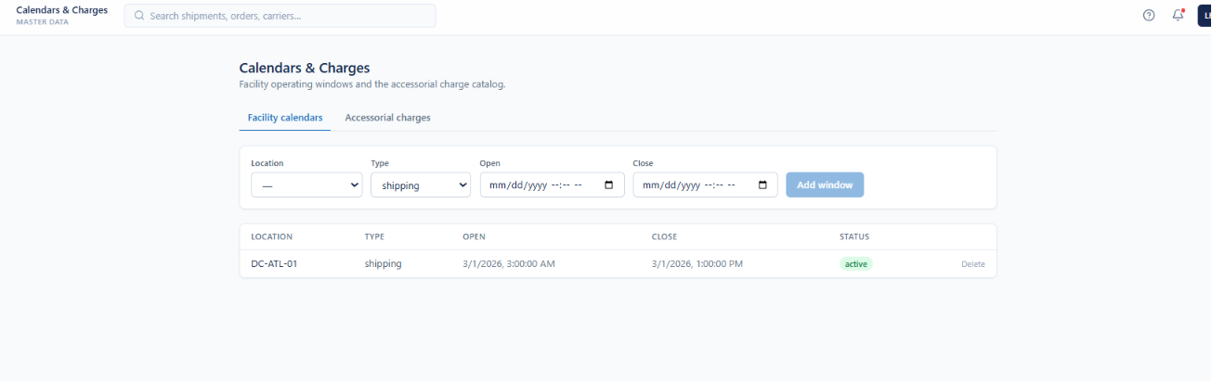
MASTER DATA
Facility Calendars
Operating windows per location
Shipping and receiving windows defined per location
Open and close timestamps bound each window
Windows drive appointment availability and block out-of-hours booking
Active status retires a window without deleting it
Enterprise Transportation Management System
Notes:
Calendars bound what appointments can be booked.

Slide 25
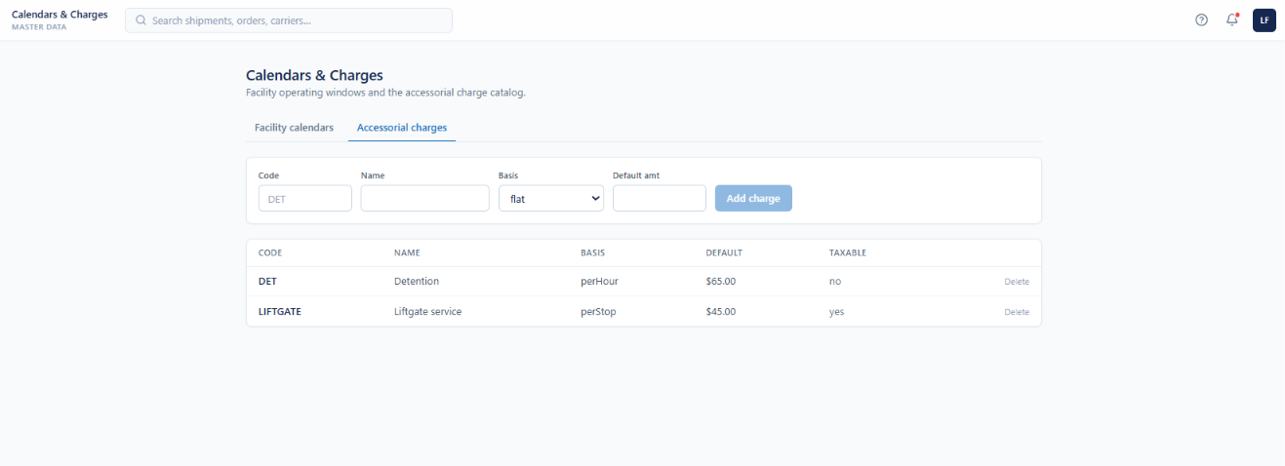
MASTER DATA
Accessorial Charge Catalog
Charges maintained beside the facility calendars they apply to
Charge code, name, basis and default amount per charge
Per-hour, per-stop and flat bases supported
Taxability recorded per charge
Charges maintained beside the facility calendars they apply to
Deleting a charge never rewrites historical rating
Enterprise Transportation Management System
Notes:
The charge catalog sits on the same screen as calendars.

Slide 26
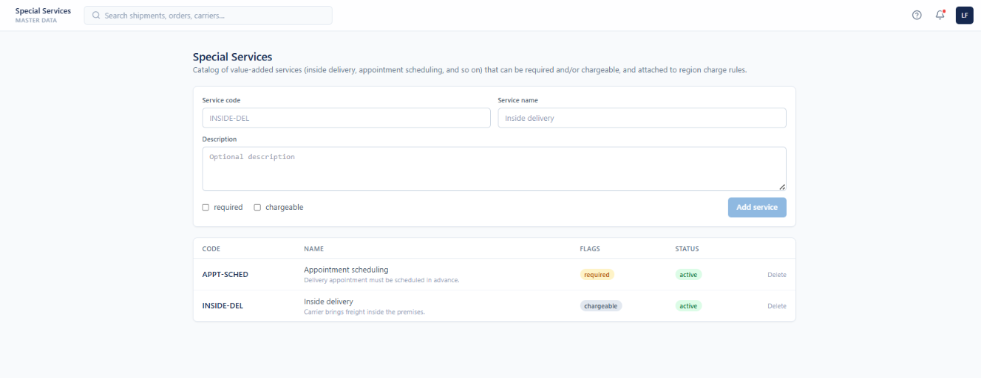
MASTER DATA
Special Services
Value-added services, required or chargeable
Catalogue of value-added services such as inside delivery
Each service carries a code, name and description
Required and chargeable flags set independently
Services attach to region charge rules
Enterprise Transportation Management System
Notes:
Required and chargeable are independent flags.

Slide 27
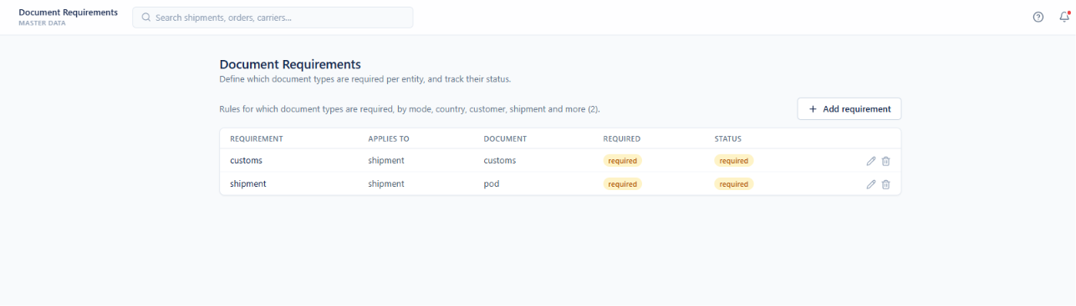
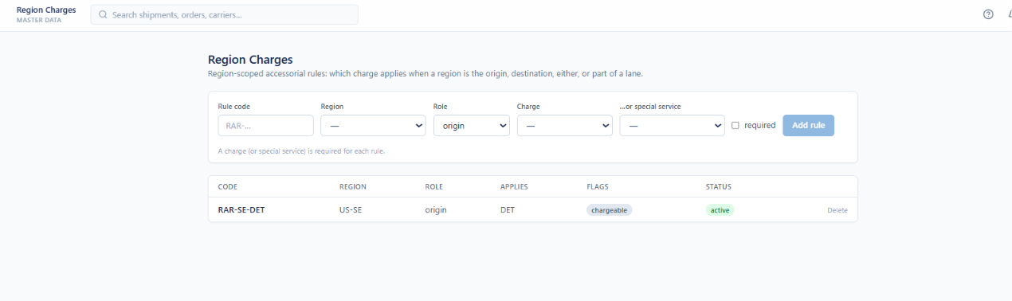
MASTER DATA
Document Requirements & Region Charges
Which documents are mandatory, and which charges a geography triggers
Required document types declared per entity and tracked to status
Rules scoped by mode, country, customer and shipment
Proof of delivery and customs paperwork enforced before closeout
Region charge rules bind a charge to a region as origin, destination or lane part
Each rule points at a charge code or a special service
Chargeable flags separate billable from merely mandatory
Enterprise Transportation Management System
Notes:
Both follow the same scope-and-resolve pattern.

Slide 28
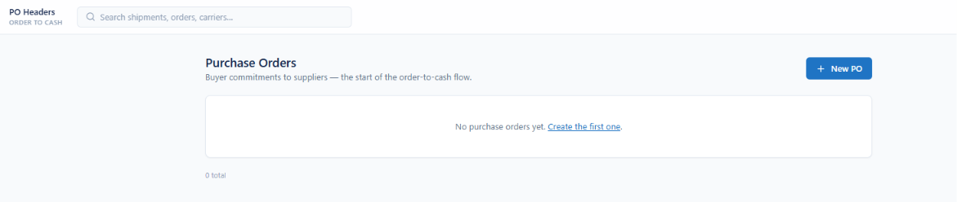
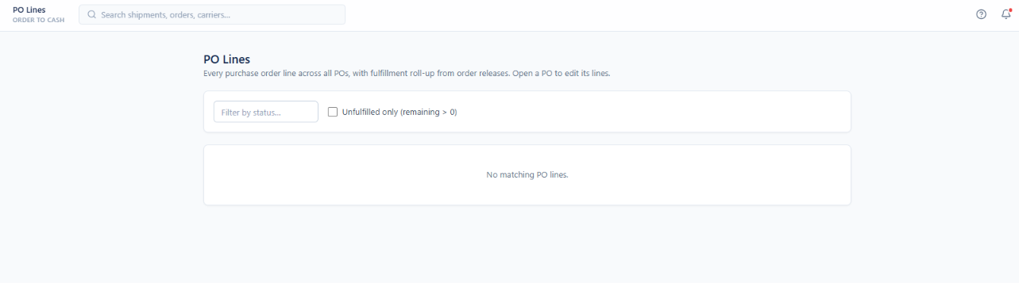
ORDER TO CASH
Purchase Orders & PO Lines
Buyer commitments to suppliers — the start of the order-to-cash flow
Buyer commitments to suppliers held as purchase orders
Every PO line visible across all POs in one list
Fulfillment rolls up from order releases onto the line
Unfulfilled-only filter isolates remaining demand
Status filter narrows to the lines a planner cares about
Lines are edited from within their purchase order
Enterprise Transportation Management System
Notes:
Everything downstream traces back to a PO line.

Slide 29
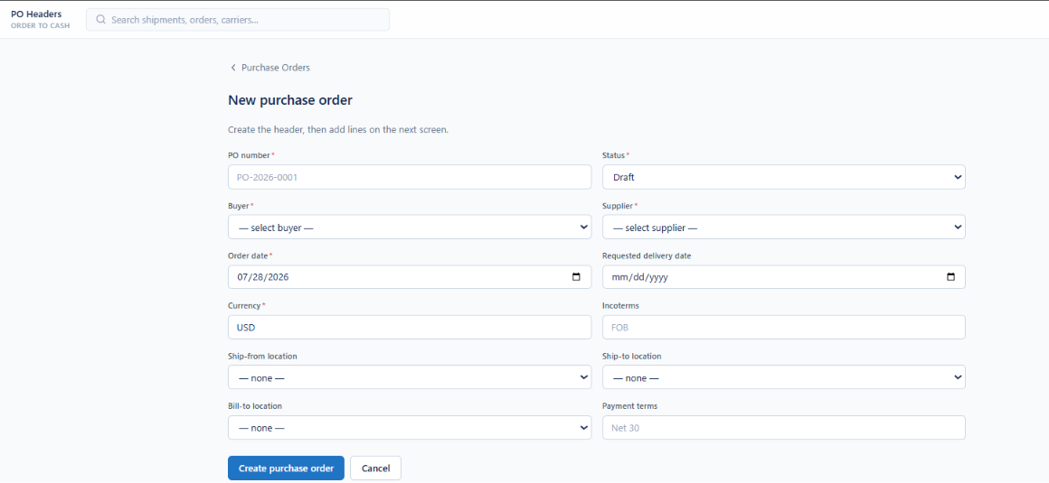
ORDER TO CASH
Creating a Purchase Order
Header first, then lines on the next screen
PO number, status, buyer and supplier form the header
Order date and requested delivery date both captured
Currency and Incoterms recorded per order
Ship-from, ship-to and bill-to locations selected from the location master
Payment terms held on the header for downstream billing
Enterprise Transportation Management System
Notes:
Incoterms and payment terms are captured up front.

Slide 30
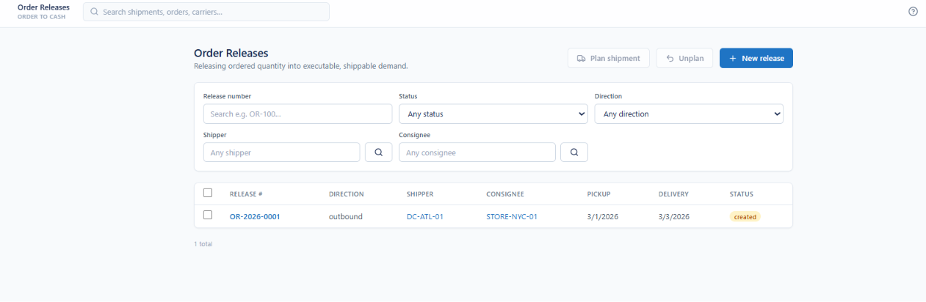
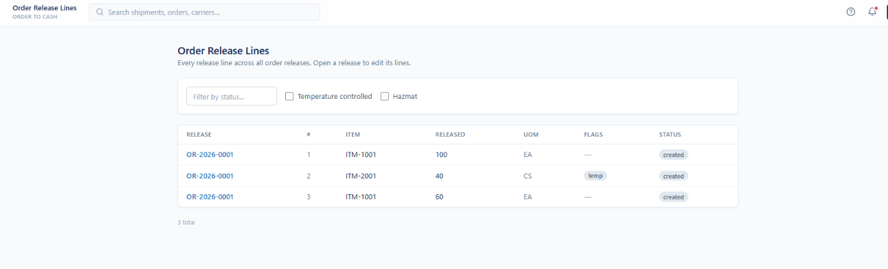
ORDER TO CASH
Order Releases
Releasing ordered quantity into executable, shippable demand
Releases turn ordered quantity into shippable demand
Filter by release number, status, direction, shipper and consignee
Plan shipment and unplan act directly on the selection
Every release line across all releases visible in one list
Temperature-controlled and hazmat filters isolate special handling
Released and planned quantities tracked per line
Enterprise Transportation Management System
Notes:
The release is the bridge from commercial order to transport plan.

Slide 31
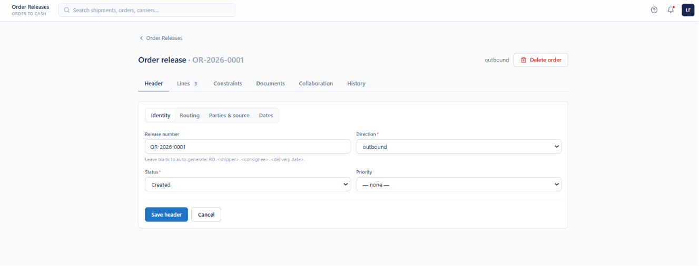
ORDER TO CASH
Release Header
Identity, routing, parties and dates on tabbed sub-forms
Header split across Identity, Routing, Parties and source, and Dates
Direction marks the release inbound or outbound
Leave the release number blank to auto-generate it from shipper, consignee and date
Status and priority drive planning sequence
Lines, constraints, documents, collaboration and history on the release tabs
Enterprise Transportation Management System
Notes:
Leave the number blank and the system generates it.

Slide 32
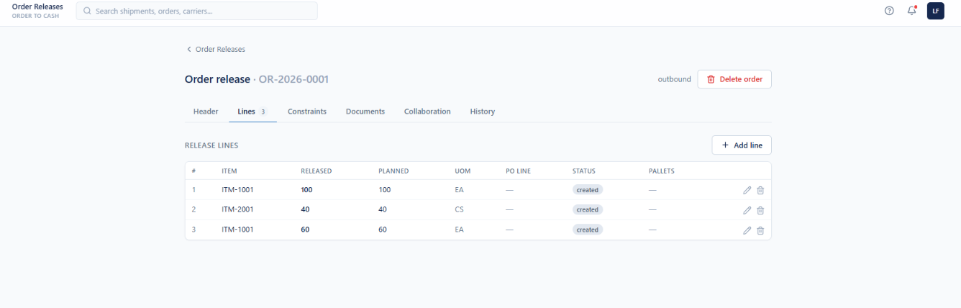
ORDER TO CASH
Release Lines
Item, quantity and pallet roll-up per line
Each line carries item, released quantity and planned quantity
Unit of measure held per line
Optional PO line link ties the release back to the purchase order
Pallet roll-up shows how the line was built into ship units
Lines added, edited and removed from the release
Enterprise Transportation Management System
Notes:
Planned versus released quantity is visible line by line.

Slide 33
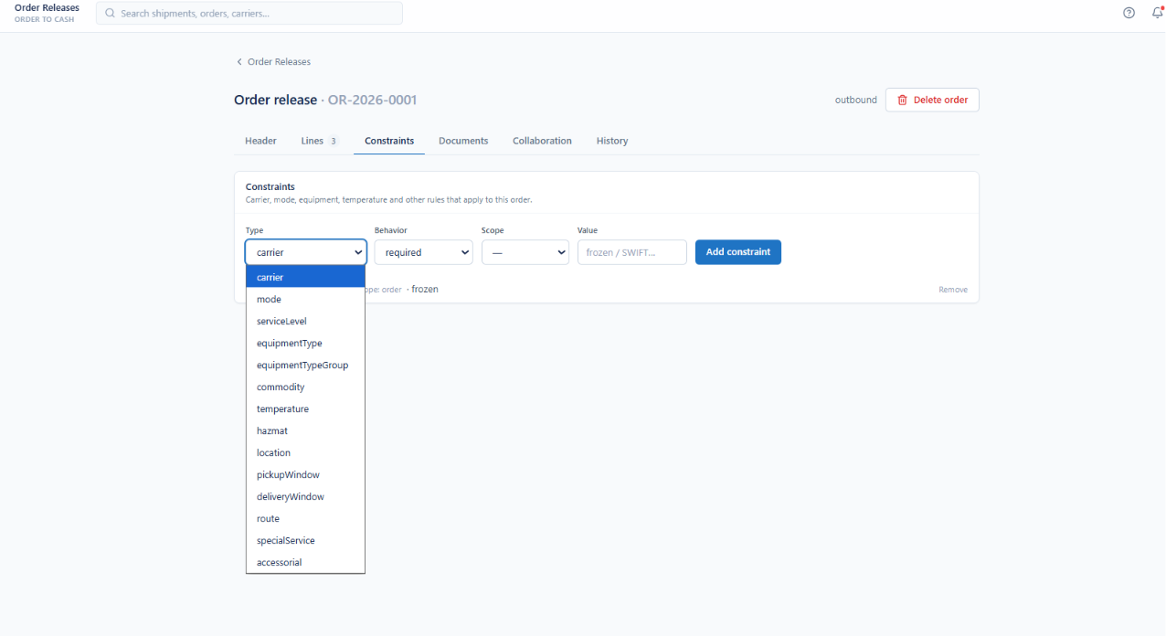
ORDER TO CASH
Order Constraints
Carrier, mode, equipment and temperature rules per order
Constraints declared per order across fifteen types
Carrier, mode, service level, equipment type and group all constrainable
Commodity, temperature and hazmat constraints supported
Location, pickup window, delivery window and route constraints available
Behaviour set to required or preferred, with a scope and a value
Enterprise Transportation Management System
Notes:
Constraints are declared per order and honoured by planning.

Slide 34
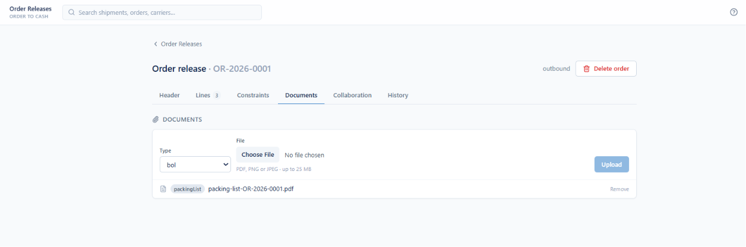
ORDER TO CASH
Release Documents
Paperwork attached directly to the order release
Documents attached per release with a document type
PDF, PNG and JPEG accepted up to 25 MB
Attached files are listed with their type badge
Documents are removed without affecting the release
The same document model is shared with shipments and trips
Enterprise Transportation Management System
Notes:
Documents live on the release, not in an email thread.

Slide 35
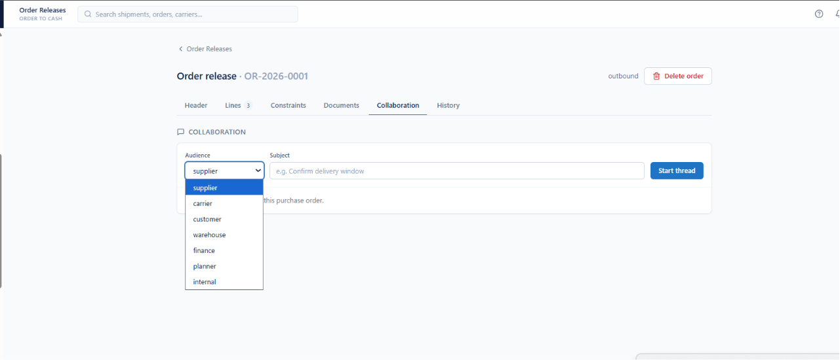
ORDER TO CASH
Release Collaboration
Threads addressed to a specific audience
Threads started against a release with a subject
Audience chosen from supplier, carrier, customer or warehouse
Finance, planner and internal audiences also available
Keeps order conversations attached to the order
Mirrors the collaboration model used on shipments and invoices
Enterprise Transportation Management System
Notes:
Audience is explicit, so the right party sees the thread.

Slide 36
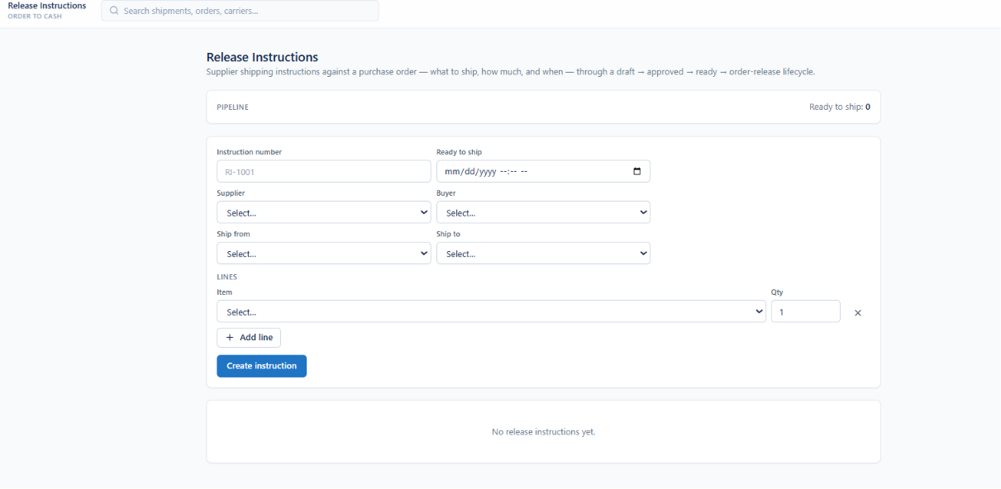
ORDER TO CASH
Release Instructions
Supplier shipping instructions against a purchase order
Supplier instructions declare what to ship, how much and when
Instruction number and ready-to-ship date per instruction
Supplier, buyer, ship-from and ship-to captured together
Lines added item by item with quantities
Lifecycle runs draft, approved, ready, then order release
A pipeline counter shows how many are ready to ship
Enterprise Transportation Management System
Notes:
Draft to approved to ready to order release.

Slide 37
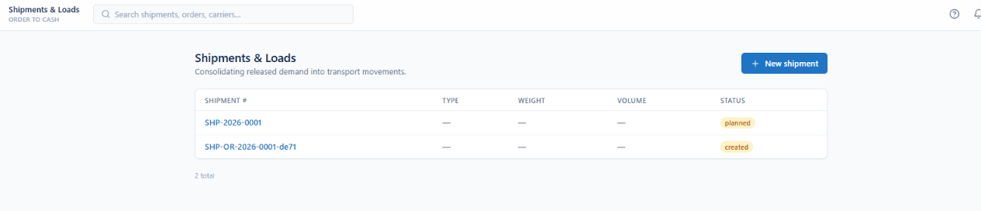
ORDER TO CASH
Shipments & Loads
Consolidating released demand into transport movements
Released demand consolidated into transport movements
Shipment number, type, weight and volume per row
Status tracks created through planned and beyond
Shipments generated from a release keep the release in their number
Twelve tabs cover costs through history on each shipment
Enterprise Transportation Management System
Notes:
Shipments are where released demand becomes a movement.

Slide 38
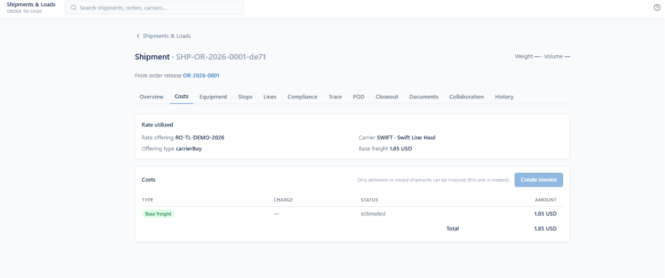
ORDER TO CASH
Shipment Costs
The rate utilized and the cost lines it produced
Rate offering and offering type recorded per shipment
Carrier and base freight shown alongside
Cost lines listed by type, charge and status
Estimated and actual amounts distinguished
Only delivered or closed shipments can be invoiced
Create invoice is disabled until the shipment qualifies
Enterprise Transportation Management System
Notes:
The rate used is recorded, not just the amount.

Slide 39
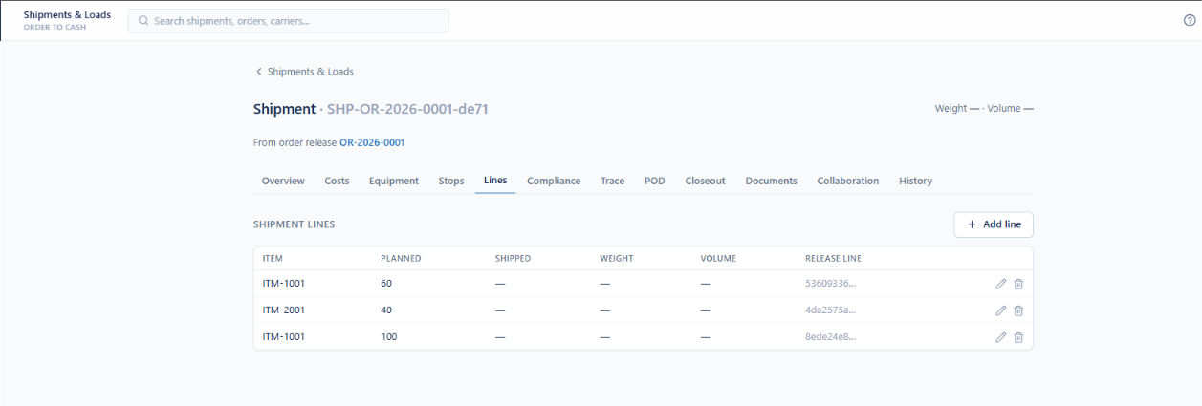
ORDER TO CASH
Shipment Lines
Planned versus shipped quantity per item
Each line carries item, planned and shipped quantity
Weight and volume held per line
Release line reference links back to the order
Lines added and edited on the shipment
Roll-ups give shipment weight and volume totals
Enterprise Transportation Management System
Notes:
Each shipment line points back to its release line.

Slide 40
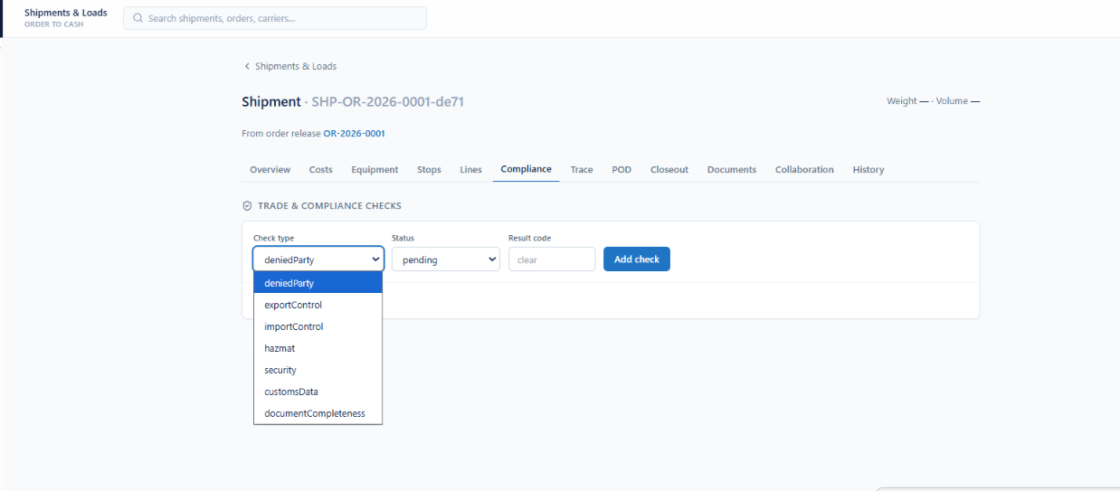
ORDER TO CASH
Trade & Compliance Checks
Denied party, export control and customs screening per shipment
Seven check types run against a shipment
Denied party, export control and import control screening
Hazmat, security and customs data checks included
Document completeness checked as part of the same set
Each check carries a status and a result code
Enterprise Transportation Management System
Notes:
Compliance checks are records with a result code, not a checkbox.

Slide 41
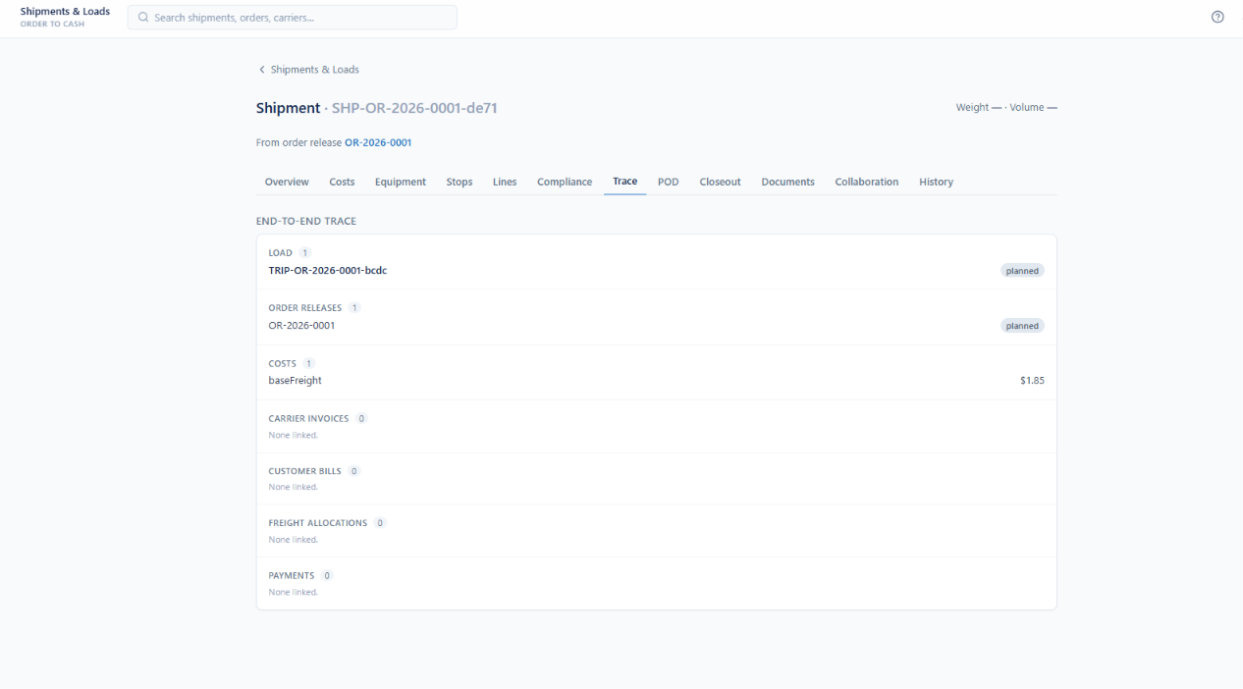
ORDER TO CASH
End-to-End Trace
Every linked record from load through payment
Load and order releases linked with their statuses
Cost lines listed with amounts
Carrier invoices and customer bills linked when raised
Freight allocations and payments shown on the same trace
Counts make gaps obvious at a glance
One screen answers what happened to this shipment
Enterprise Transportation Management System
Notes:
This is the traceability story in one screen.

Slide 42
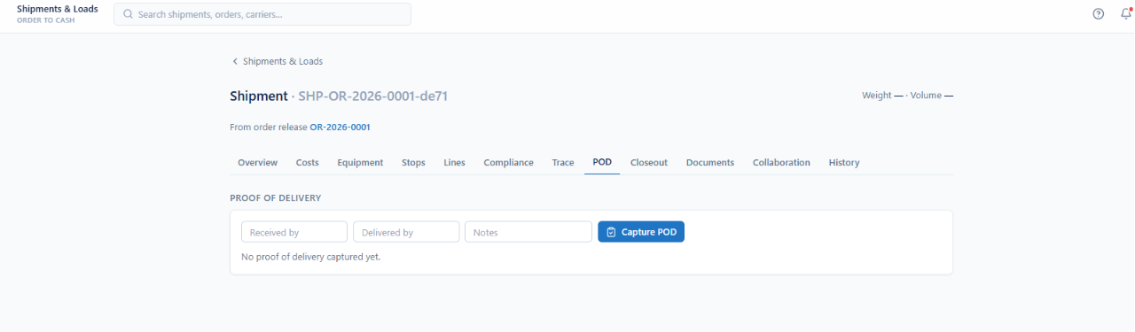
ORDER TO CASH
Proof of Delivery
Captured on the shipment at delivery
Received by and delivered by captured at delivery
Free-text notes recorded alongside
POD status is visible on the shipment
Missing proof of delivery blocks closeout
Document requirements can make POD mandatory
Enterprise Transportation Management System
Notes:
POD is a gate for closeout and invoicing.

Slide 43
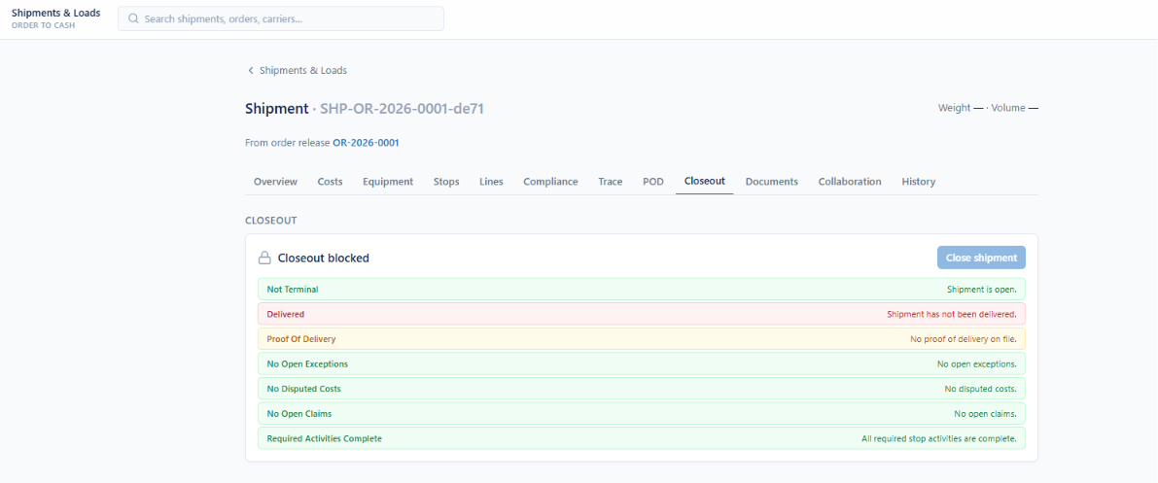
ORDER TO CASH
Closeout Gates
Explicit conditions a shipment must satisfy to close
Closeout is blocked until every gate passes
Not terminal, delivered and proof of delivery checked
No open exceptions, disputed costs or open claims required
Required stop activities must all be complete
Each gate states its own reason in plain language
Enterprise Transportation Management System
Notes:
Closeout is rule-driven and shows exactly what is blocking.

Slide 44
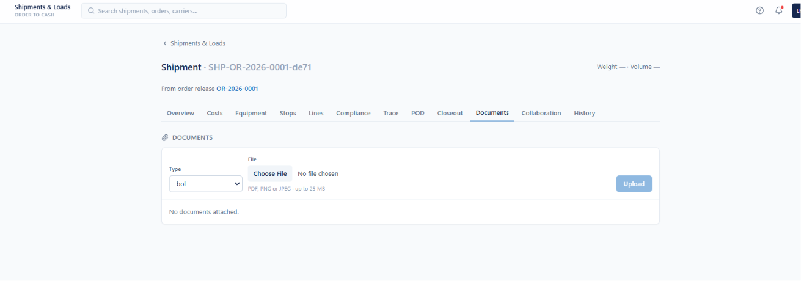
ORDER TO CASH
Shipment Documents
Bills of lading and supporting paperwork on the movement
Documents attached per shipment with a type
Bill of lading, POD and customs paperwork supported
PDF, PNG and JPEG up to 25 MB
Attached documents listed and removable
Collaboration threads sit on the adjacent tab with the same audience model
Enterprise Transportation Management System
Notes:
Same document engine as releases; type-driven.

Slide 45
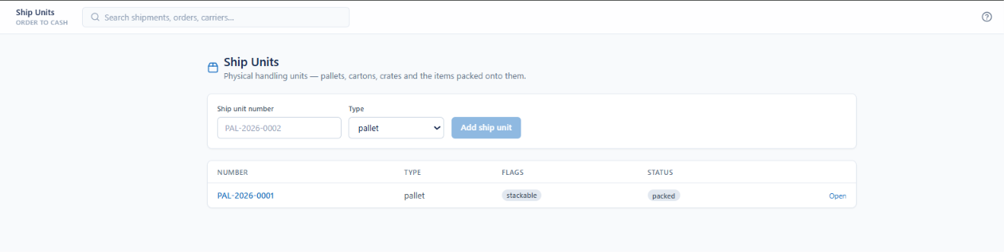
ORDER TO CASH
Ship Units
Pallets, cartons and crates as physical handling units
Pallets, cartons and crates registered as handling units
Ship unit number and type per unit
Stackable and other flags shown as badges
Status tracks packing state
Units opened to manage dimensions and contents
Enterprise Transportation Management System
Notes:
Ship units are the physical layer between items and trailers.

Slide 46
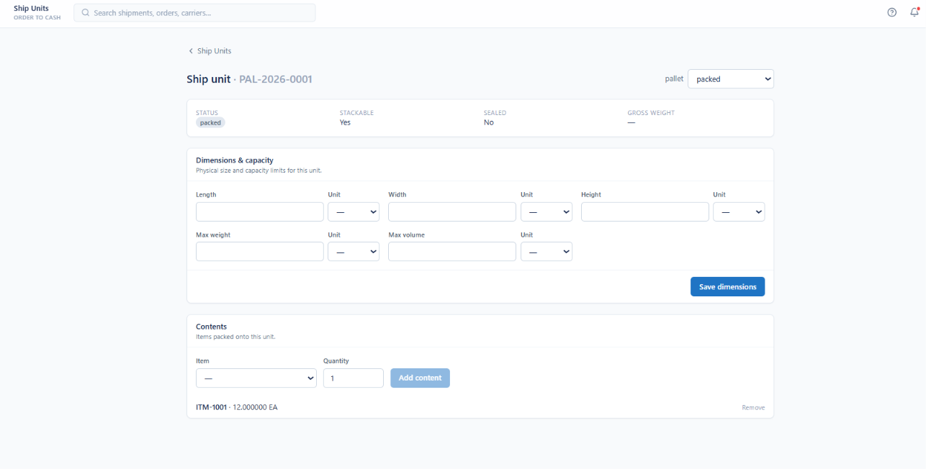
ORDER TO CASH
Ship Unit Detail
Dimensions, capacity limits and packed contents
Status, stackable, sealed and gross weight summarized
Length, width and height captured with per-axis units
Max weight and max volume set the capacity limits
Contents list the items packed onto the unit with quantities
Items added and removed without rebuilding the unit
Enterprise Transportation Management System
Notes:
Capacity limits are what palletization plans against.

Slide 47
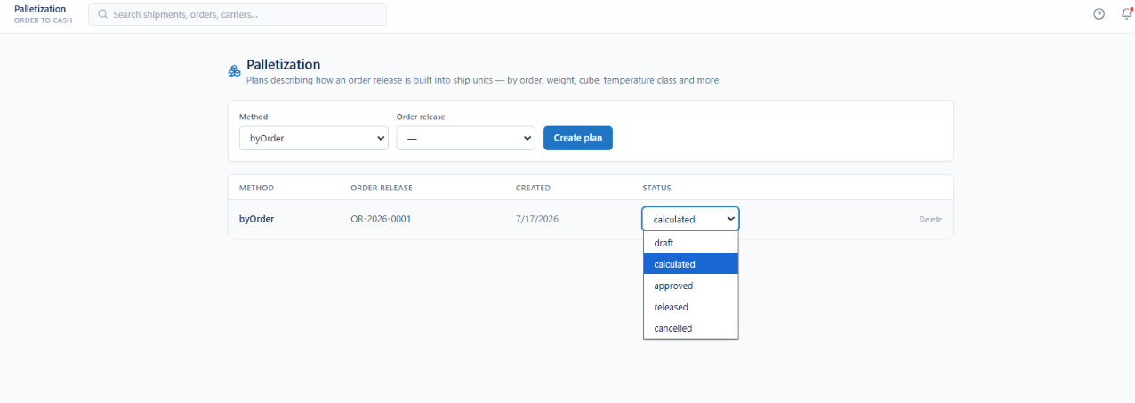
ORDER TO CASH
Palletization
Plans describing how a release is built into ship units
Plans describe how an order release becomes ship units
Method options include by order, weight, cube and temperature class
Plans created per order release
Status runs draft, calculated, approved, released and cancelled
Plans are deleted without touching the release
Enterprise Transportation Management System
Notes:
Method-driven, with its own lifecycle.

Slide 48
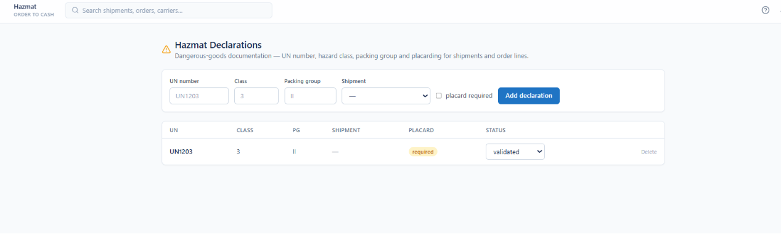
ORDER TO CASH
Hazmat Declarations
Dangerous-goods documentation per shipment and order line
UN number, hazard class and packing group per declaration
Declarations attach to shipments and order lines
Placard-required flag tracked explicitly
Status moves through validation
Feeds compliance checks and document requirements
Enterprise Transportation Management System
Notes:
Placarding is a tracked requirement, not a note.

Slide 49
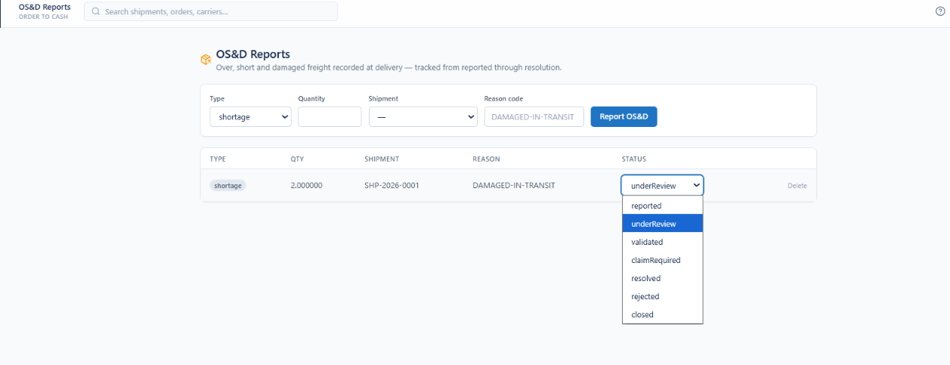
ORDER TO CASH
OS&D Reports
Over, short and damaged freight recorded at delivery
Overage, shortage and damage recorded at delivery
Quantity and reason code captured per report
Reports tied to the shipment they occurred on
Status runs reported, under review, validated and resolved
Claim-required status routes the case into claims
Rejected and closed states end the record
Enterprise Transportation Management System
Notes:
OS&D is tracked to resolution, with a claim path.

Slide 50

ORDER TO CASH
Carbon Estimates
Freight emissions per shipment, trip or order
Emissions estimated per shipment, trip or order
Methodology recorded per estimate, such as GLEC
Kilograms of CO2 equivalent held with distance
Status runs estimated, actualized, adjusted and allocated
Reported and archived states close the record
A running total sits on the screen header
Enterprise Transportation Management System
Notes:
Estimates are actualized, not left as forecasts.

Slide 51

ORDER TO CASH
Trips & Stops
Physical vehicle journeys and their ordered stop sequence
Trips represent physical vehicle journeys
Trip number, type, tractor and trailer per row
Status tracks planned through completion
Trips generated from a release carry its number
Stops are held in an ordered sequence on the trip
Enterprise Transportation Management System
Notes:
The trip is the physical movement; shipments ride on it.

Slide 52

ORDER TO CASH
Trip Detail
Carrier, driver, equipment, distance and cost on one record
Trip number, type, status and currency on the header
Tractor and trailer numbers recorded
Carrier, driver and equipment type assigned per trip
Total distance and total cost held on the trip
Planned start and end captured alongside actual start and end
Enterprise Transportation Management System
Notes:
Planned versus actual start and end are both captured.

Slide 53

ORDER TO CASH
Load Status, Stops & ETA
Tendering, stop sequence, consolidation and at-risk tracking
Tender and cancel act on the load from its status panel
Dispatch readiness lists what is missing: carrier, driver, equipment
A trip must be accepted before it can be dispatched
Stops listed in sequence with planned arrival and status
Unassigned shipments consolidated onto the load
ETA panel counts arrived, late and at-risk stops
Enterprise Transportation Management System
Notes:
A trip must be accepted before it can be dispatched.

Slide 54

ORDER TO CASH
Feasibility & Field Execution
Load checks, route plans and stop-level activity capture
Feasibility checks carrier and equipment assignment on the load
Hazmat and temperature commodities checked against the load
Optimized route plans generated per load
Field execution captures activities as driver or other roles
Activities recorded stop by stop
Cost roll-up sits at the foot of the trip
Enterprise Transportation Management System
Notes:
Feasibility is checked before commitment, not after.

Slide 55

ORDER TO CASH
Returns
Authorized customer returns moved back through the reverse pipeline
Return authorizations created with a number and reason
Damaged and other reason codes supported
Disposition recorded, such as restock
Approved authorizations become return orders
Returns move back through the reverse pipeline
Authorizations closed when the return completes
Enterprise Transportation Management System
Notes:
Reverse logistics closes the order-to-cash loop.

Slide 56

CARRIER & RATING
Carriers
Transportation providers used on trips and shipments
All transportation providers in one register
Carrier code, name, SCAC and status per row
Status controls eligibility to be tendered
New carriers created from the same screen
Enterprise Transportation Management System
Notes:
The carrier register; status controls tender eligibility.

Slide 57

CARRIER & RATING
Carrier Profile
Risk, compliance and financial exposure up front
A header strip summarizes risk, onboarding and service state
Insurance, compliance and scorecard status shown before tendering
Active contract count and outstanding balance visible
Addresses, services and lanes, qualifications, performance, financials and notifications by tab
Linked party keeps one legal identity across the platform
Enterprise Transportation Management System
Notes:
The header strip is the risk view planners see before tendering.

Slide 58

CARRIER & RATING
LTL Tariff Discounts
Discounts off the gross class rate with a minimum charge floor
Weight breaks and class rates form the structure the calculator prices against
Discounts apply off the gross class rate
An absolute minimum charge sets the floor
A discount can be tariff-wide or scoped to a class, a break, or both
The calculator applies the most specific discount that matches
Enterprise Transportation Management System
Notes:
Most specific discount wins.

Slide 59

CARRIER & RATING
FAK Mappings
Rate an actual freight class on another class rate row
Freight-All-Kinds maps an actual freight class to a rated class
The shipment is then priced on the rated class rate row
A common negotiated term that simplifies mixed commodities
Mappings are held per tariff
Enterprise Transportation Management System
Notes:
FAK is a negotiated simplification for mixed freight.

Slide 60


CARRIER & RATING
Spot Quotes
Request, compare and award carrier and broker spot rates
Quote requests created with their own number and tracked by status
Issued, quoted, expired and cancelled states filterable from the list
Response count and best available rate summarized on the header
Each response records carrier, quoted amount, capacity and status
Capacity availability shown next to price, so award is not cost-only
Collect responses, mark quoted, cancel or expire from one control row
Enterprise Transportation Management System
Notes:
Capacity is shown next to price so award is not cost-only.

Slide 61

CARRIER & RATING
Fuel Records
Consumption telemetry feeding surcharge and emissions work
Fuel logged by carrier, fuel type, quantity, unit and cost
Record count, total quantity and total cost summarized
Source retained per record, telematics or manual entry
Filterable by carrier and fuel type
Enterprise Transportation Management System
Notes:
Source is retained per record: telematics or manual.

Slide 62

CARRIER & RATING
Accessorials & Surcharges
The charge catalog and the region rules that apply it
Charge code, name, type, basis and default amount defined centrally
Per-hour, per-stop and flat bases supported
Taxability set per charge
Charges are deactivated rather than deleted, preserving historical rating
Region rules on the same screen control where each charge applies
Enterprise Transportation Management System
Notes:
Charges are deactivated, never deleted — historical rating stays intact.

Slide 63


CARRIER & RATING
Shipment Cost Allocation
Cost built up on the shipment, then distributed across stops
Cost lines built up on shipments and trips by type and charge code
Base freight, fuel and accessorials tracked as separate lines
Estimated and actual amounts distinguished on every line
Stop allocations distribute cost to the stops that caused it
A responsible party is named per allocation, such as shipper or consignee
Running totals keep allocated amounts reconciled to the original charge
Enterprise Transportation Management System
Notes:
Allocation is the bridge from freight cost to the GL.

Slide 64

EXECUTION
Planning Scenarios
Routing and carrier-selection what-ifs before commitment
Scenarios named and typed before running
Carrier sourcing, consolidation, mode shift and network optimization types
Facility region, private fleet and continuous move also supported
Every scenario is compared baseline-versus-scenario before adoption
Enterprise Transportation Management System
Notes:
Planners test before committing.

Slide 65

EXECUTION
Dispatch Assignment
Binding carrier, trip, driver and equipment under rules
Assignment binds carrier, trip, shipment, driver, tractor and trailer
The tractor must be a power unit and the trailer a towed unit
Live statuses mark the driver and vehicles as assigned
Completing or cancelling releases them back to available
Dispatched and completed timestamps recorded, completion never before dispatch
Enterprise Transportation Management System
Notes:
Power-unit and towed-unit rules are enforced by the form.

Slide 66

EXECUTION
Tracking & Visibility
Tracking, seal and mobile streams merged into one timeline
The timeline is scoped to a trip or a shipment
Trip scope shows tracking events only
Shipment scope merges all three event streams
Each event shows its type, source and timestamp
Events can be reversed rather than deleted
Enterprise Transportation Management System
Notes:
Scope decides how many streams merge.

Slide 67

EXECUTION
Tracking Event Log
The core visibility event log behind the merged timeline
Core visibility events logged per trip and shipment
Event name, type, source and timestamp per row
Telematics and manual sources distinguished
Events created manually when a feed is unavailable
Reverse undoes an event without deleting the record
Enterprise Transportation Management System
Notes:
Events are reversed rather than deleted.

Slide 68

EXECUTION
Event Definitions
Which status changes emit milestones, and where they publish
Definitions declare which status changes emit milestone events
Each names its triggering entity and status
Publish targets listed per event: ERP, WMS, Finance, Carrier and BI
Order, shipment, invoice and billing milestones all covered
Subscriptions are configured, not coded
Enterprise Transportation Management System
Notes:
Downstream publishing is configured, not coded.

Slide 69


EXECUTION
Seal & Mobile Events
Chain-of-custody and driver-app evidence as first-class records
Seal events log applied, verified and broken states against a seal number
Each seal event names the role that recorded it and when
Mobile events capture driver-app milestones such as arrived at stop
Source is retained per event, separating driver-app from telematics
Events can be entered manually when a device or feed is unavailable
All three streams roll into the merged shipment timeline for audit
Enterprise Transportation Management System
Notes:
These two streams are what make custody defensible.

Slide 70

EXECUTION
Cold Chain Temperature
Readings with automatic excursion flagging
Reading count, excursion count, min and max temperature summarized
Readings logged against a probe with a unit of measure
A band min and max define the acceptable range
If a reading falls outside the band, the excursion flag is set automatically
Enterprise Transportation Management System
Notes:
Excursions are flagged automatically against the configured band.

Slide 71

EXECUTION
Chain of Custody
Party-to-party handoffs recorded on the shipment
Handoffs recorded from one party to another with a timestamp
Each handoff can be verified, disputed or voided
Records are never edited away, which is what supports claims
Works alongside temperature logs as evidence
Enterprise Transportation Management System
Notes:
Handoffs are verified, disputed or voided — never edited away.

Slide 72


EXECUTION
Documents & Notifications
Versioned transportation documents and event-driven alerting
Documents attach to shipments, trips, orders and more
Every document carries a type, reference, version and status
Superseding creates a new version rather than overwriting the original
Requirements sit on the same screen, showing what is still missing
Notifications dispatch an event to its subscribers with a severity
Each notification is tracked from queued through sent to acknowledged
Enterprise Transportation Management System
Notes:
Superseding creates a version; notifications track to acknowledgement.

Slide 73


EXECUTION
Appointments & Dock Doors
Dock appointments booked against real door capability
Appointments held by location, type and time window
Scheduled, confirmed and no-show states tracked per appointment
Dock doors registered per facility with a shipping or receiving type
Hazmat and temperature capability recorded per door
Door capability prevents booking freight a dock cannot handle
Facility calendars from master data bound the available windows
Enterprise Transportation Management System
Notes:
Door capability prevents booking freight a dock cannot handle.

Slide 74


EXECUTION
Yard Zones & Assets
Capacity by zone, placement and load state by asset
Yard zones defined per facility with a type and a capacity
Parking and staging zones distinguished so moves have a purpose
Trailers, containers and other assets tracked with their current zone
Loaded and empty state recorded alongside availability
Zone capacity versus placed assets gives a live yard inventory
Assets remain linked to the fleet records held in master data
Enterprise Transportation Management System
Notes:
Zones carry capacity; assets carry placement.

Slide 75

EXECUTION
Gate Visits
Check-in and check-out driving dwell and detention
Truck visits driven through gate check-in and check-out
Tractor and trailer captured together per visit
In and out timestamps are the source for dwell and detention
Expected and checked-in states separate booked from actual arrivals
Enterprise Transportation Management System
Notes:
Gate timestamps are the source for detention and dwell.

Slide 76

EXECUTION
Yard Moves
Relocating assets between zones with a move type
Moves relocate an asset from one zone to another
Move type recorded, such as spot
From and to zones shown on every move
Status runs requested through completion
Completing a move updates the asset placement automatically
Enterprise Transportation Management System
Notes:
Completing a move updates asset placement automatically.

Slide 77

EXECUTION
Slot Scheduling
Published slots and carrier-initiated requests
Slots published per location with a window and a capacity
Used-versus-capacity shown per slot
Carriers request a window, optionally against a published slot
Requests move through confirmation with an audit of actions
Enterprise Transportation Management System
Notes:
Carriers request against published capacity rather than calling.

Slide 78

FINANCIALS
Profitability
Revenue, cost and margin snapshots per shipment, order or customer
Snapshots taken per shipment, order or customer on a given date
Revenue captured alongside carrier, accessorial and allocated cost
Margin and margin percentage computed automatically
Historical snapshots preserve margin as it stood at each point in time
Gives commercial teams margin by lane and customer, not just total spend
Enterprise Transportation Management System
Notes:
Margin is computed, not typed.

Slide 79

FINANCIALS
Carrier Invoices
Carrier freight bills with charge lines and variance
Carrier freight bills held with number, carrier, date and amount
Status tracks received through matched, disputed and paid
Expected-versus-billed variance surfaced per invoice
New invoices created or imported from the same screen
Enterprise Transportation Management System
Notes:
The invoice register; status carries the audit state.

Slide 80

FINANCIALS
Freight Audit
Charge lines matched line by line against expected cost
Match, flag variance, dispute and cancel from the invoice header
Charge lines compare billed against expected with a variance amount
Each line resolves to matched or variance found, not just a total
Cost by shipment rolls the same charges up for allocation review
Payment terms, period and due date maintained on the header
Enterprise Transportation Management System
Notes:
Line-level variance is the core of freight audit.

Slide 81

FINANCIALS
Settlement Groups
Batched payables and receivables ready for export
Groups batch carrier invoices or client bills for processing
Grouping by carrier or by customer
Currency and period bounds set per group
Groups start as drafts and collect their invoices on the next screen
Enterprise Transportation Management System
Notes:
Groups batch what goes to AP or AR.

Slide 82

PLATFORM
Integration
Inbound and outbound message inbox with a system registry
Inbound and outbound messages logged with type and source
The object each message affects is named
Retry count and status tracked per message
Failed messages are visible and reprocessable
A registry of connected external systems sits alongside
Enterprise Transportation Management System
Notes:
Failures are visible and reprocessable, not silent.

Slide 83

PLATFORM
Reporting & Analytics
A KPI catalog with dimensioned snapshots and subscriptions
KPIs catalogued with code, name, category and reporting frequency
Tender acceptance, on-time delivery and cost per mile ship as defaults
Opening a KPI records and charts its dimensioned snapshots
Alert subscriptions managed alongside the metric catalog
Enterprise Transportation Management System
Notes:
KPIs are a catalog, not hardcoded charts.

Slide 84

PLATFORM
Security & Users
Application users and effective-dated role grants
Application users held with display name and email
Status controls whether a user can sign in
Role grants are effective-dated per user
Users, roles and role permissions on three tabs
Grants are added without editing the role itself
Enterprise Transportation Management System
Notes:
Role grants are effective-dated, so access has a history.

Slide 85

PLATFORM
Security Roles
Twenty-one roles spanning operations, finance and administration
Twenty-one roles cover the whole operating surface
Ops, dispatch, yard and billing roles included
Rating, audit and administration roles separated
Each role carries its own permission set
Roles are reused across users rather than duplicated
Enterprise Transportation Management System
Notes:
Roles are named for the job, not the table.

Slide 86

PLATFORM
Roles & Permissions
Granular grants per capability, separated by action
Permissions grouped by domain: allocation, billing, carrier, dispatch and more
View, manage and approve granted separately
Twenty-one roles cover ops, billing, yard, rating, audit and administration
All and clear shortcuts speed up role setup
Changes are saved per role, or reset if abandoned
Enterprise Transportation Management System
Notes:
View, manage and approve are granted separately.

Slide 87

PLATFORM
Workflow & Approvals
Multi-step approval chains over invoices, payments and other records
Multi-step approval chains run over invoices and payments
Workflow type names the process, such as invoice approval
Reference points at the record under approval
Current step shown per workflow
Status tracks not started through completion
Enterprise Transportation Management System
Notes:
Approvals are records with a step position and status.

Slide 88


PLATFORM
Audit Trail & Collaboration
An immutable change record with threads attached to it
An immutable, system-wide record of every change, read-only by design
Entity, action, actor and before-and-after values on each row
System actions logged alongside user actions, filterable by actor
Multi-step approval chains run over invoices, payments and other records
Conversation threads attach to invoices, shipments and other records
Disputes are resolved on the record, not in a separate mailbox
Enterprise Transportation Management System
Notes:
Disputes get resolved on the record, not in a mailbox.

Slide 89
One system from purchase order to payment
Master data, rating, execution and settlement share one model, so every charge, event and approval traces back to the line that caused it.
CONFIGURED, NOT CODED
FINANCIALLY COMPLETE
ENTERPRISE READY
Rules, calendars, charges, document requirements and event publishing are all master data.
Cost allocation, line-level freight audit, settlement batching and margin snapshots in the same platform.
Multi-entity, granular roles, immutable audit trail and monitored integration with ERP, WMS and carriers.
Flow Ops Global
Enterprise Transportation Management System
Notes:
Three things to leave them with, then the ask.

Slide 90
Contact
LOCATION
PHONE
EMAIL
Toronto, Ontario, Canada
+1 (416) 402-4551
miguel@flowopsglobal.com
flowopsglobal.com
Enterprise Transportation Management System
Notes:
Close with a working session on their lanes, fleet and settlement process.

