Slide 1

Cross-Dock Operating System
Appointment to departure on one platform: yard, dock, floor, staging, outbound loads, exceptions and governed KPIs
Flow Ops Global
Product Overview
Notes:
Frame the cross-dock platform as one operational system of record for the facility.

Slide 2
OVERVIEW
Platform Map
Six operating domains on one facility-centric data model
1
2
3
4
5
6
Facilities & Master Data
Inbound & Appointments
Dock, Yard & Floor
Outbound & Load Build
Exceptions & Governance
Labour & Analytics
Facilities, locations, site constraints, customers, carriers and items — governed, not free text.
ASNs, appointment capacity, booking, check-in and the expected-freight picture.
Doors, trailer visits, yard slots, the freight board, staging lanes and scan execution.
Shipments, freight matching, priority ranking, consolidation and load closeout.
Exception cases, missing freight, alert rules, roles, authority and audit.
Tasks, labour capacity, supervisor productivity and governed operational KPIs.
FACILITY SCOPED
RULE DRIVEN
TRACEABLE
Every record carries its facility, so multi-site networks run on one instance.
Door rules, capacity policy, scan enforcement and authority are configuration, not code.
Every pallet links from ASN line through scan, lane and load to departure and KPI.
Cross-Dock Operating System
Notes:
Six domains. Everything that follows sits in one of them, in this order.

Slide 3
OVERVIEW
End-to-End Operating Flow
From expected freight to published departure, in seven controlled steps
1
2
3
4
Plan demand and capacity
Gate arrival and trailer visit
Assign door and start work
Receive and trace freight
Appointments, ASNs, orders, shipments and capacity slots created or received from upstream systems.
Gate-in captures driver, trailer, seal, appointment and yard-slot context.
Trailer, load or appointment assigned to an eligible door; unload or load session opens.
ASN lines received, handling units created and scanned, contents and movements tracked.
5
6
7
THROUGHOUT
Sort and stage
Build and validate load
Depart and publish
Exceptions, holds, scan enforcement and governance controls apply at every step, with each decision persisted for audit.
Freight matched to route, load or customer, assigned to a sort plan and staged to a lane.
Shipments and pallets assigned to the load; sequence, shorts, misroutes and readiness validated.
Closeout completed, documents captured, gate-out stamped, events and KPIs published.
Cross-Dock Operating System
Notes:
Seven steps from expected freight to published departure. The product follows this order.

Slide 4
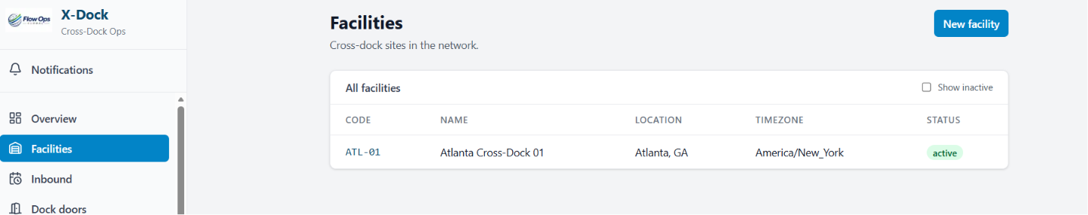
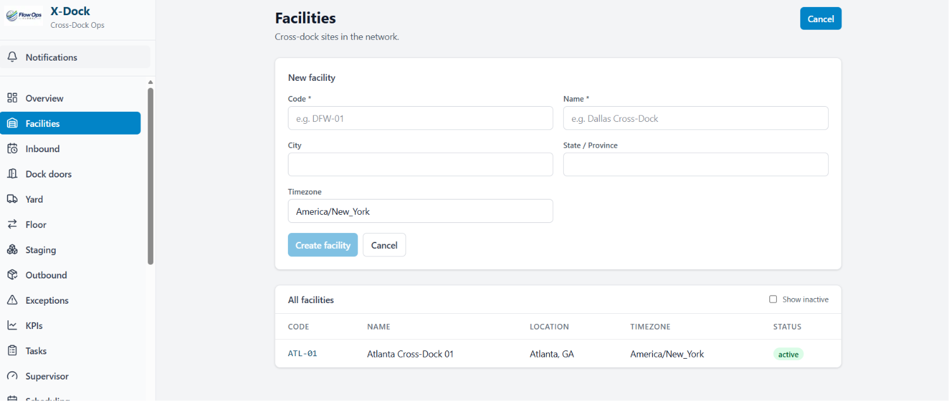
FACILITIES & MASTER DATA
Cross-Dock Facility Network
Every site in the network with its own code, timezone and operating state
The facility is the anchor: every appointment, pallet, task and KPI is scoped to one site
Code, name, location, timezone and status on a single register
New facilities created inline from the list, no separate setup module
Inactive sites hidden by default but retained so history stays valid
Timezone drives appointment windows, dwell clocks and KPI day boundaries
Facility scoping means users only see the site they are assigned to
Cross-Dock Operating System
Notes:
The facility record is the anchor for everything else in the platform.

Slide 5
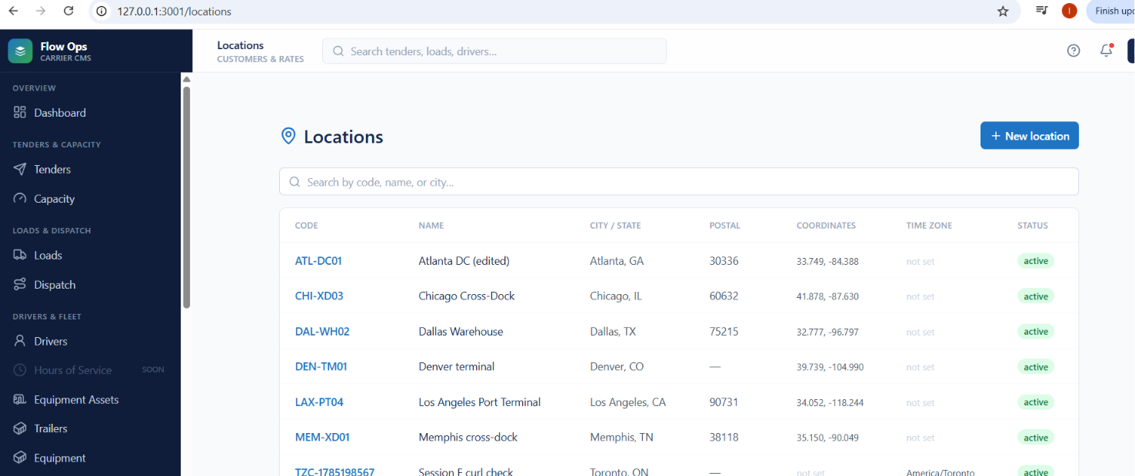
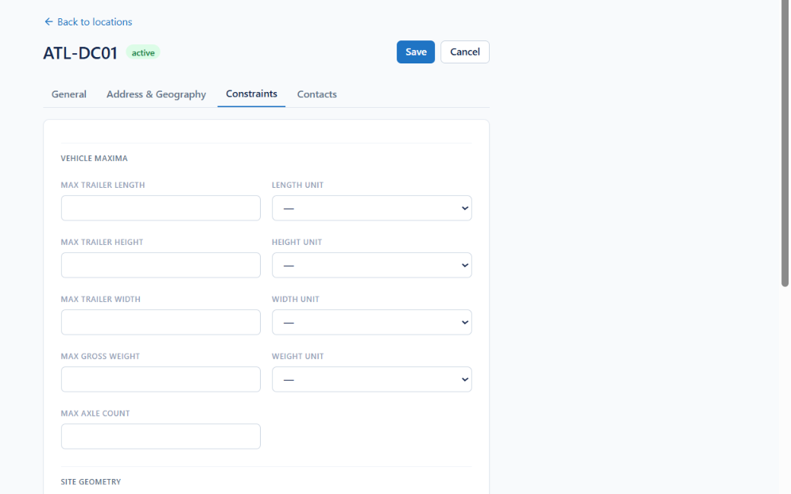
FACILITIES & MASTER DATA
Locations & Site Constraints
Geocoded locations carrying the physical limits each site can accept
Every location geocoded with postal code, coordinates and timezone
Searchable by code, name or city across the whole network
Vehicle maxima held per site: trailer length, height, width, gross weight, axle count
Site geometry such as turning radius and dock approach captured with units
Constraints validated when appointments are booked and doors assigned
Address, geography and site contacts kept on the same record
Cross-Dock Operating System
Notes:
Constraints are master data, so bookings are validated instead of corrected later.

Slide 6
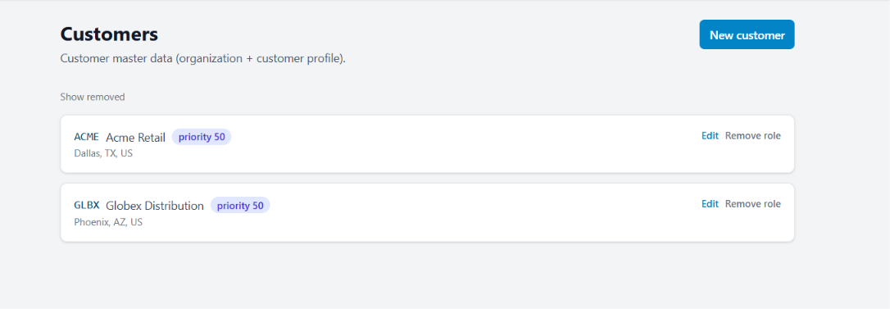
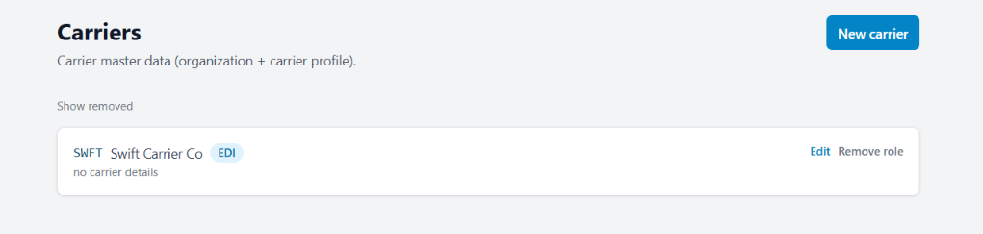
FACILITIES & MASTER DATA
Customers & Carriers
One organization record, distinct trading roles
An organization can hold a customer profile, a carrier profile or both
Short codes appear on every screen, label and document
Customer priority ranking drives sortation and staging decisions
EDI-capable carriers flagged for automated tender and status exchange
Roles are removed rather than deleted, so history stays intact
Removed records shown on demand for audit and reactivation
Cross-Dock Operating System
Notes:
One party model avoids duplicate records when a partner is both shipper and carrier.

Slide 7
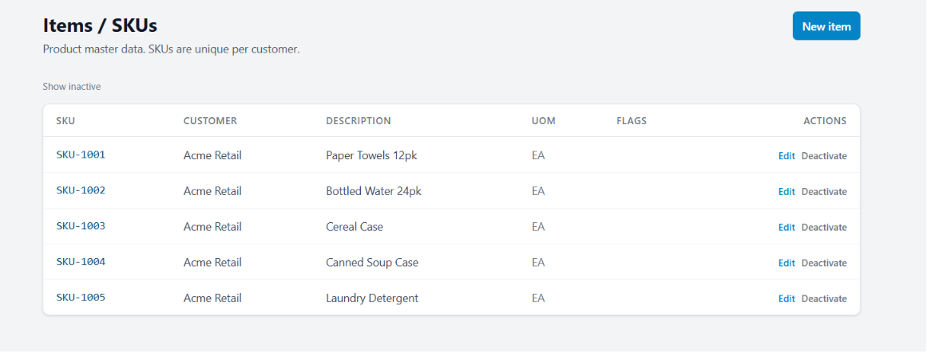
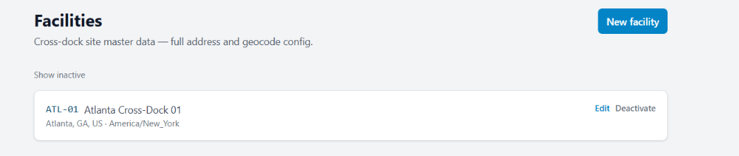
FACILITIES & MASTER DATA
Items & SKUs
Product master scoped per customer, with the site register beside it
SKUs unique per customer, so overlapping customer numbering is safe
Description and unit of measure on every item
Handling flags drive door, lane and temperature eligibility downstream
Deactivate rather than delete keeps received and shipped history valid
Facility master data carries full address and geocode configuration
Master data changes run through a request and approval workflow
Cross-Dock Operating System
Notes:
Per-customer SKU scoping is what lets multiple shippers share one dock.

Slide 8
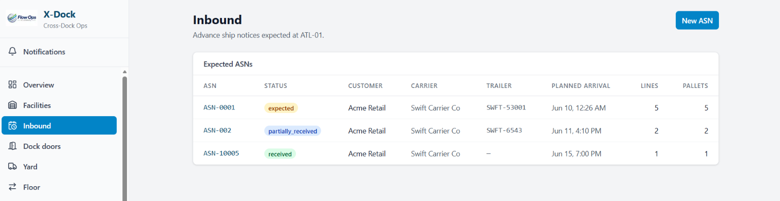
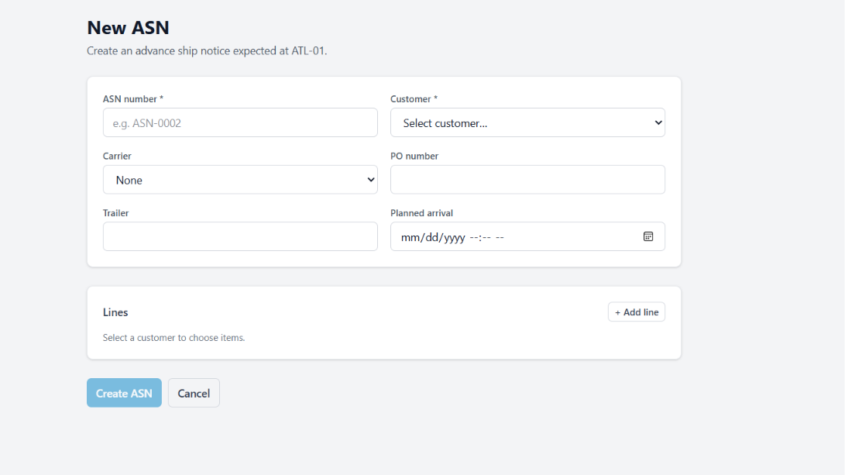
INBOUND & APPOINTMENTS
Advance Ship Notices
Expected freight, line by line, before the trailer arrives
ASN register per facility with expected, partially received and received states
Customer, carrier, trailer and planned arrival on every row
Line and pallet counts show the receiving workload at a glance
New ASN captures PO number, carrier, trailer and planned arrival
Lines selected from the customer’s own SKU catalogue
Received quantities compare back to ASN lines to expose shortage and overage
Cross-Dock Operating System
Notes:
The ASN is the expectation the dock measures reality against.

Slide 9
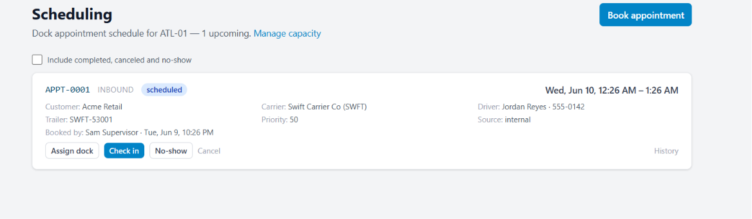
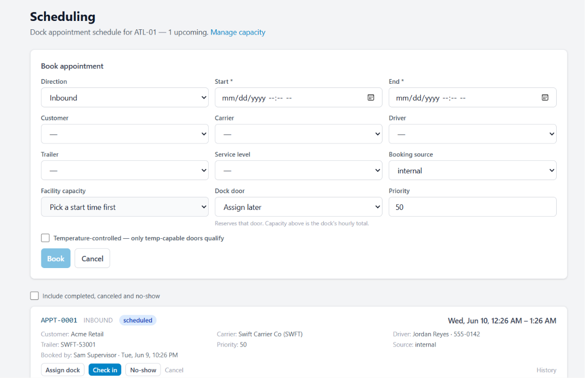
INBOUND & APPOINTMENTS
Dock Appointment Scheduling
Capacity-checked booking with a controlled arrival lifecycle
Inbound and outbound appointments booked against hourly facility capacity
Customer, carrier, driver, trailer and service level captured on the booking
Dock door either reserved at booking or assigned closer to arrival
Temperature-controlled bookings restricted to temp-capable doors
Priority ranks the appointment when the dock is oversubscribed
Check in, no-show and cancel actions with full appointment history
Cross-Dock Operating System
Notes:
Capacity protection is what keeps the dock from being oversold.

Slide 10
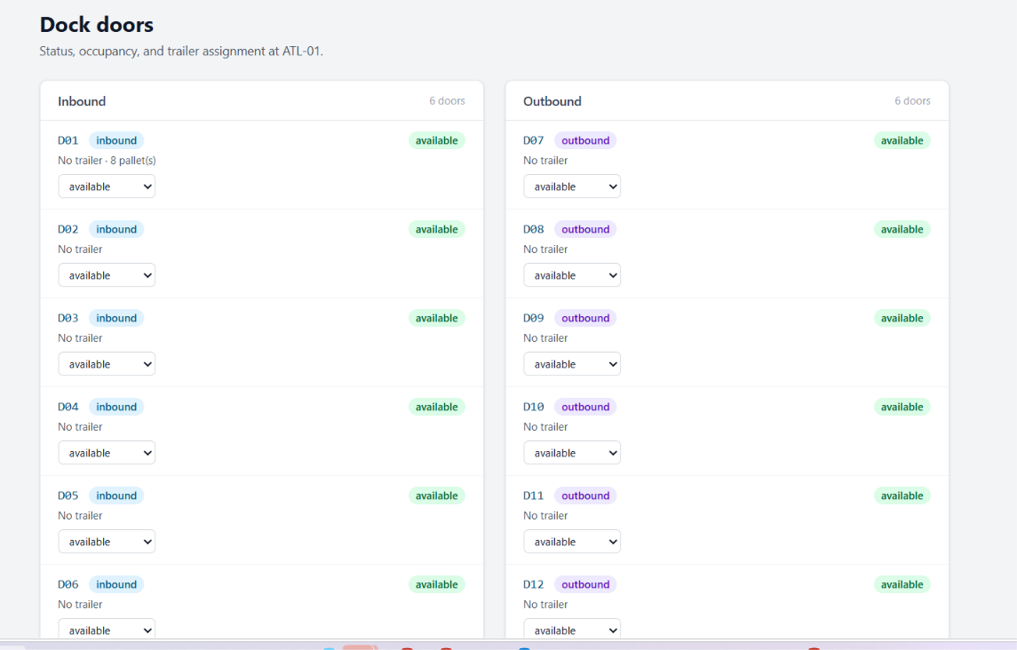
DOCK, YARD & FLOOR
Dock Door Control
Inbound and outbound door status, occupancy and trailer assignment
Doors grouped by direction, with occupancy visible per door
Live status: available, occupied, blocked or under maintenance
Trailer currently at the door and pallets in progress shown on the card
Status changed inline by the dock supervisor, no separate screen
Door rules and blackout windows restrict what each door can accept
Assignment history retained for dwell and utilisation reporting
Cross-Dock Operating System
Notes:
Door state is the single most contested resource on the dock.

Slide 11
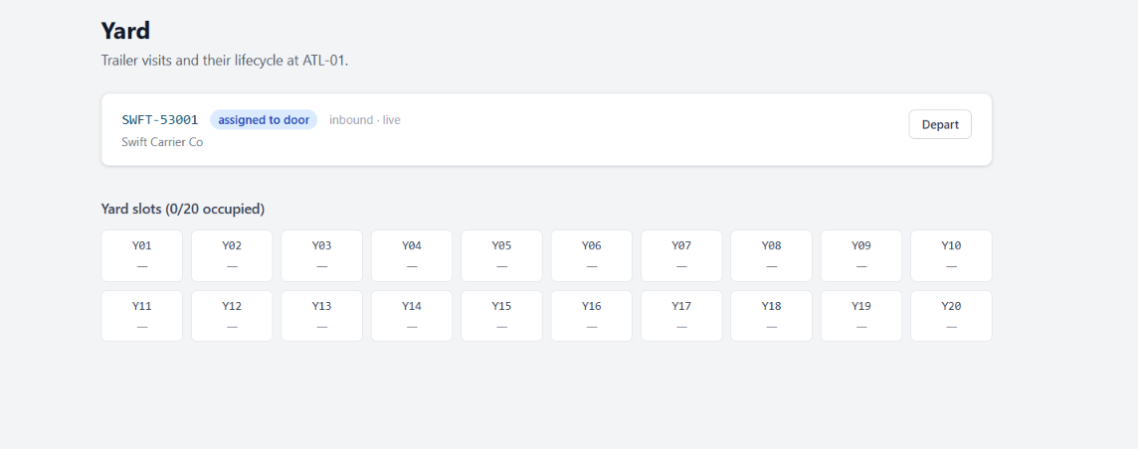
DOCK, YARD & FLOOR
Yard & Trailer Visits
Trailer lifecycle from gate-in to departure across the whole yard
Every trailer visit tracked with carrier, direction and live state
Trailers assigned to a door separated from those parked in the yard
Twenty yard slots with occupancy visible at a glance
Depart closes the visit, frees the slot and stamps the gate-out time
Yard moves issued as tasks with a driver and a destination slot
Slot reservations and dispatch priority prevent yard congestion
Cross-Dock Operating System
Notes:
The yard is a queue; the platform treats it as one.

Slide 12
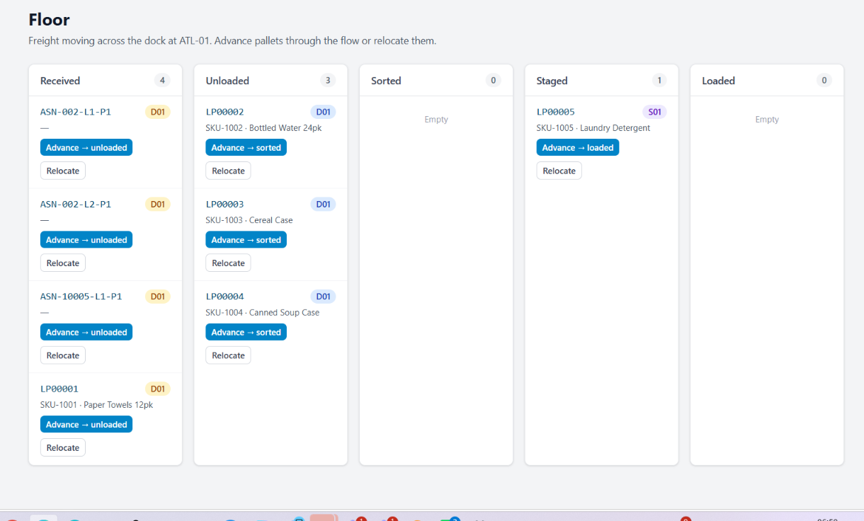
DOCK, YARD & FLOOR
Freight on the Floor
Received, unloaded, sorted, staged, loaded — one board
Pallets advance through five operational states with a single action
Each card carries licence plate, SKU, description and current door or lane
Relocate moves freight without breaking its movement history
Counts per column expose exactly where the dock is backing up
Every advance writes a freight movement and a scan event
Handling-unit contents traced from receipt through to load
Cross-Dock Operating System
Notes:
This is the screen a dock lead lives on during a shift.

Slide 13
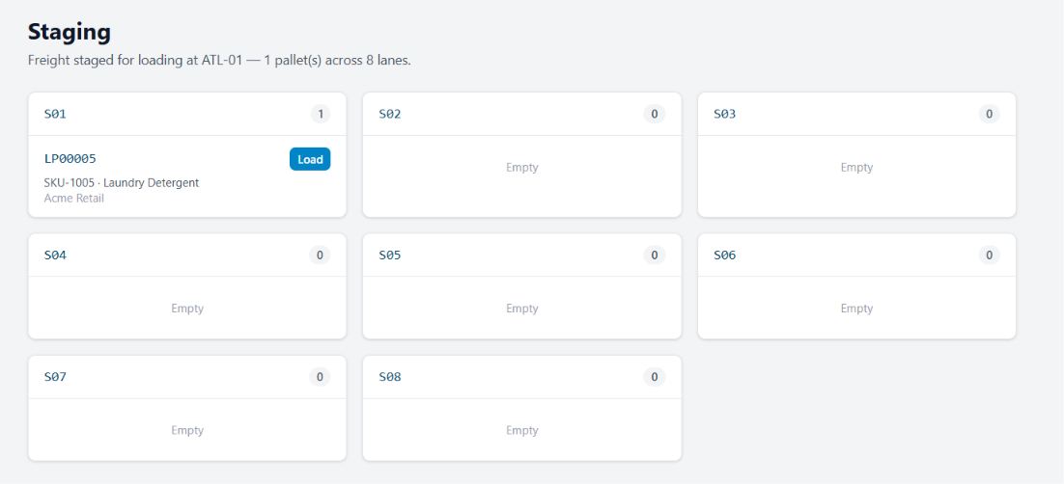
DOCK, YARD & FLOOR
Staging Lanes
Freight staged by outbound lane, ready to load
Lanes shown with live pallet counts, empty lanes included
Each staged pallet shows SKU, description and owning customer
Load moves the pallet straight onto the outbound load
Lane compatibility and capacity checked before freight is staged
Empty lanes visible so supervisors can rebalance mid-shift
Staging snapshots feed dwell and departure-readiness metrics
Cross-Dock Operating System
Notes:
Staging is where sortation decisions become physical.

Slide 14
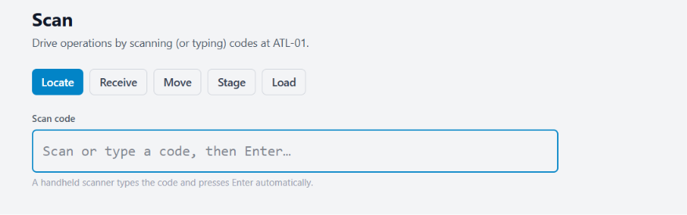
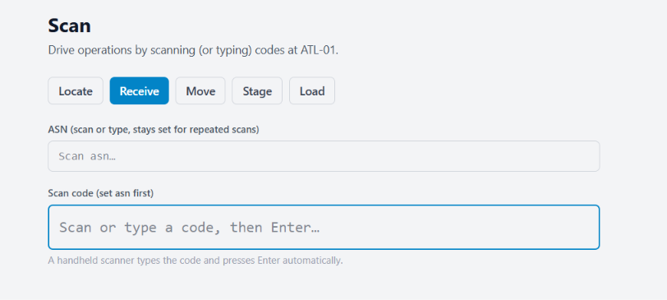
DOCK, YARD & FLOOR
Scan-Driven Execution
Five scan modes on one screen, built for a handheld
Locate resolves any code: pallet, ASN, door, lane or load
Receive holds the ASN context so pallets scan in a continuous run
The handheld types the code and presses Enter, no extra taps
Every scan writes an event with user, device, location and timestamp
Scan policies define which process steps must be scanned
Blocked scans raise an exception with a controlled override path
Cross-Dock Operating System
Notes:
Scanning is the primary interface for the floor, not a side feature.

Slide 15
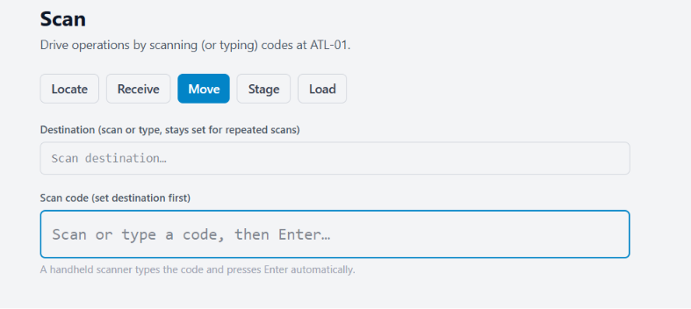
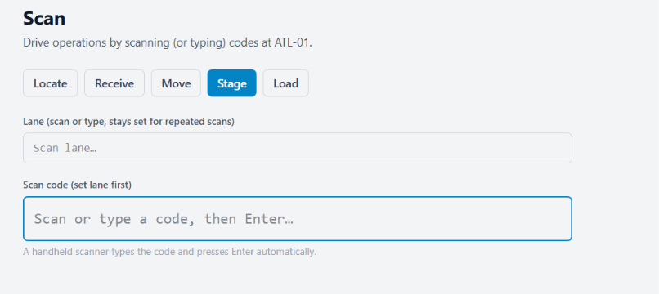
DOCK, YARD & FLOOR
Move & Stage by Scan
Destination-first scanning keeps hands on the freight
Move mode sets the destination once, then scans pallet after pallet
Stage mode locks the lane and stages a run of pallets into it
Sticky context removes repeated destination entry between scans
Invalid destinations and incompatible lanes rejected at scan time
Movements post immediately to the floor board and the audit trail
Scan compliance measured per shift as a governed KPI
Cross-Dock Operating System
Notes:
Sticky destination is the difference between 8 and 30 seconds per pallet.

Slide 16
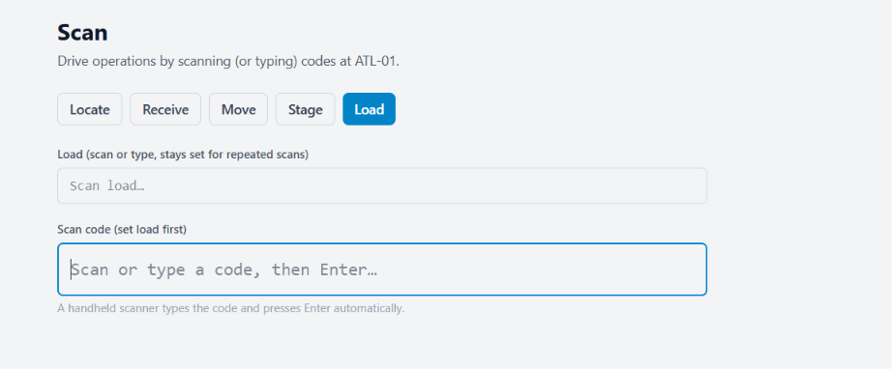
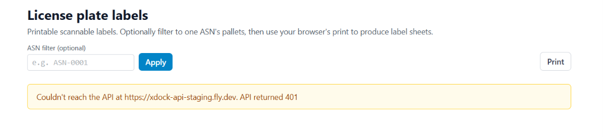
DOCK, YARD & FLOOR
Loading & Licence Plate Labels
Load by scan, with printable pallet labels
Load mode sets the outbound load, then scans each pallet aboard
Load accuracy validated against planned shipment content
Printable licence plate labels for pallets built on the dock
Labels filtered to one ASN for a single receiving run
Label sheets printed straight from the browser, no print client
Service connection state surfaced explicitly when labels cannot be reached
Cross-Dock Operating System
Notes:
Labels make freight scannable from the moment it is built.

Slide 17
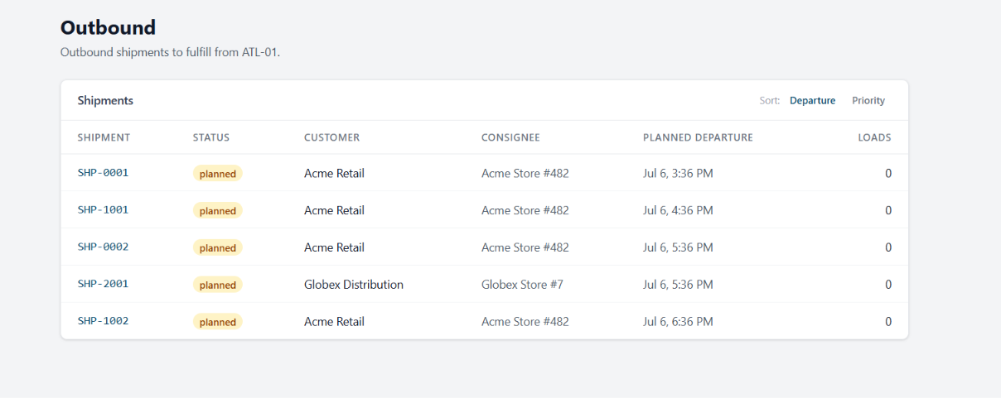
OUTBOUND & LOAD BUILD
Outbound Shipments
What has to leave the dock, ordered by departure or priority
Shipments listed with customer, consignee and planned departure
Sort by departure time or by operational priority
Load count shows what has already been built per shipment
Status carries the shipment from planned through to departed
Shipment lines and stops link back to the originating ASN and order
Departure readiness checked before closeout is permitted
Cross-Dock Operating System
Notes:
Outbound demand is what the whole floor is working toward.

Slide 18
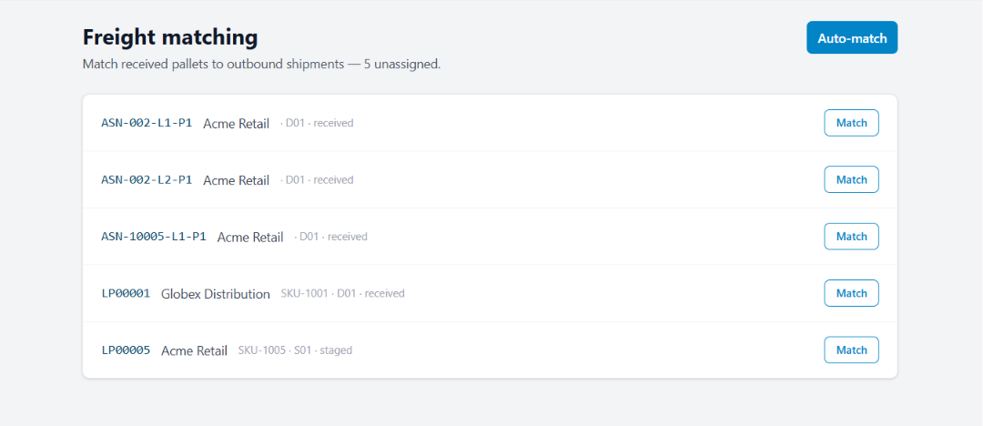
OUTBOUND & LOAD BUILD
Freight Matching
Received pallets tied to the outbound shipment that needs them
Unassigned received and staged pallets queued with door or lane
Auto-match applies configured matching rules across the whole queue
Manual match handles freight the rules cannot resolve
Rules configured per customer, route and service level
Overrides recorded with a reason for governance review
Unmatched freight raises an exception before departure, not after
Cross-Dock Operating System
Notes:
Matching is where cross-dock either works or turns into storage.

Slide 19
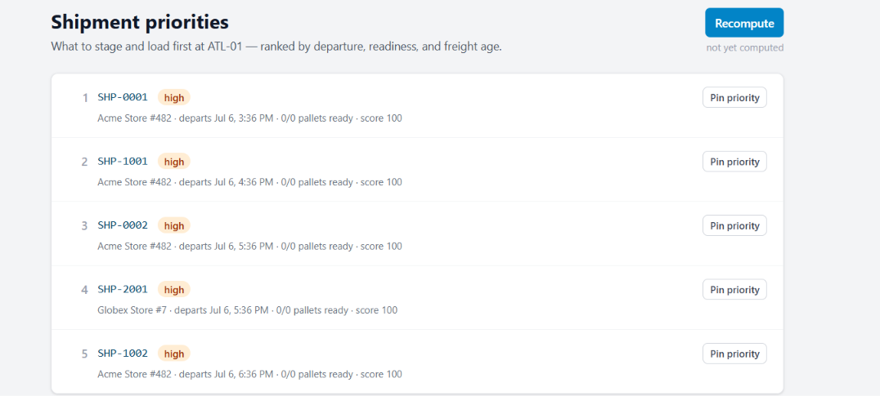
OUTBOUND & LOAD BUILD
Shipment Priorities
What to stage and load first, computed rather than guessed
Ranked queue scored on departure time, readiness and freight age
Every row shows consignee, departure, pallets ready and score
Recompute refreshes the ranking as the floor state changes
Priorities can be pinned to override the computed order
Score components stay visible so supervisors trust the ranking
Feeds the labour queue and the staging sequence
Cross-Dock Operating System
Notes:
A ranked queue replaces the argument about what to load next.

Slide 20
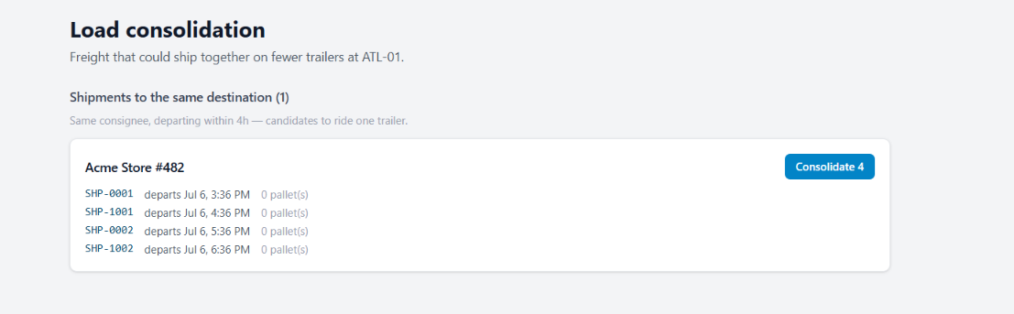
OUTBOUND & LOAD BUILD
Load Consolidation
Freight that could ride one trailer instead of four
Shipments grouped by consignee and departure window
A four-hour window identifies genuinely combinable freight
One action consolidates the group into a single load
Pallet counts shown so trailer capacity can be judged
Fewer trailers and fewer departures for the same freight
Consolidation recorded against the load for audit and costing
Cross-Dock Operating System
Notes:
This is the clearest hard-dollar saving in the product.

Slide 21
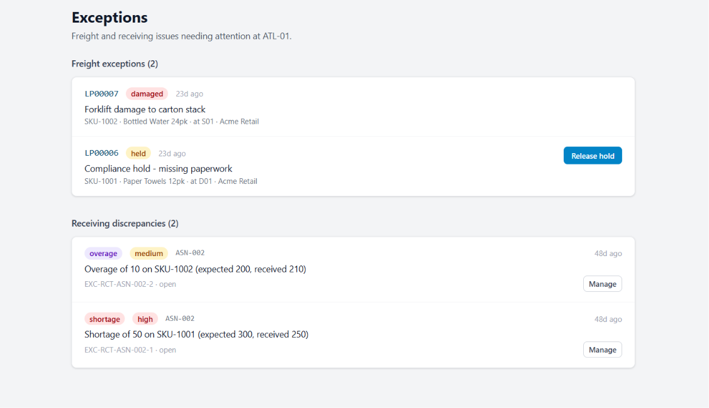
EXCEPTIONS & GOVERNANCE
Exceptions & Holds
Freight issues and receiving discrepancies in one queue
Freight exceptions such as damage and holds kept separate from receiving discrepancies
Each record names the pallet, SKU, location and customer
Compliance holds released only by an authorised role
Overage and shortage quantified against the ASN line
Severity drives escalation and notification routing
Age shown on every open item so nothing sits quietly
Cross-Dock Operating System
Notes:
Exceptions are worked from a queue, not from memory.

Slide 22
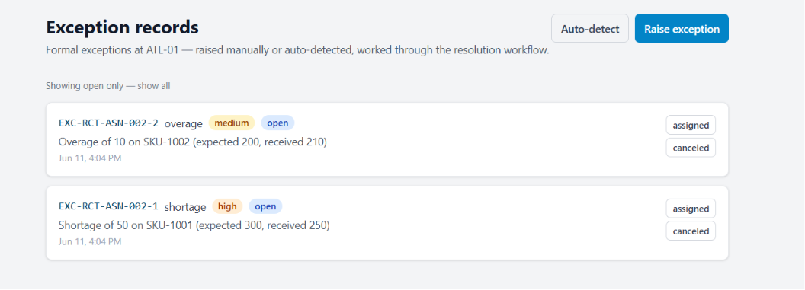
EXCEPTIONS & GOVERNANCE
Exception Records
The formal case file behind every exception
Exceptions raised manually or auto-detected from validation failures
Type, severity and status follow a controlled lifecycle
Assignment and cancellation actions record the acting user
Open-only view by default, full history available on demand
Close reasons, root causes and corrective actions captured
Financial exposure recorded for detention, chargeback and claim risk
Cross-Dock Operating System
Notes:
The case file is what turns an incident into a preventable pattern.

Slide 23
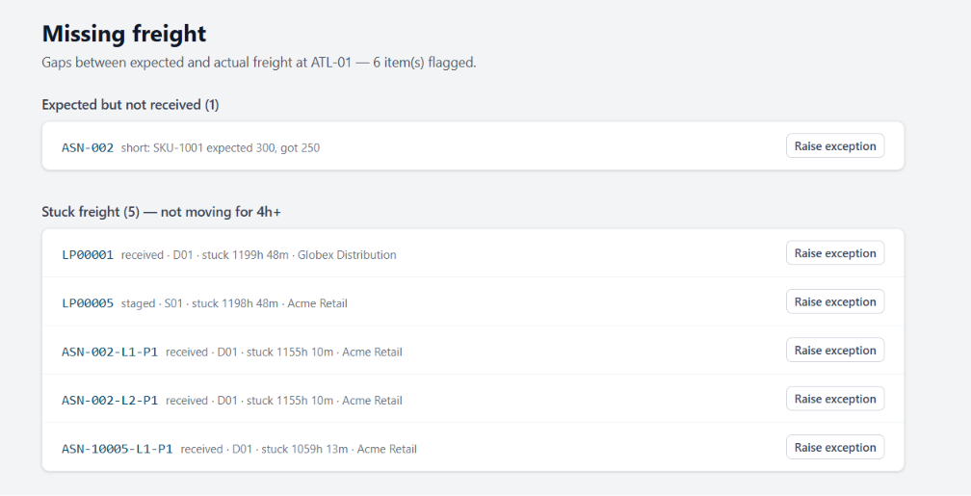
EXCEPTIONS & GOVERNANCE
Missing Freight
Gaps between what was expected and what is actually here
Expected-but-not-received lines shown with quantity variance
Stuck freight flagged after four hours without movement
Dwell duration and current location on every flagged item
Owning customer shown so notification can go out early
One action raises a formal exception from any row
Detection runs continuously rather than as a shift-end review
Cross-Dock Operating System
Notes:
Finding freight before the customer does is the whole point.

Slide 24
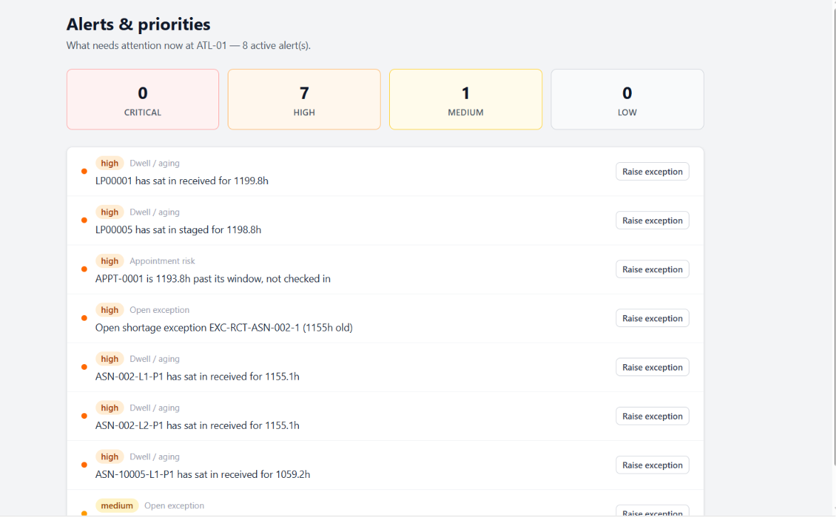
EXCEPTIONS & GOVERNANCE
Alerts & Priorities
What needs attention right now, ranked by severity
Counts by critical, high, medium and low across the facility
Dwell and aging alerts on freight that has stopped moving
Appointment risk raised when a booking passes its window unchecked-in
Open exceptions aged against their SLA policy
Raise-exception turns any alert into a tracked case
A single screen for the shift-start stand-up
Cross-Dock Operating System
Notes:
This is the shift stand-up screen.

Slide 25
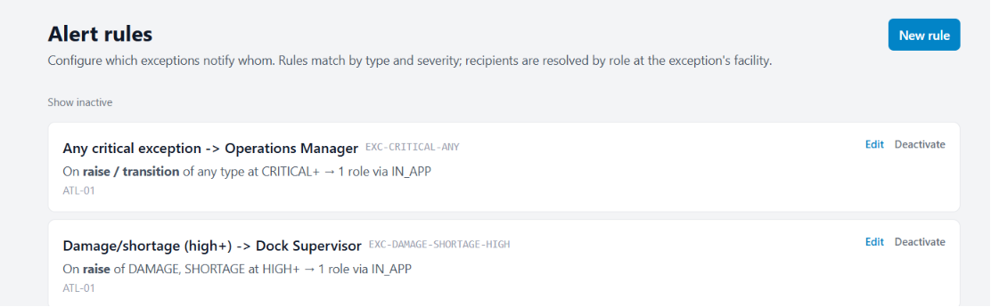
EXCEPTIONS & GOVERNANCE
Alert Rules
Who gets told, configured rather than coded
Rules match exceptions by type and severity threshold
Recipients resolved by role at the exception’s own facility
Triggers on raise, on transition, or both
Delivery channel chosen per rule
Rules scoped per facility and deactivated without deletion
Every notification logged as a communication event
Cross-Dock Operating System
Notes:
Escalation paths are configuration, so they can change without a release.

Slide 26
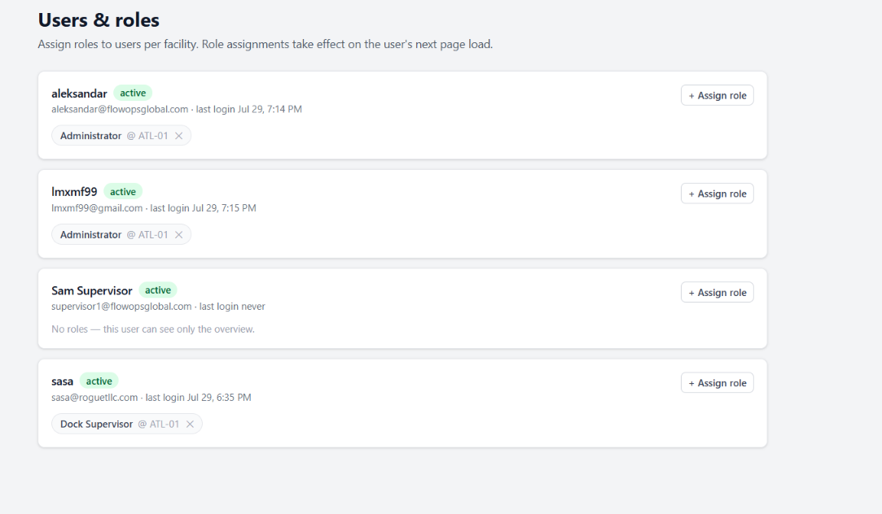
EXCEPTIONS & GOVERNANCE
Users & Roles
Access granted per user, per facility
Role assignments scoped to a facility rather than the whole platform
A user with no roles sees only the overview
Multiple roles per user across multiple sites
Last login visible for periodic access review
Assignments take effect on the user’s next page load
Grants and revocations both recorded in the audit trail
Cross-Dock Operating System
Notes:
Per-facility scoping is what makes multi-site operation safe.

Slide 27
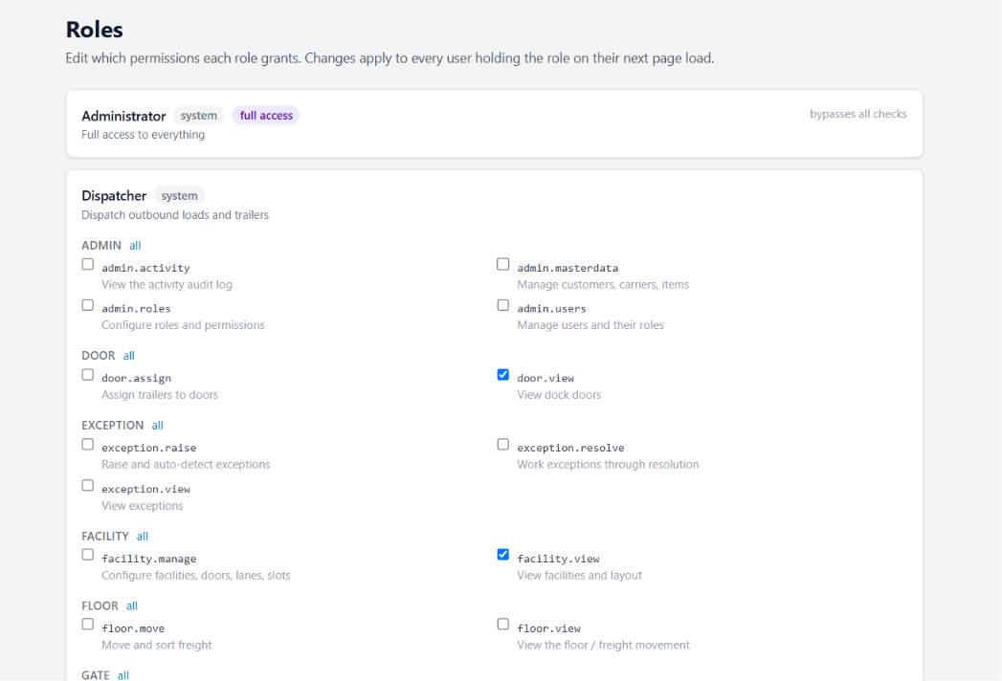
EXCEPTIONS & GOVERNANCE
Roles & Permissions
Permission sets written in operational language
System roles for administrator, dispatcher, dock supervisor and more
Permissions grouped by domain: admin, door, exception, facility, floor, gate
Each permission documented in plain operational terms
The administrator role bypasses checks by design and is labelled as such
Changes apply to every holder of the role on next page load
An authority matrix defines who may override, approve or waive
Cross-Dock Operating System
Notes:
Permissions are readable by operations, not just by engineers.

Slide 28
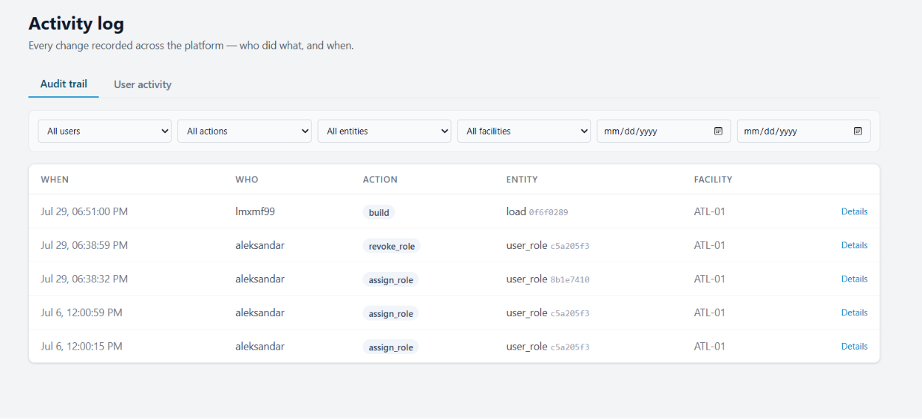
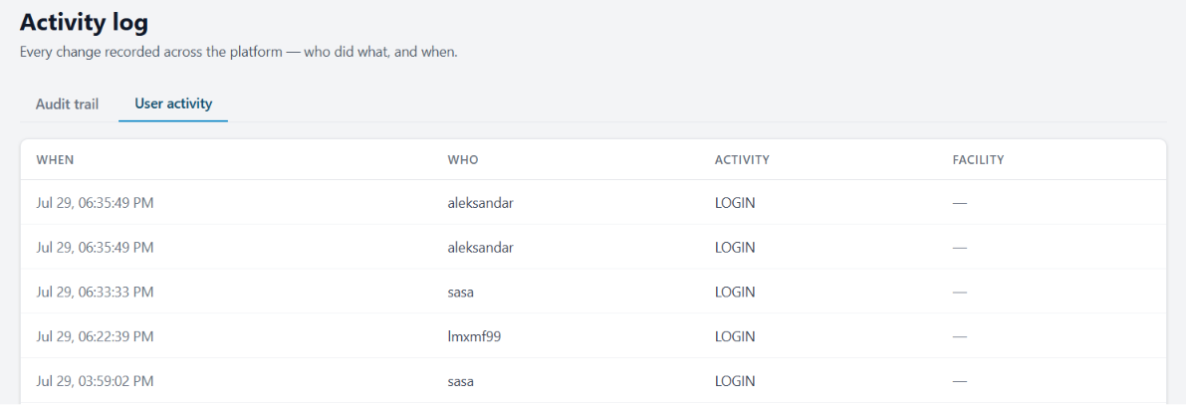
EXCEPTIONS & GOVERNANCE
Audit Trail & User Activity
Every change and every login, on the record
Audit trail records who did what, to which entity, when and where
Filters by user, action, entity, facility and date range
Entity identifiers retained so a change traces to a specific record
Detail view exposes the before-and-after payload
User activity tracked separately from data changes
Read-only by design: evidence for customer and compliance review
Cross-Dock Operating System
Notes:
Audit is evidence, so it is read-only by construction.

Slide 29
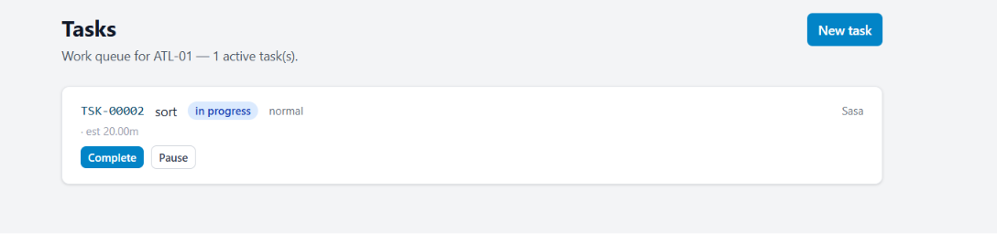
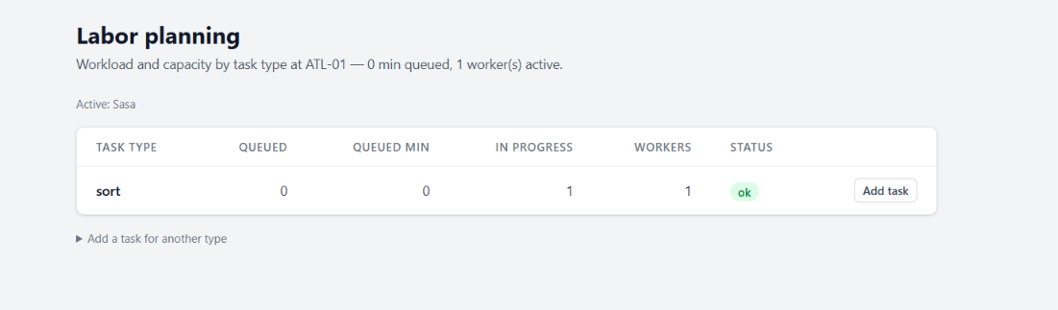
LABOUR & PERFORMANCE
Tasks & Labour Planning
Work issued as tasks, capacity judged by task type
Active work queue per facility with type, status and priority
Complete and pause actions capture real time against the task
Estimated minutes on every task for comparison against standards
Workload by task type shows queued minutes against active workers
Status flags where a task type is under-resourced right now
Tasks added directly from the planning view
Cross-Dock Operating System
Notes:
Labour is planned against measured workload, not headcount habit.

Slide 30
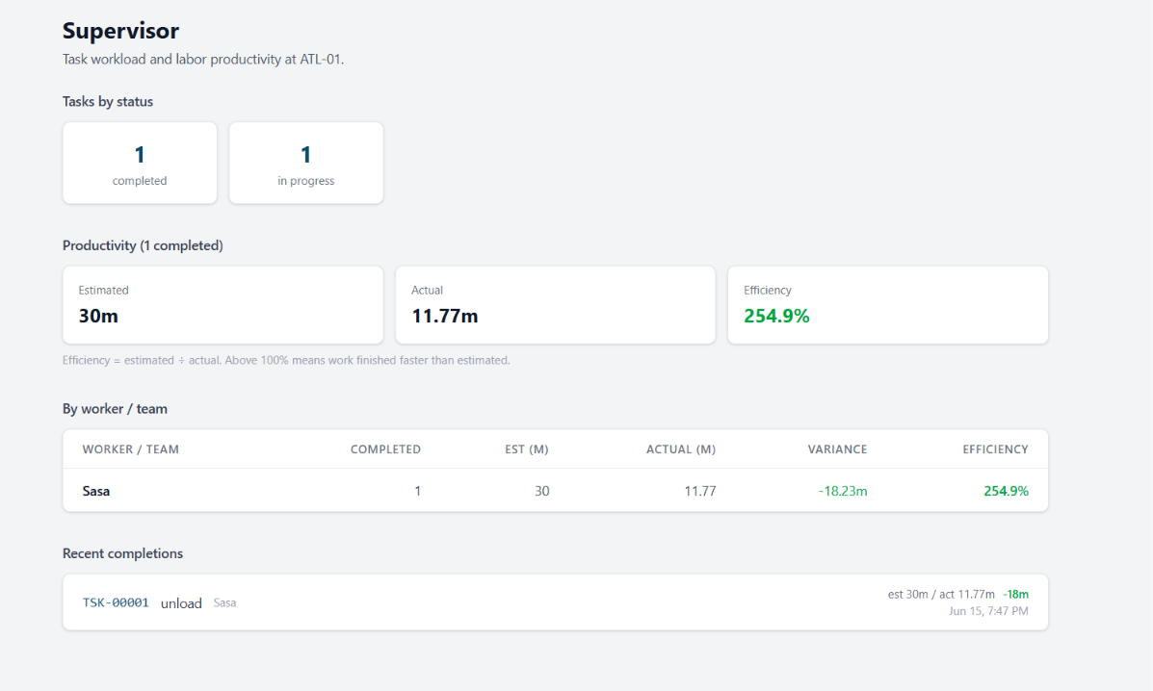
LABOUR & PERFORMANCE
Supervisor Console
Workload and labour productivity for the shift
Task counts by status across the facility
Estimated against actual minutes on completed work
Efficiency stated plainly as estimate divided by actual
Per-worker table with variance and efficiency
Recent completions listed with time and actor
Labour standards refined from measured actuals over time
Cross-Dock Operating System
Notes:
Standards improve because actuals are captured as a by-product of work.

Slide 31
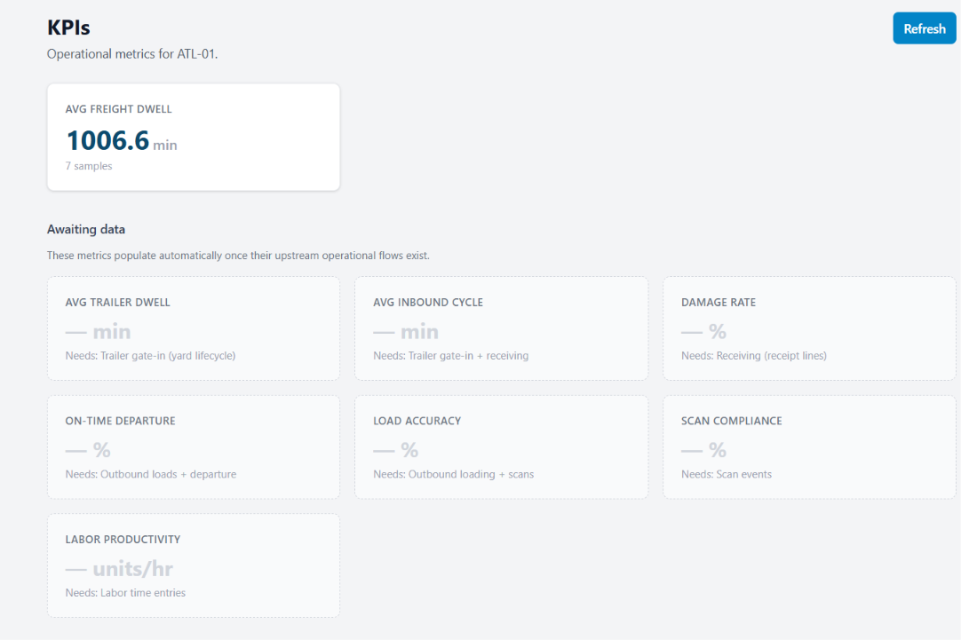
LABOUR & PERFORMANCE
Operational KPIs
Metrics that populate as the operational flows come online
Average freight dwell computed from live movement data
Awaiting-data metrics state exactly which upstream flow they need
Trailer dwell, inbound cycle and damage rate follow gate and receiving
On-time departure, load accuracy and scan compliance follow outbound
Labour productivity derived from captured time entries
Refresh recomputes from the event stream on demand
Cross-Dock Operating System
Notes:
Honest metrics: the platform says what it cannot yet measure.

Slide 32
One system from appointment to departure
Yard, dock, floor, staging, outbound and exceptions share one model, so every pallet traces back to the ASN line it arrived on and forward to the load it left on.
BUILT FOR THE FLOOR
GOVERNED BY CONFIGURATION
PROVABLE
Scan-first execution, sticky context and one-action state changes, designed for a handheld and a moving dock.
Door rules, capacity protection, scan enforcement, authority limits and alert routing all change without a release.
Immutable audit trail, chain of custody, exception case files and KPI definitions your customers can be shown.
Flow Ops Global
Cross-Dock Operating System
Notes:
Three things to leave them with, then the ask.

Slide 33
Contact
LOCATION
PHONE
EMAIL
Toronto, Ontario, Canada
+1 (416) 402-4551
miguel@flowopsglobal.com
flowopsglobal.com
Cross-Dock Operating System
Notes:
Close with a working session on their dock, doors and appointment volumes.

