Slide 1

Enterprise Carrier Management System
Transform transportation operations through one connected platform
Flow Ops Global
Product Overview
Notes:
Open with the platform framing: one connected system for transportation operations.

Slide 2
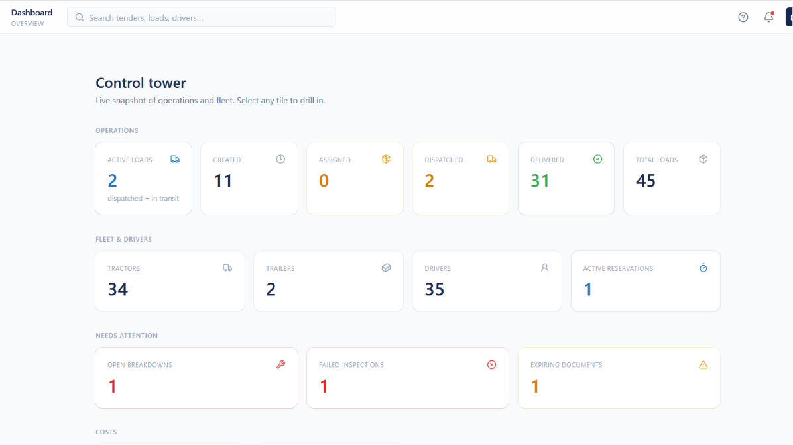
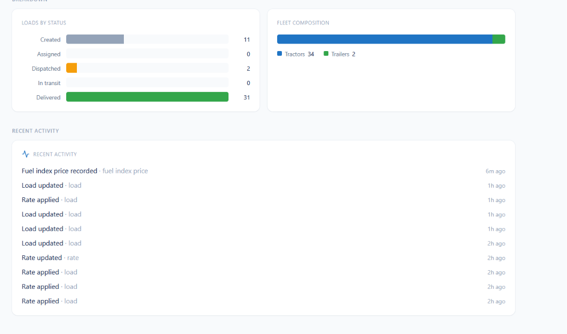
OPERATIONS
Executive Control Tower
Real-time operational visibility across transportation execution
Centralized visibility across every active load in the network
Load lifecycle tracked from creation through delivery
Status breakdown of created, assigned, dispatched, in-transit and delivered loads
Tractor, trailer and driver availability at a glance
Fleet capacity and active reservations in a single view
Critical exceptions surfaced instantly: breakdowns, inspections, documents
Recent Activity feed logs load, rate and fuel index changes
Timestamped events provide a complete audit trail
Drill down from any tile into detailed operational metrics
Supports proactive decisions on utilization and service levels
Enterprise Carrier Management Platform
Notes:
The dashboard is the daily home screen: operations, fleet, and exceptions in one place.

Slide 3
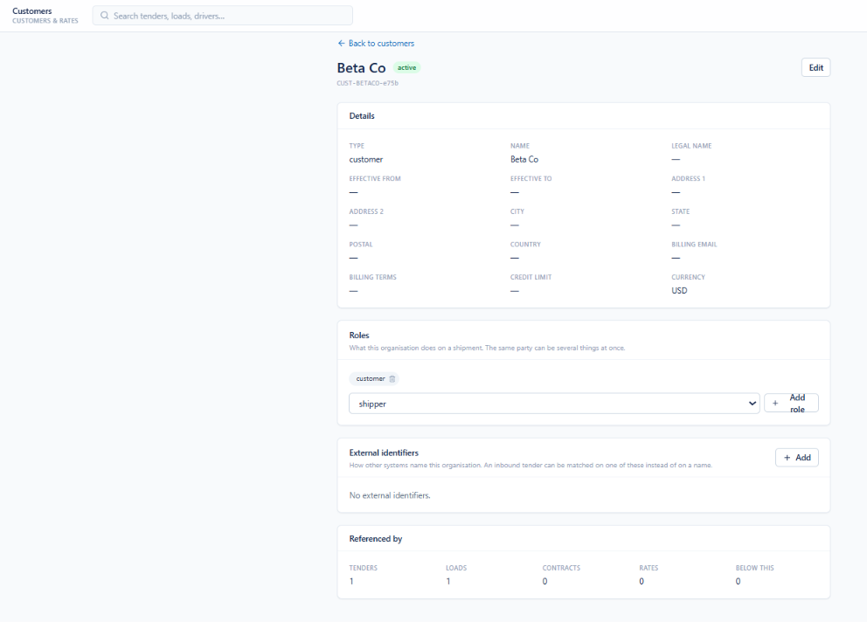
COMMERCIAL
Customer Management
A single master profile for every customer organization
Full profile of the selected customer organization
Customer name, system-generated ID and active status
Core master data including type, legal name and effective dates
Billing email, billing terms, credit limit and currency
Organization roles added or removed directly from the profile
External identifiers match inbound transactions from other systems
Edit action updates customer master data in place
References show associated tenders, loads, contracts and rates
Enterprise Carrier Management Platform
Notes:
Customer master data is the anchor record for tenders, loads, contracts and rates.

Slide 4
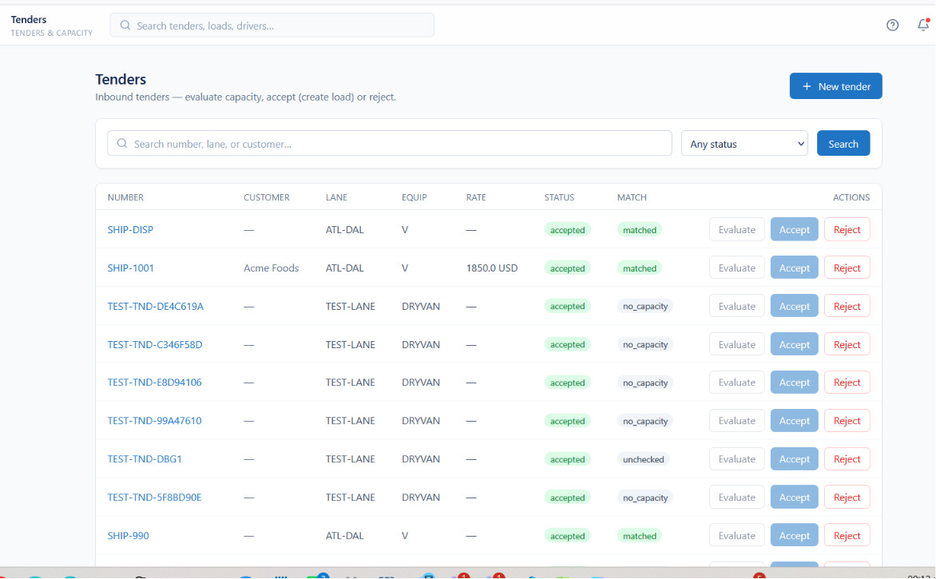
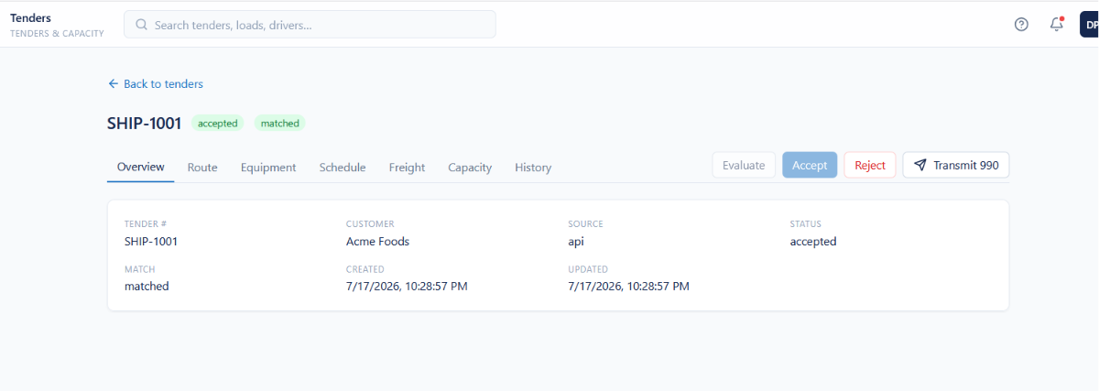
PLANNING
Tender Management
Digitized tender creation, tracking and execution
Centralized workspace for all inbound transportation tenders
Search and filter by number, customer, lane, equipment and status
Customer, lane, equipment type and freight rate on every record
Carrier and fleet capacity evaluated automatically before acceptance
Capacity matching status flags tenders needing operational review
Route, Equipment, Schedule, Freight, Capacity and History tabs
Accept, reject or transmit tenders from a single workspace
Complete visibility maintained across the tender lifecycle
Streamlined tender-to-load conversion with fewer manual steps
Improves planning accuracy and standardizes decision-making
Enterprise Carrier Management Platform
Notes:
Tender intake and evaluation: capacity is checked before anyone commits.

Slide 5
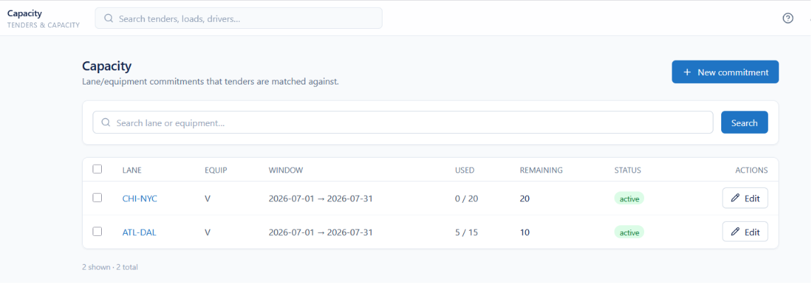
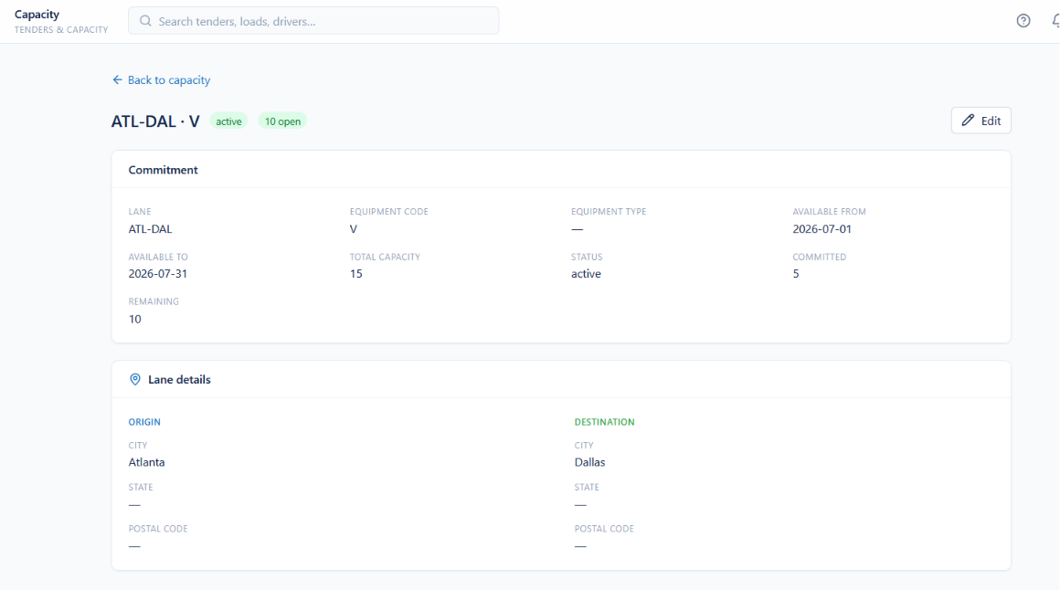
PLANNING
Capacity Management
Lane and equipment capacity commitments in one register
Central management of carrier and equipment capacity commitments
Lane-specific availability defined with planning windows
Equipment codes and supported types associated with each lane
Effective dates establish when capacity becomes available
Total, committed and remaining capacity tracked in real time
Consumption monitored against predefined commitments
Origin and destination shown for every transportation lane
Search and filter capacity by lane or equipment type
Feeds automated capacity matching during tender evaluation
Improves planning accuracy, utilization and execution efficiency
Enterprise Carrier Management Platform
Notes:
Capacity commitments are what make automated tender matching possible.

Slide 6
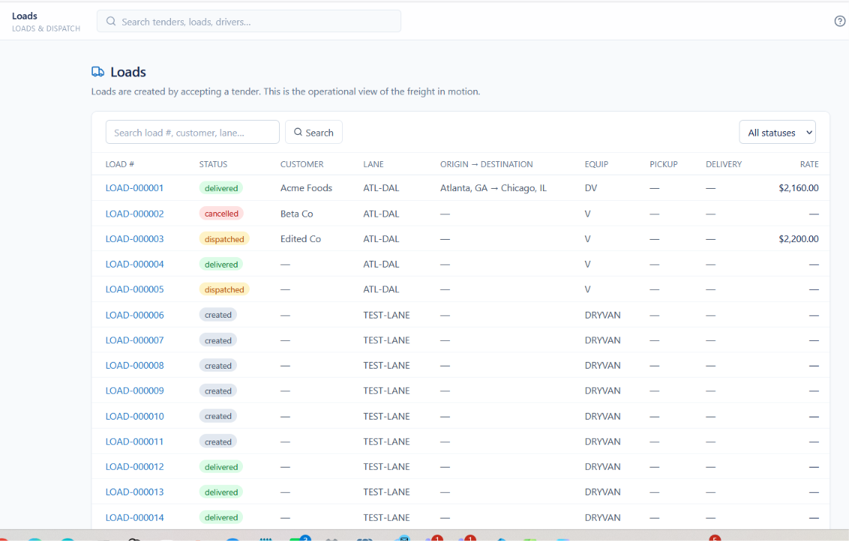
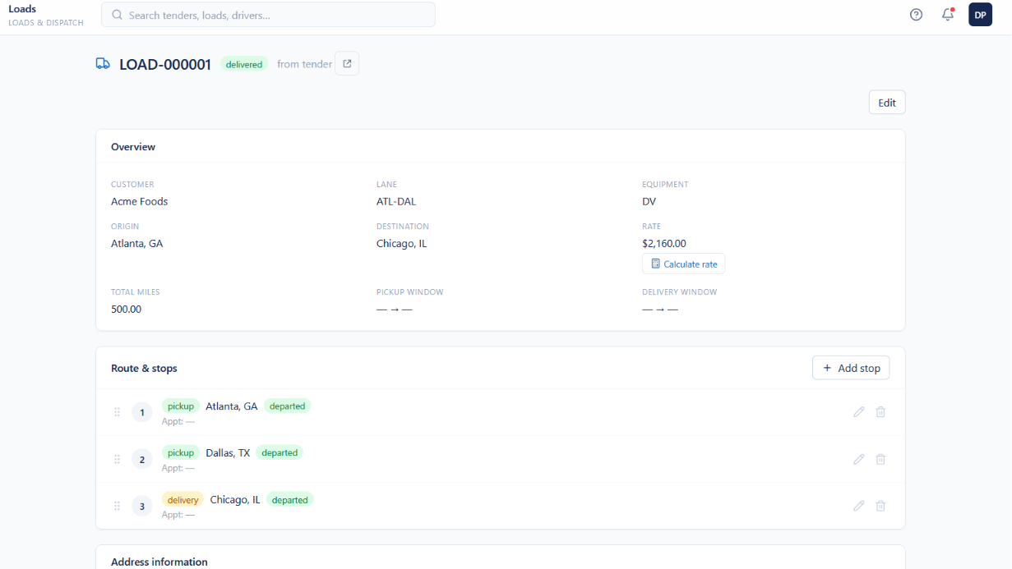
EXECUTION
Loads Management
Every load, from creation to delivery, in one workspace
Centralized operational view of all transportation loads
Search and filter by load number, customer, lane or status
Statuses tracked across Created, Dispatched, Delivered and Cancelled
Customer, lane, origin, destination and assigned equipment
Scheduled pickup, delivery and freight rate information
Transportation rate applied and freight charges calculated
Multi-stop routes visualized with pickup and delivery sequencing
Stop completion and departure status monitored in real time
Stops added, edited and managed from a single screen
Faster identification of shipment exceptions and delays
Enterprise Carrier Management Platform
Notes:
Loads is the execution workspace dispatchers live in all day.

Slide 7
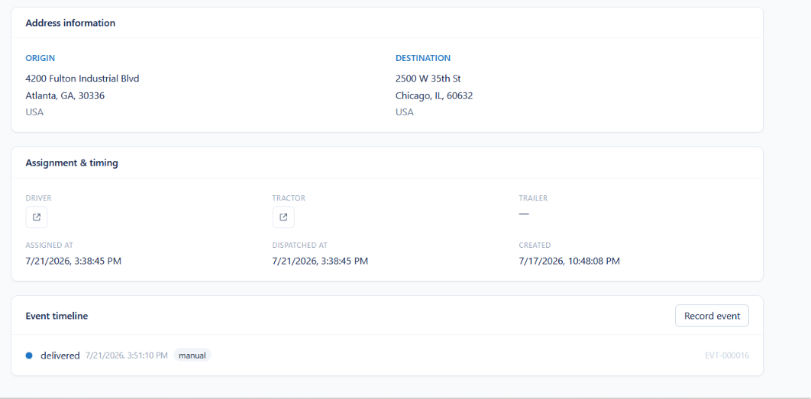
EXECUTION
Load Execution Timeline
Assignment detail and chronological event history for every load
Complete origin and destination address information
Driver, tractor and trailer assignment details per shipment
Assignment, dispatch and creation timestamps recorded
Chronological event timeline maintained for every load
Operational milestones and delivery confirmations captured
Manual event entry supports real-time shipment updates
Full shipment traceability through complete event history
Accurate audit trails for compliance and customer service
Enterprise Carrier Management Platform
Notes:
The event timeline is the audit trail customers and compliance teams ask for.

Slide 8
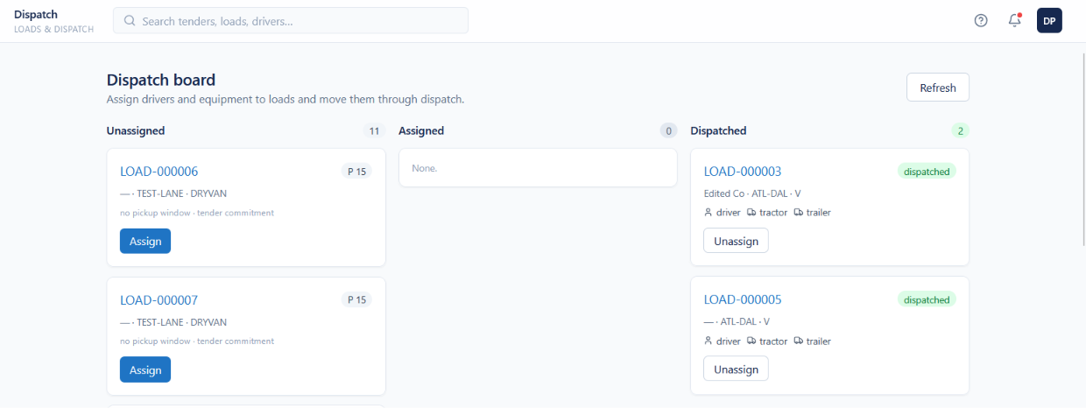
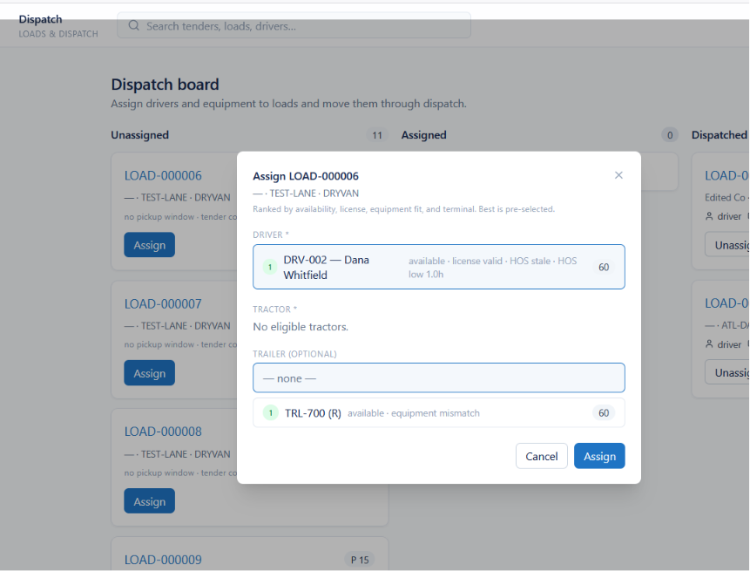
EXECUTION
Dispatch Management
A visual board with guided, rules-based resource assignment
Dispatch board organized by Unassigned, Assigned and Dispatched
Drivers, tractors and trailers assigned directly to loads
Kanban interface shows dispatch progress in real time
Loads awaiting resource assignment identified immediately
Eligible drivers ranked automatically by configurable business rules
Driver qualifications, licensing and Hours of Service validated
Equipment compatibility verified before assets are assigned
Unavailable equipment and mismatches flagged instantly
Optional trailer selection supports flexible dispatch planning
Higher fleet and driver utilization with less manual effort
Enterprise Carrier Management Platform
Notes:
Dispatch board plus guided assignment: the system ranks who can legally take the load.

Slide 9
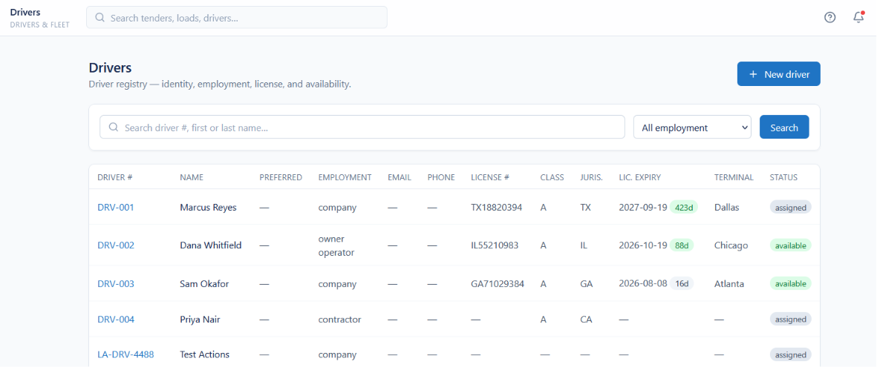
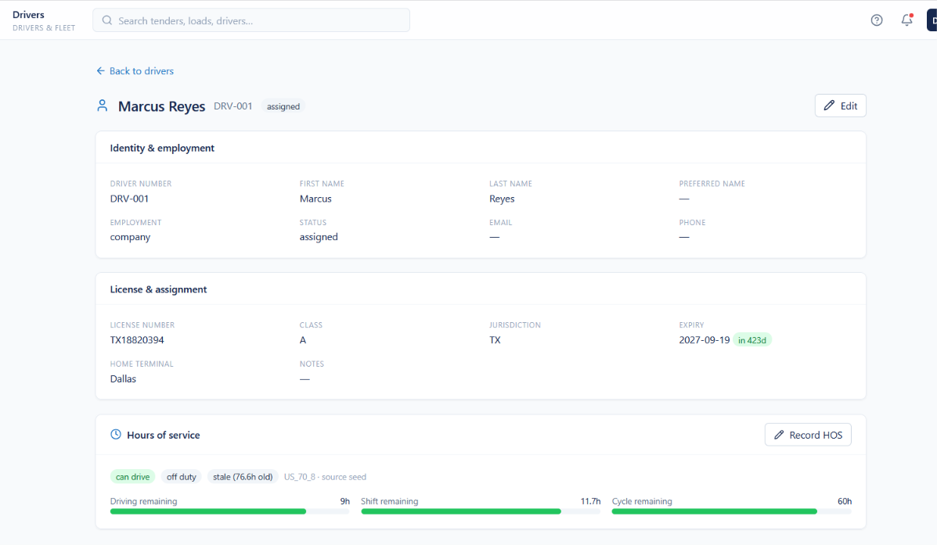
WORKFORCE
Driver Management
A single registry for driver identity, licensing and availability
Centralized registry for the entire driver workforce
Profiles, employment type and contact details maintained
Commercial license number, class and jurisdiction tracked
Expiration dates monitored to support regulatory compliance
Real-time availability and assignment status per driver
Drivers associated with home terminal and operating location
Company, owner-operator and contractor models supported
Hours of Service recorded with driving, shift and cycle hours
Search and filter by name, employment type or status
Improves utilization, compliance and dispatch eligibility decisions
Enterprise Carrier Management Platform
Notes:
Driver records carry the compliance data that gates dispatch eligibility.

Slide 10
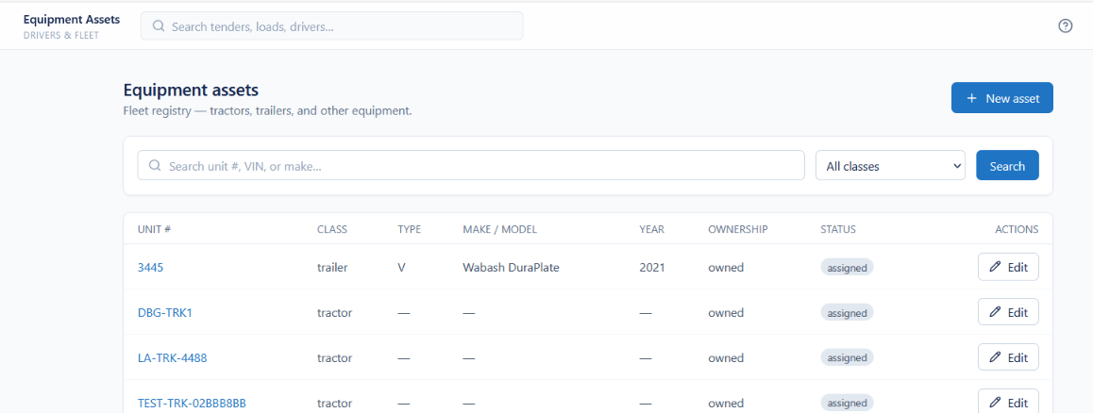
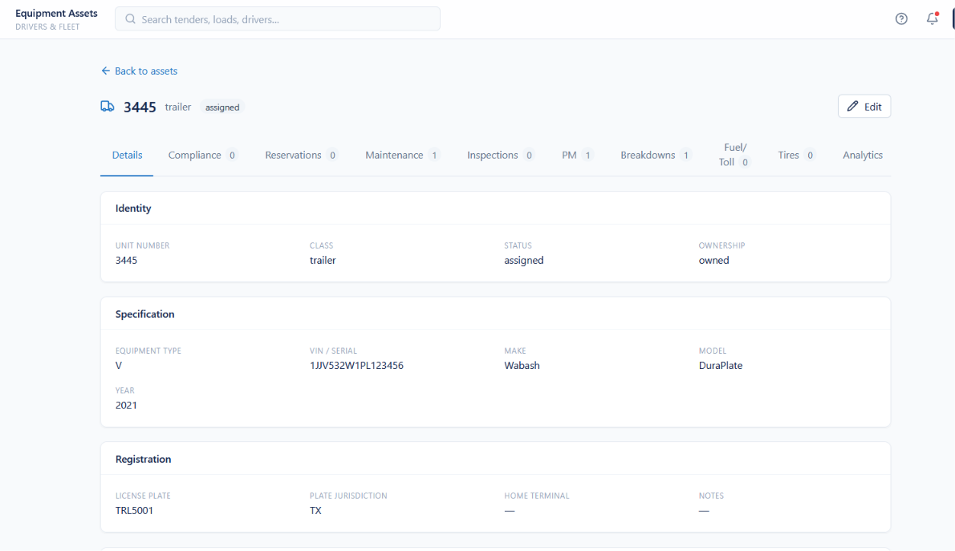
FLEET
Equipment Asset Management
Complete lifecycle visibility for tractors and transportation assets
Centralized fleet registry for tractors, trailers and assets
Search by unit number, VIN, make, model or class
Complete records covering type, year, ownership and specifications
Registration details, license plates and terminal assignments
Status and real-time assignment availability tracked
Owned and third-party fleet assets both supported
Compliance, inspections, preventive maintenance and breakdowns monitored
Reservations and availability managed for dispatch planning
Fuel, toll, tire and maintenance records held in one place
Analytics measure equipment utilization and performance
Enterprise Carrier Management Platform
Notes:
One asset record carries specs, compliance, cost and utilization.

Slide 11
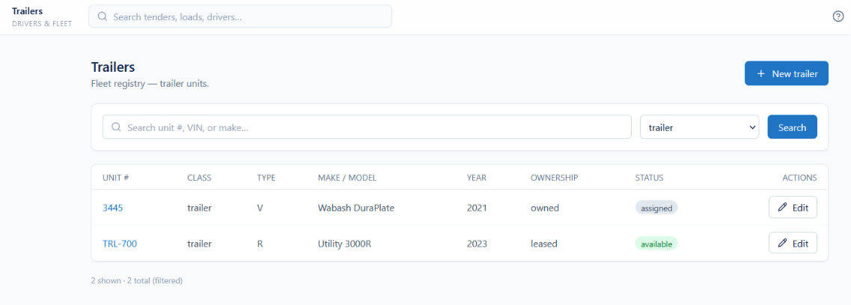
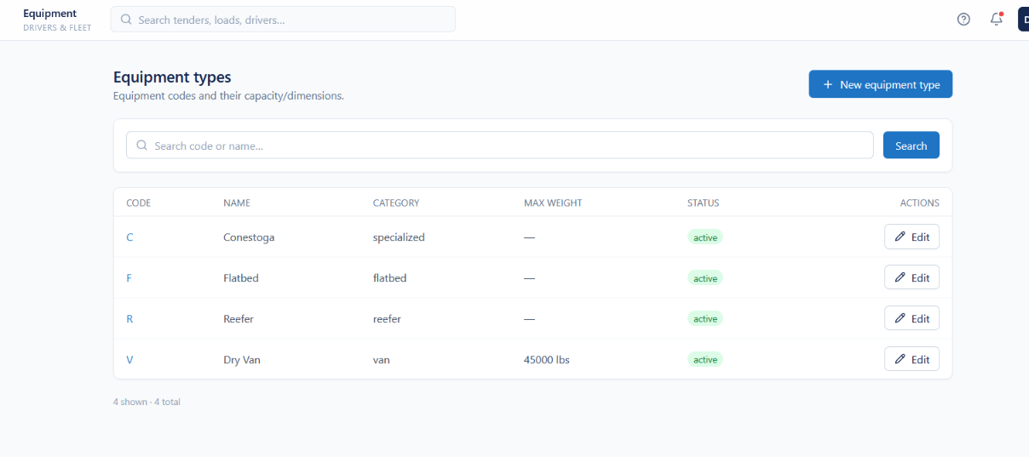
FLEET
Trailer Management
Trailer inventory and standardized equipment classifications
Centralized registry for every trailer asset
Search and filter by unit number, VIN, make, model or class
Specifications maintained for type, make, model and year
Ownership status tracked across owned and leased fleets
Real-time trailer availability and assignment status
Rapid trailer selection during load planning and dispatch
Standardized equipment codes and descriptions
Equipment classified by trailer and vehicle category
Dry Van, Reefer, Flatbed and Conestoga equipment supported
Consistent equipment matching across planning and dispatch
Enterprise Carrier Management Platform
Notes:
Trailers are tracked as their own pool, with standardized equipment types.

Slide 12
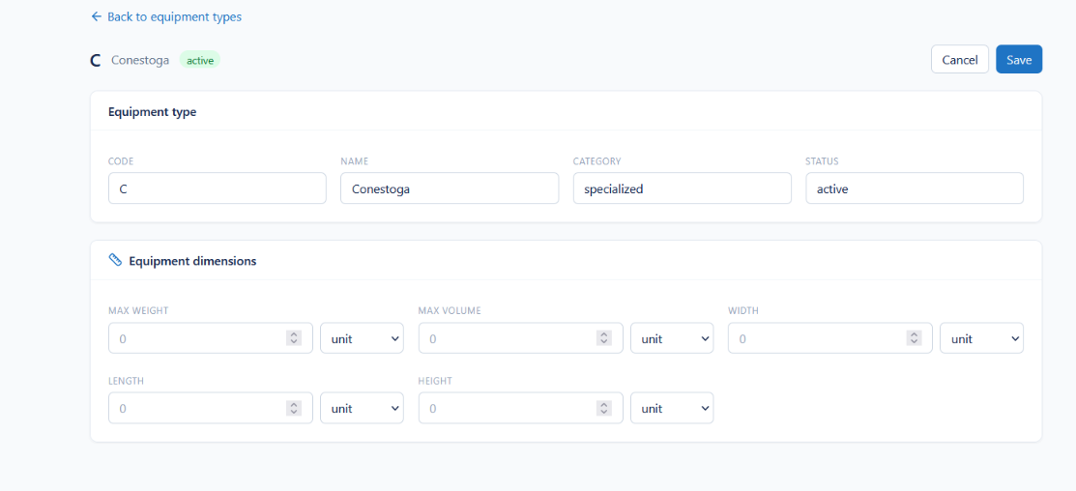
FLEET
Equipment Type Configuration
Standardized equipment definitions with capacity and dimensional limits
Equipment codes, names, categories and status configured centrally
Maximum weight, volume and dimensional constraints defined
Length, width and height specifications captured
Configurable units of measure for all equipment dimensions
Active and inactive equipment type definitions maintained
Accurate equipment matching during planning and dispatch
Load planning validated against capacity and dimensions
Consistent equipment definitions across the whole operation
Enterprise Carrier Management Platform
Notes:
Equipment type configuration is the master data behind load planning validation.

Slide 13
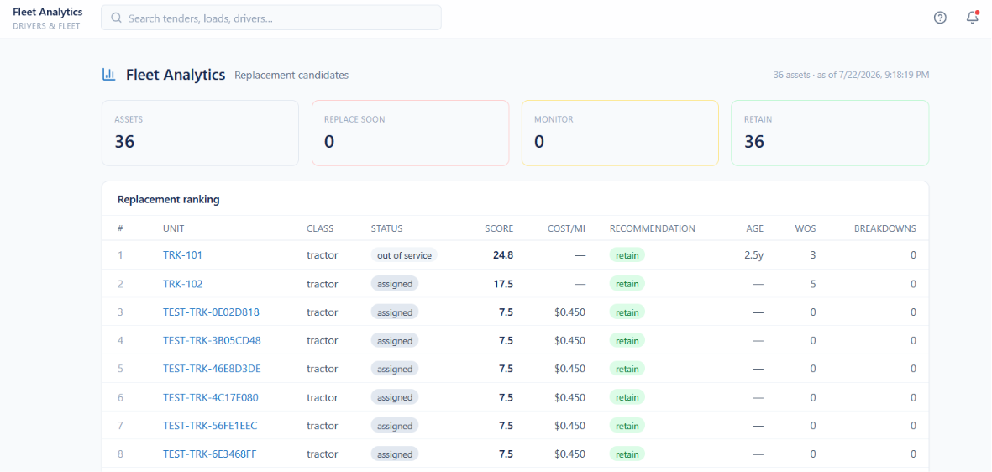
FLEET
Fleet Analytics
Replacement scoring and asset health for capital planning
Executive dashboard for fleet performance and asset health
Replacement candidates analyzed using configurable scoring metrics
Assets ranked by operational performance and replacement priority
Age, cost per mile, breakdown history and Weeks Out of Service tracked
Assets categorized as Retain, Monitor or Replace Soon
Underperforming assets identified for maintenance or replacement
Supports data-driven investment and lifecycle decisions
Strengthens capital planning with actionable fleet metrics
Enterprise Carrier Management Platform
Notes:
This is the slide for CFO-type buyers: replacement scoring and capital planning.

Slide 14
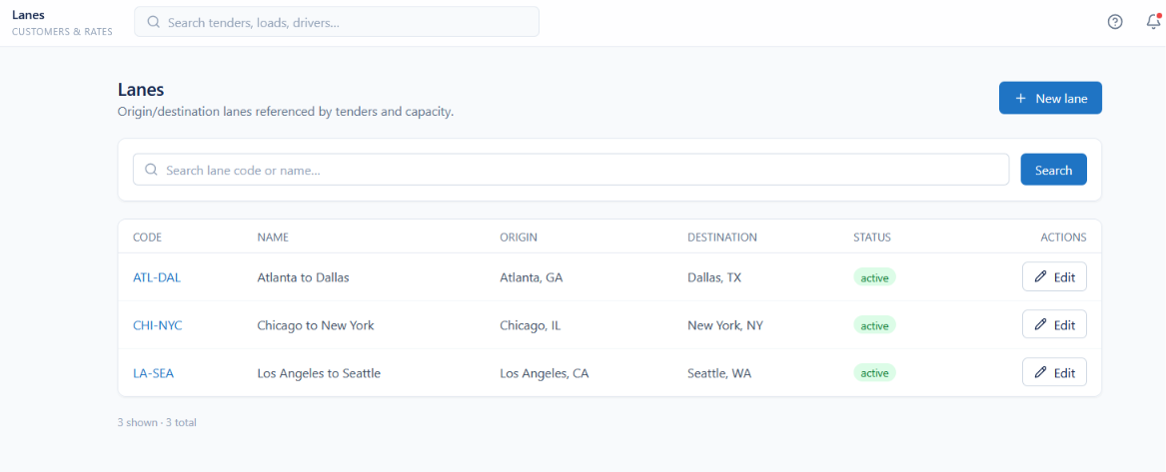
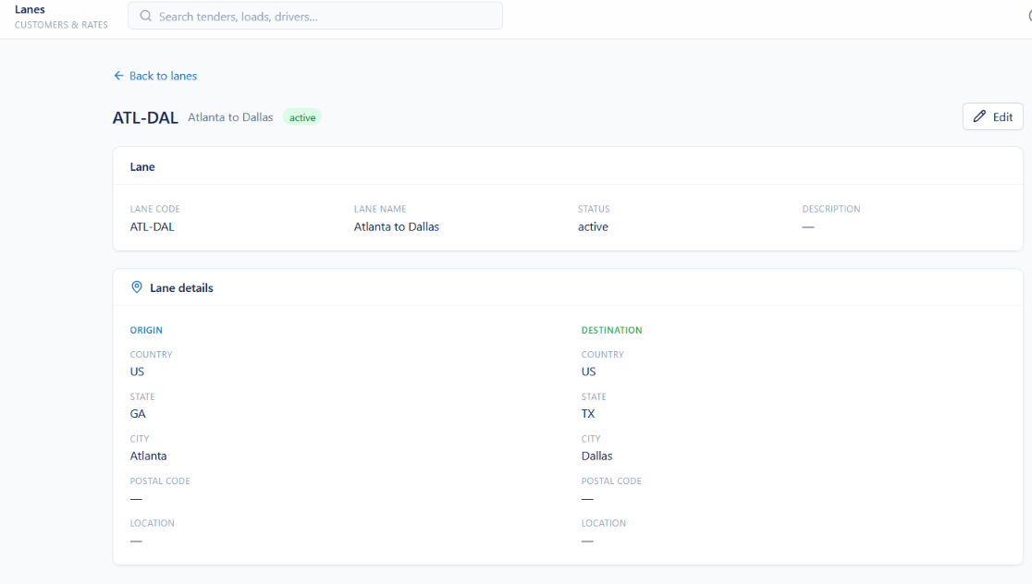
NETWORK
Lane Management
Standardized shipping corridors shared across the platform
Centralized repository for lanes and shipping corridors
Standardized origin-to-destination lane configurations
Lane codes, names, descriptions and status maintained
Country, state, city and postal code captured per location
Search and filter lanes by code or lane name
Active and inactive status maintained for operational control
Lane definitions shared by tender, capacity and rate management
Consistent routing for tendering, capacity planning and dispatch
Master data maintained through centralized administration
Improves routing consistency and network planning accuracy
Enterprise Carrier Management Platform
Notes:
Lanes are the shared backbone for tendering, capacity and rating.

Slide 15
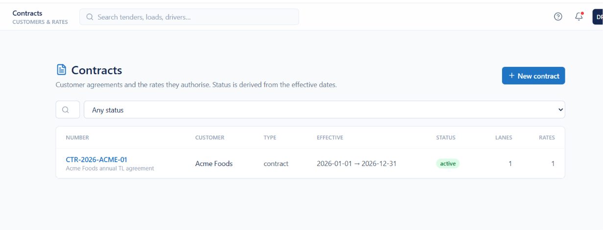
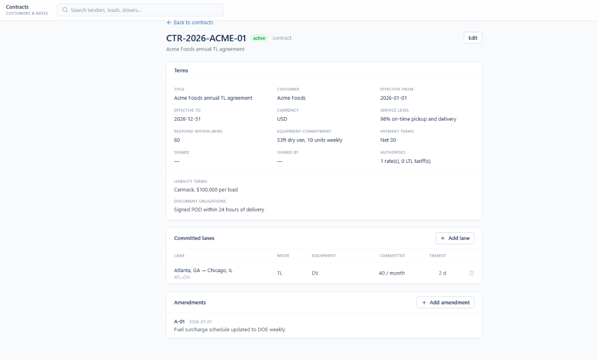
COMMERCIAL
Contract Management
Customer agreements, service levels and lane commitments
All customer contracts held in one centralized list
Status filter for active, expired, future and other states
Status derived automatically from effective start and end dates
Contract number, customer, agreement type and date range shown
Currency and payment terms recorded per contract
Service levels defined with on-time pickup and delivery targets
Carrier response-time requirements captured for tenders
Equipment commitments recorded with trailer type and weekly volume
Liability terms, document obligations and signatures stored
Committed lanes listed with mode, volume and transit time
Enterprise Carrier Management Platform
Notes:
Contracts hold the commitments the operation is measured against.

Slide 16
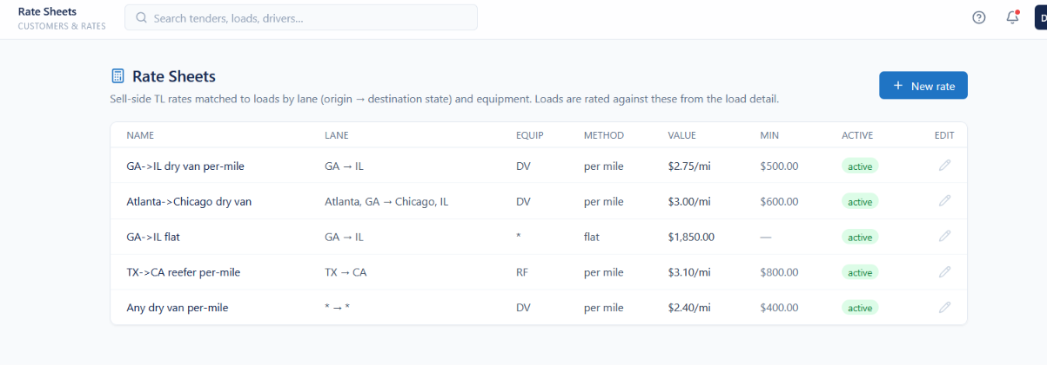
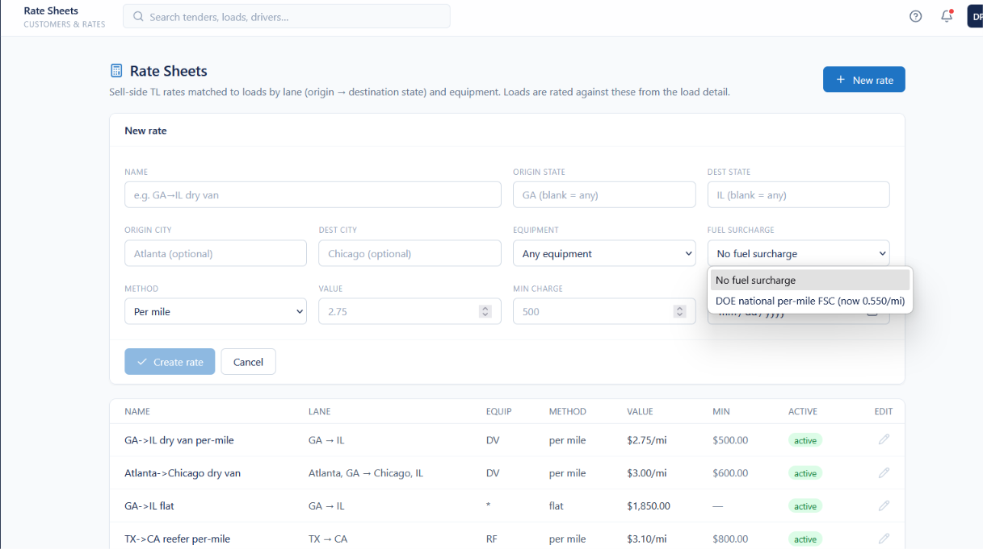
PRICING
Rating
Rate sheets that price freight automatically at load planning
Centralized repository for transportation rate sheets
Lane- and equipment-specific freight rates configured
Rates defined by origin, destination, equipment type and lane
Per-mile and flat pricing methods supported
Minimum charges configured to enforce pricing policy
Optional fuel surcharge programs applied to rates
City- and state-level pricing for greater rating accuracy
Freight charges calculated automatically during load planning
Active rate schedules maintained through one interface
Standardizes pricing across customers, lanes and equipment
Enterprise Carrier Management Platform
Notes:
Rating turns lane and equipment data into automatic freight charges.

Slide 17
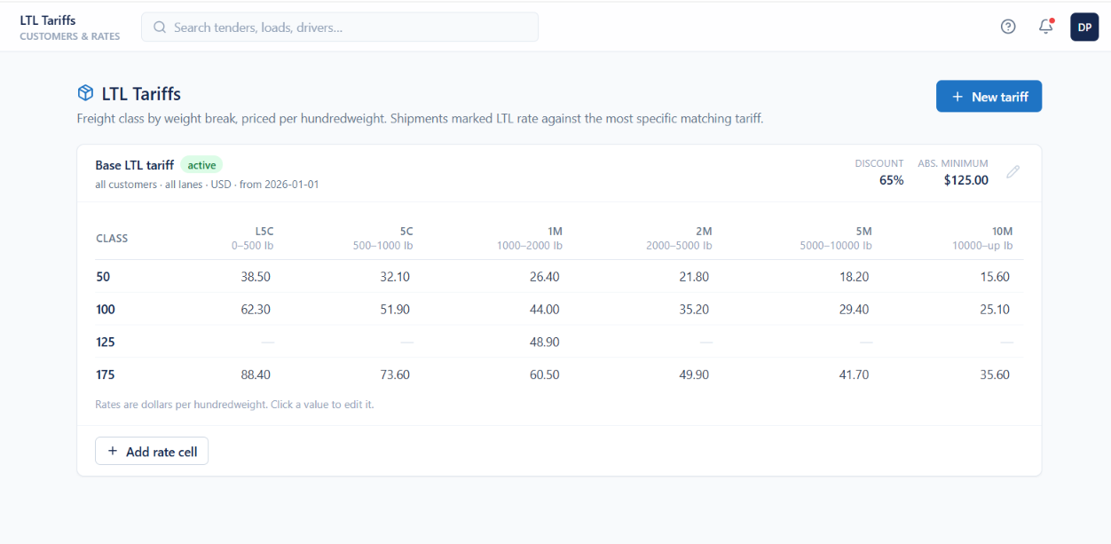
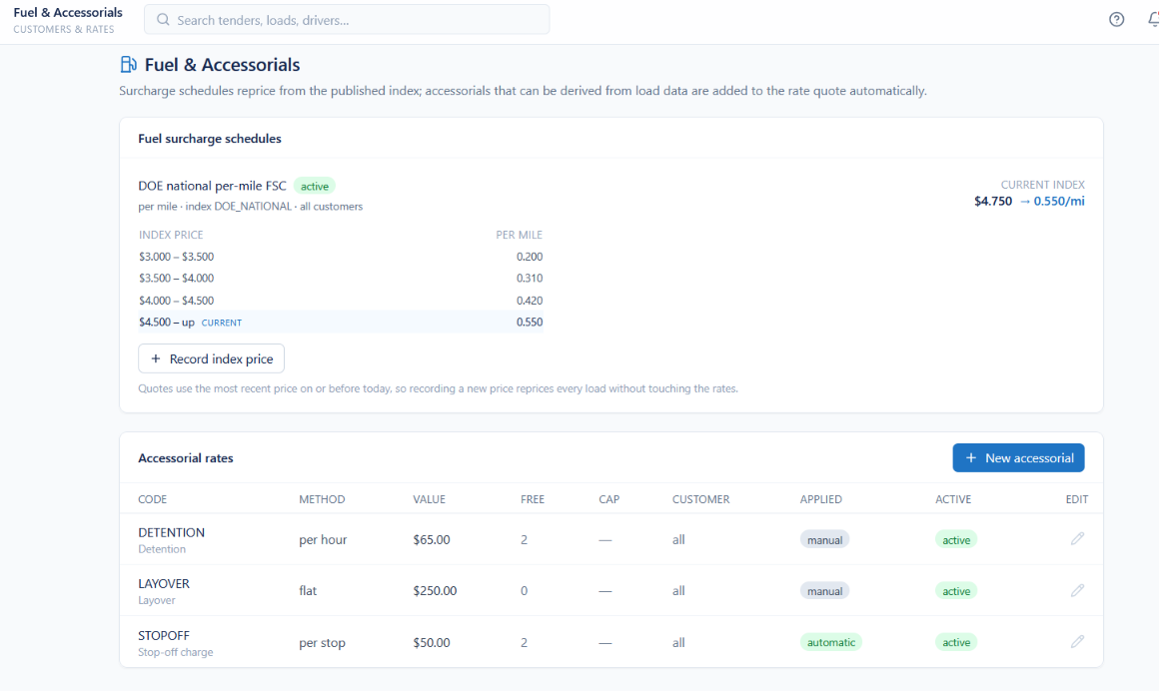
PRICING
LTL Tariffs, Fuel and Accessorials
Class-based tariffs, index-driven fuel and accessorial charges
LTL tariff schedules managed with freight classifications
Rates configured by NMFC freight class and weight break
Hundredweight pricing supported across multiple weight ranges
Tariff discounts and absolute minimum charges defined
Most specific matching tariff applied automatically at rating
Fuel surcharge tables driven by published fuel price indexes
Surcharges recalculated as index prices change
Accessorials defined for detention, layover and stop-off
Free time, charge limits and customer-specific rules configured
Automates LTL calculations to streamline quoting and billing
Enterprise Carrier Management Platform
Notes:
LTL tariffs, fuel indexes and accessorials complete the pricing picture.

Slide 18
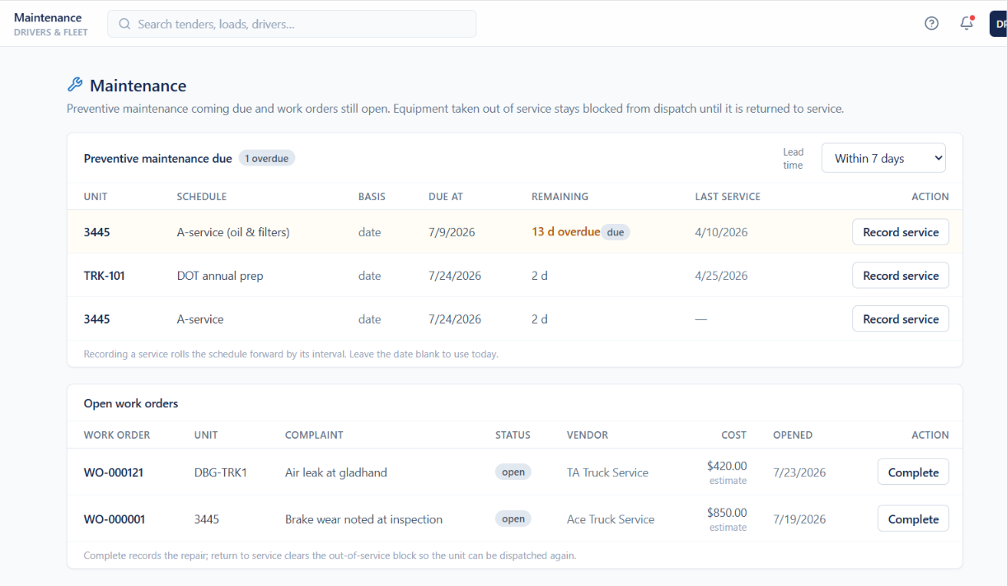
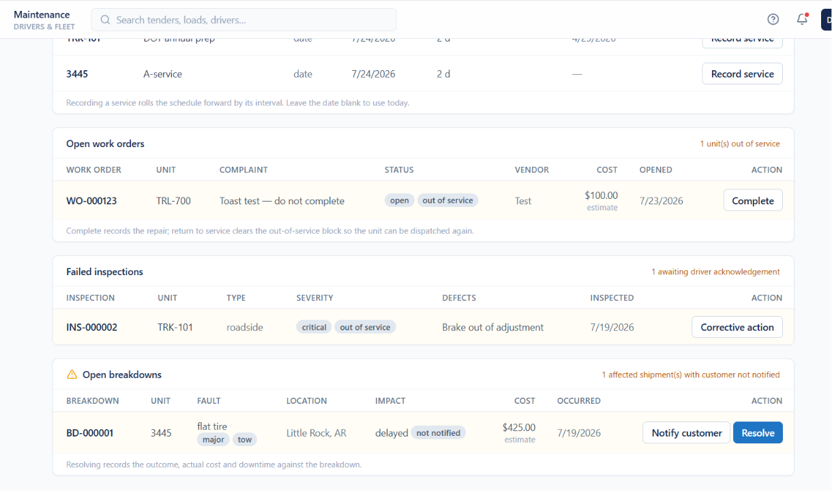
FLEET
Maintenance
Preventive schedules, work orders, inspections and breakdowns
Central dashboard for preventive maintenance and repairs
Upcoming and overdue schedules monitored by asset
Due dates driven by time or configurable service intervals
Completed work automatically updates future service schedules
Open work orders tracked with status, vendor and estimated cost
Out-of-service equipment blocked from dispatch until repaired
Failed inspections, defect severity and corrective actions monitored
Breakdowns logged with fault details, location and repair cost
Customers notified of delays caused by equipment failures
Reduces unplanned downtime and extends asset life
Enterprise Carrier Management Platform
Notes:
Maintenance closes the loop: out-of-service equipment cannot be dispatched.

Slide 19
Contact
LOCATION
PHONE
EMAIL
Toronto, Ontario, Canada
+1 (416) 402-4551
miguel@flowopsglobal.com
flowopsglobal.com
Enterprise Carrier Management Platform
Notes:
Close with the ask: a working session on their lanes and fleet.

